Slide 1





WHAT TO EXPECT WHEN EXPECTING A SITE VISIT
Preparing with Confidence

Slide 2
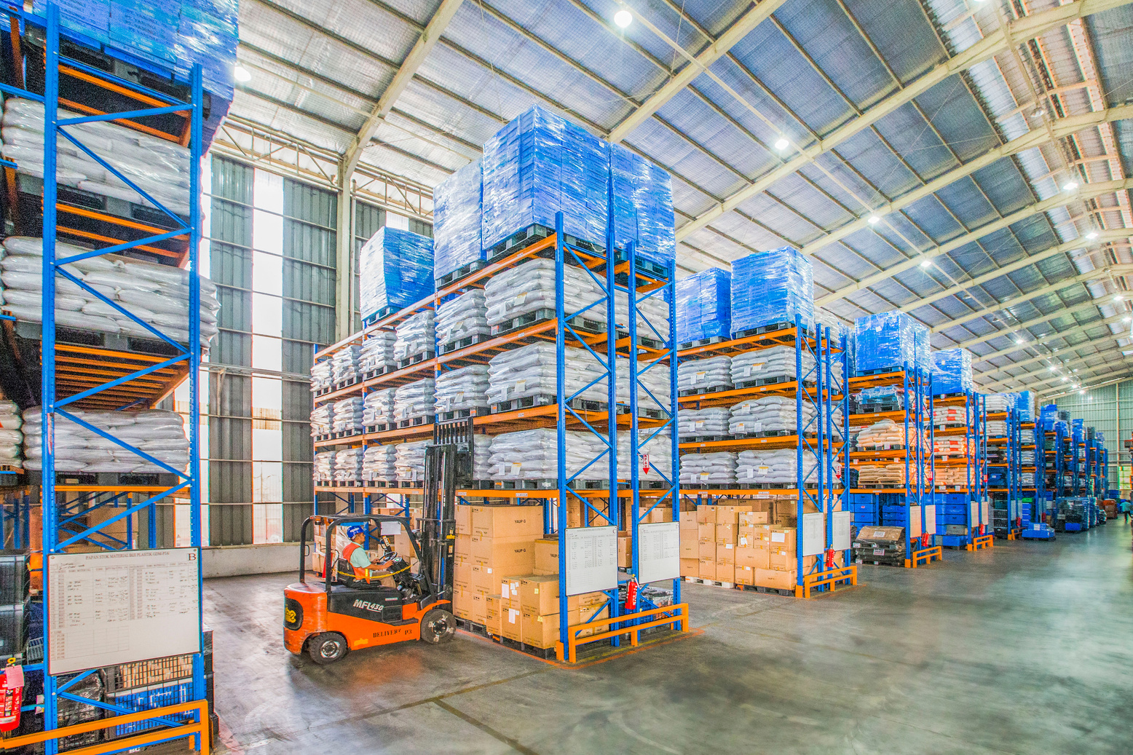


Introduction
  We’re here to support you, not to catch mistakes
  Our team works with partners across Alaska to:
    Ensure compliance with program requirements
    Provide training and resources
    Strengthen food safety and neighbor service

Slide 3




Why Site Visits Happen
Feeding America requires us to visit our partners every 2 years. It’s a great opportunity for us to learn more about your operations too!
Ensure compliance with program requirements
Maintain food safety standards
Support agencies with resources & training

Slide 4
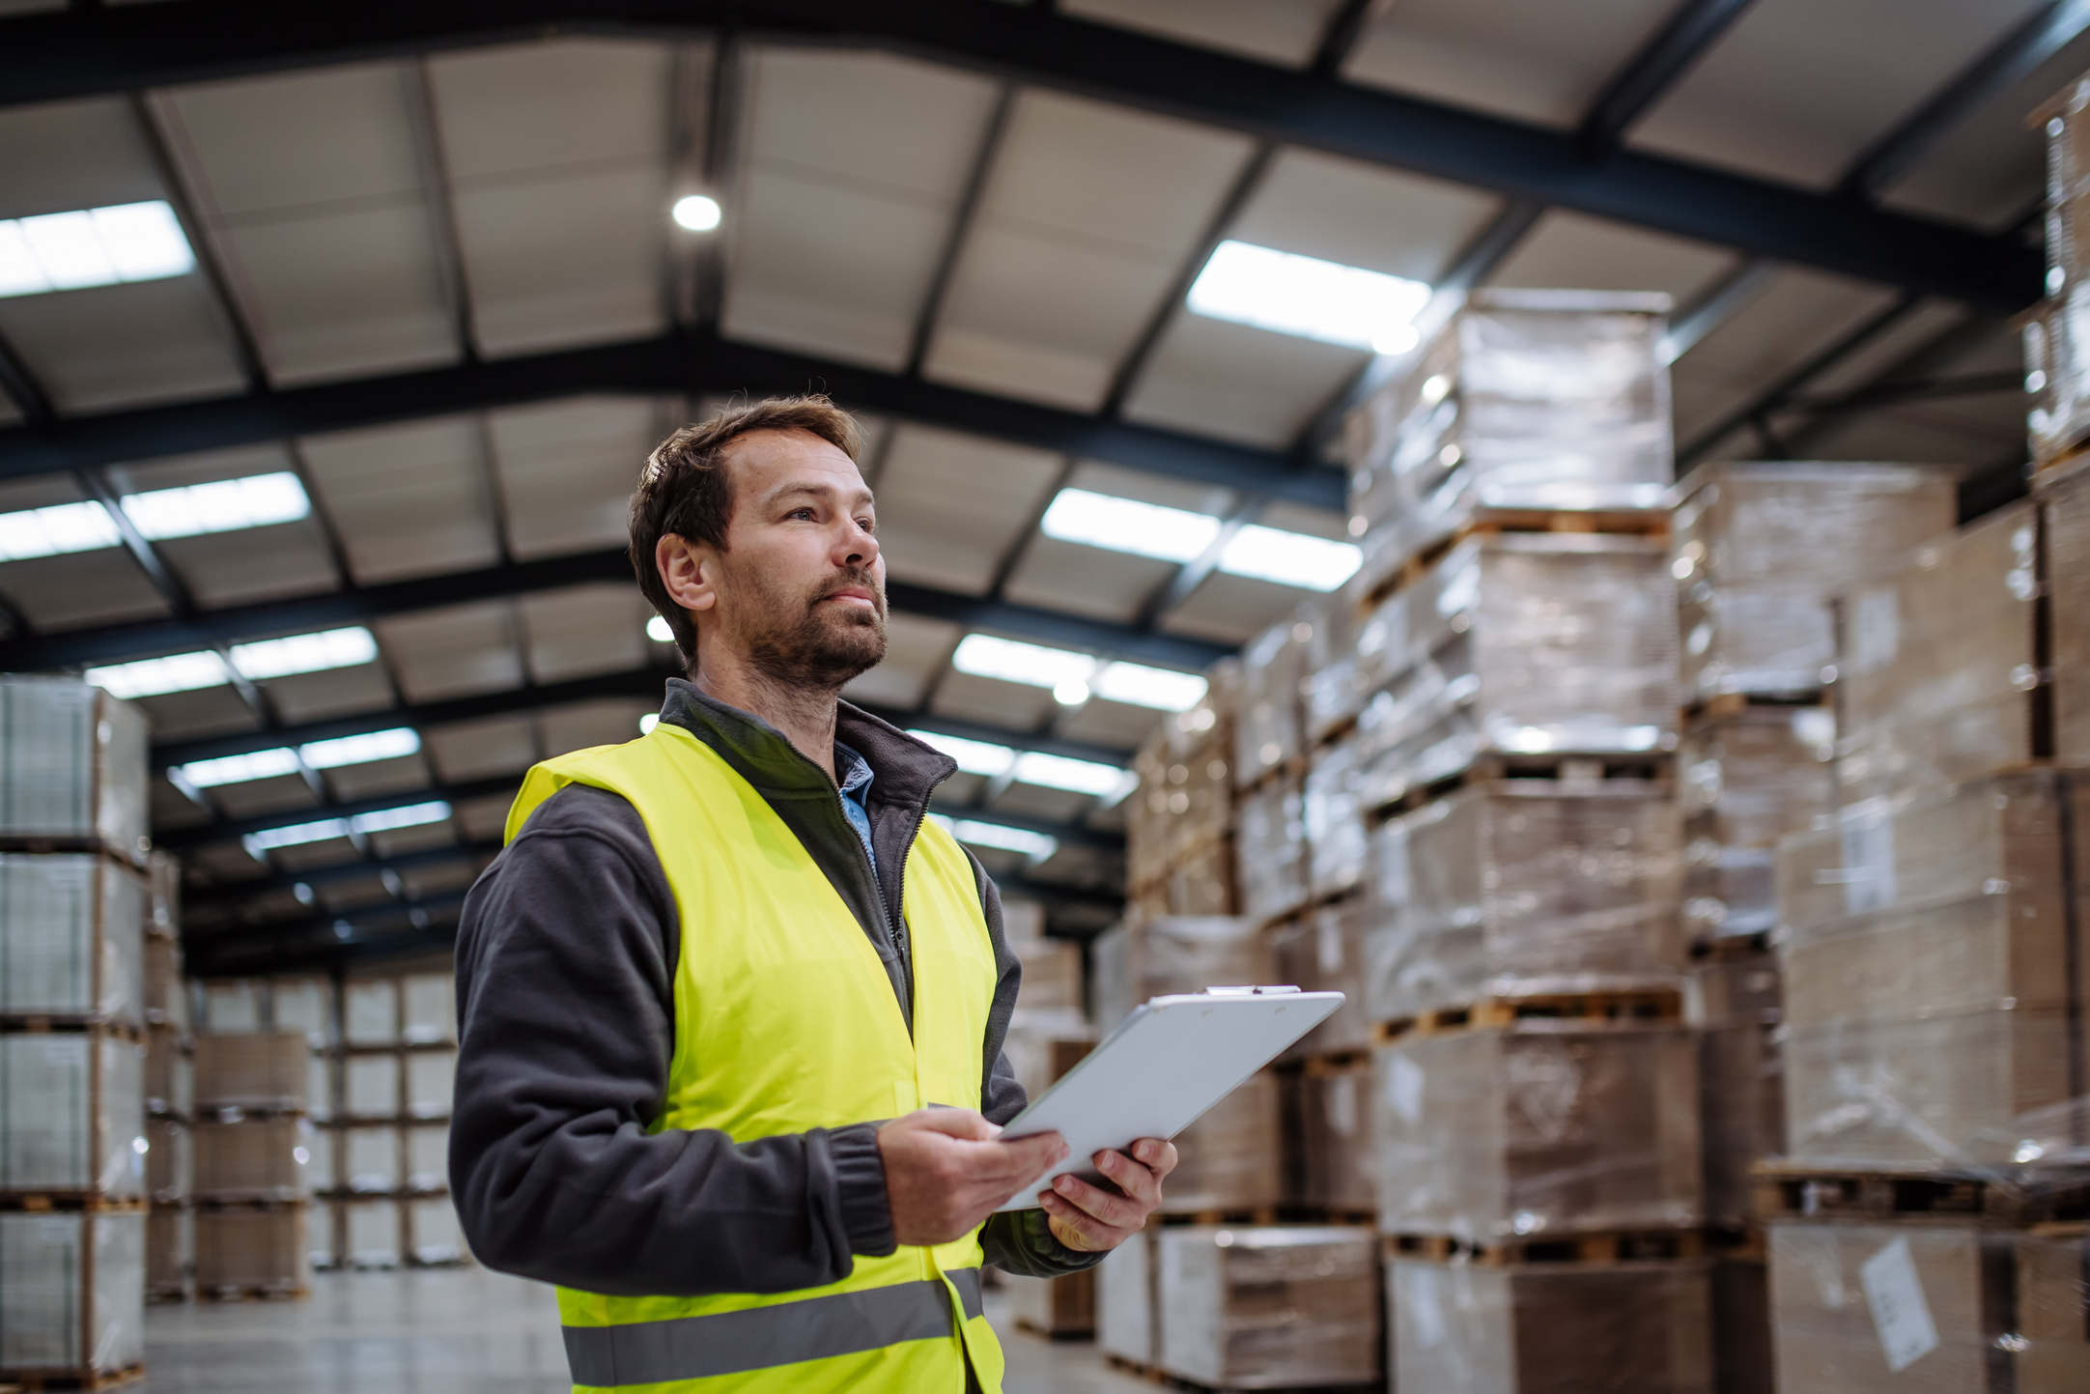

Before the visit
A little preparation goes a long way in making your site visit smoooth and stress free.
Review your agency agreement
Check your food safety certification(s)
Make sure reports are up to date
Verify temperature logs are current
Check that food storage areas are clean and organized
Train staff/volunteers on key procedures

Slide 5
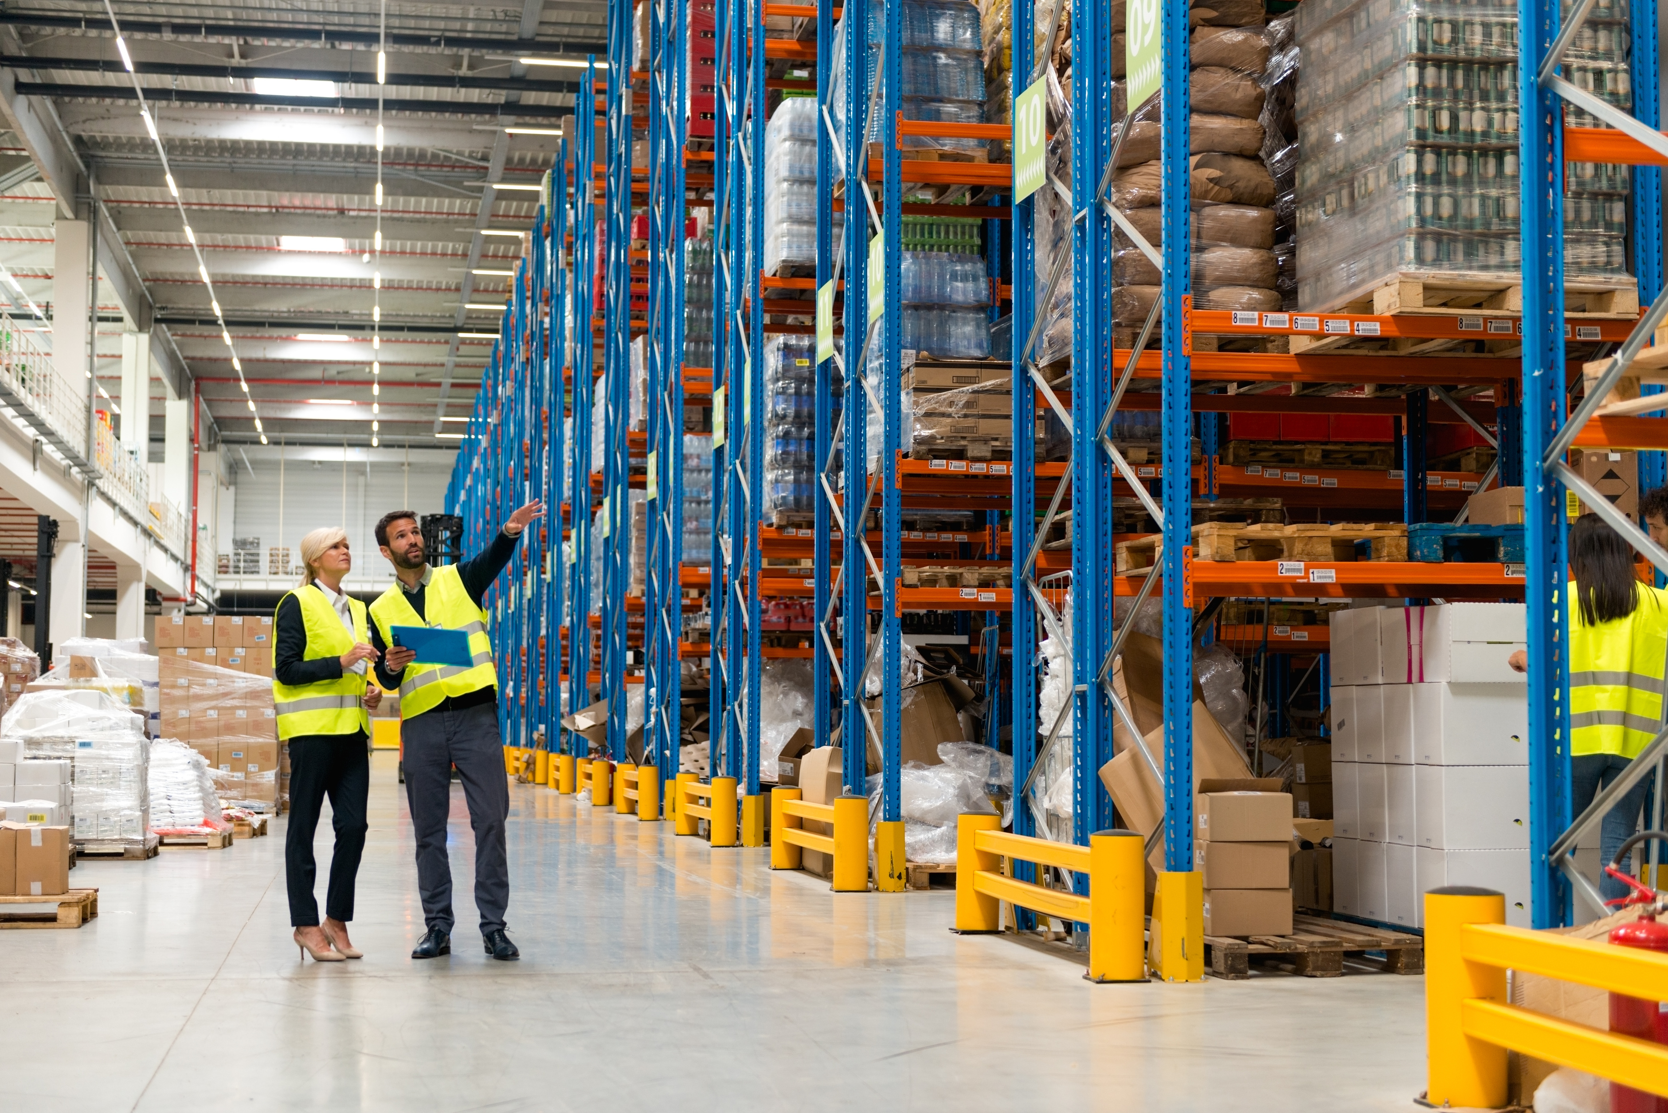
During the Visit
Site visits are meant to be a conversation and a chance to highlight your work.
Walk-through of storage and distribution areas
Review of paperwork (temperature logs, reports, applications, agency invoices, etc.
Discussion about challenges & successes
Opportunity to ask questions & get support

Slide 6



After the Visit
We’ll provide feedback and support so you know exactly what’s going well and what needs attention.
You’ll receive a summary of findings
Address any follow-up items (if needed)
Celebrate what’s going well

Slide 7


Tips for Success
Think of site visits as a partnership, not a test.
Keep documentation current year-round
Do regular self assessments before the visit
Train new staff/volunteers
Ask questions - we’re here to help

Slide 8

Food Safety
Food safety is one of the most important parts of a visit, and we’ll cover it in more detail this afternoon.
Proper storage, handling, and recordkeeping = safe food for families
Want to learn more?
Join us this afternoon for the Food Safety Session at 2pm in the YUKON ROOM!

Slide 9

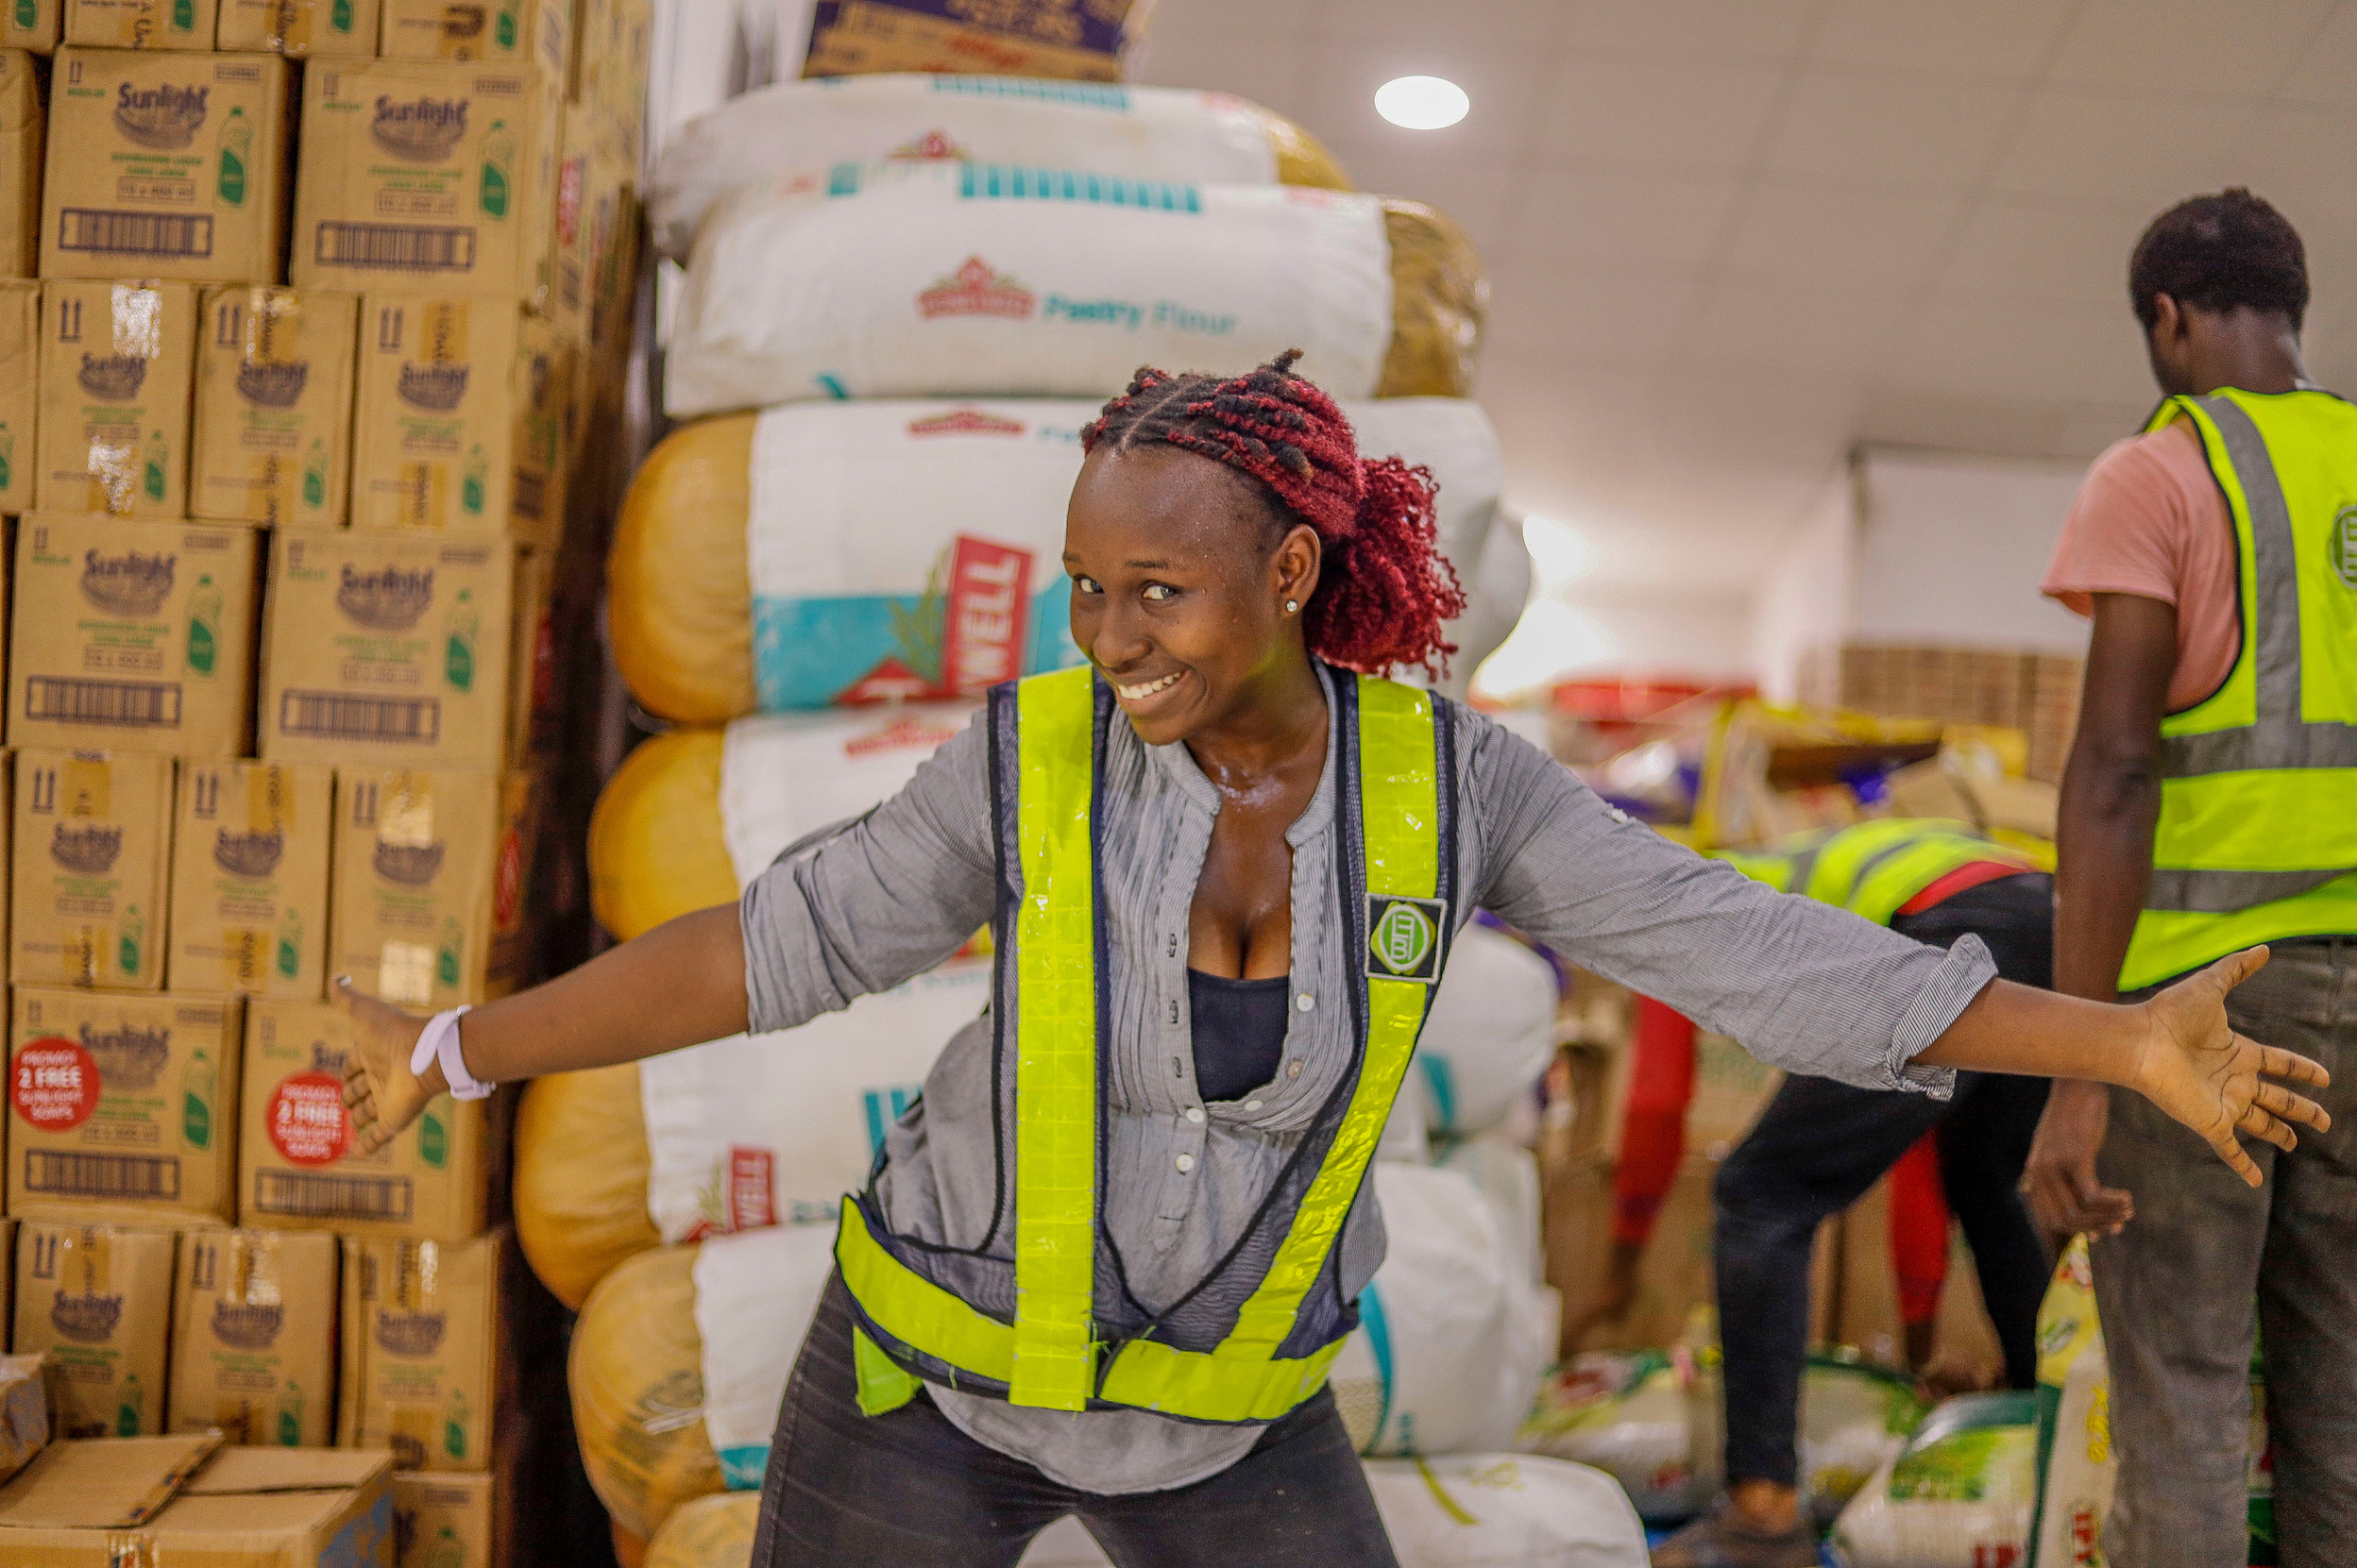
THANK YOU
Mel Buhr
Partner Services Manager
mbuhr@foodbankofalaska.org

