Slide 1

Fundraising Amidst Uncertainty
Or ‘the Importance of a Simple Plan’

Slide 2

Framework, and/or fresh perspective
Immediate, practical application
A ‘compass’ to hold on to or direction to steer toward

Slide 3

Something to
hold on to

Slide 4
TODAY
Making your next fundraising plan the most effective you’ve ever had.
But first…

Slide 5
      “When times are good, major donors give.
      When times are bad, major donors give.
      When times are uncertain, major donors hold back.”

Slide 6
As a fundraiser, in times of uncertainty,
what are the most important things to keep in mind?

Slide 7

Fundraise more. Not less.
“But, it would be insensitive to fundraise right now …. .”
DON’T!

Slide 8
Fundraise more. Not less.
Your beneficiaries are counting on you to fundraise and advocate on their behalf.
(And so are donors who love what you do!)

Slide 9
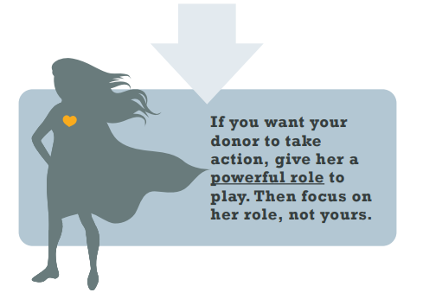

“Opportunistic giving” is a gift!

Slide 10
‘Show and tell’.
Get (more) specific about the impact.

Slide 11
~30%
more raised this year

Slide 12

655,000
miles

Slide 13
Don’t give up planning!
      “When there is total uncertainty about what comes next, the best thing a business (or non-profit) … can do is to make a plan,
      even if that plan changes 20 times.”

Slide 14
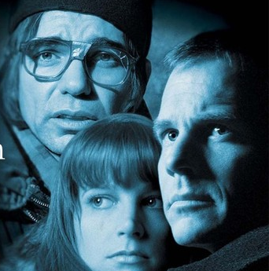
a simple plan

Slide 15


Slide 16


Slide 17
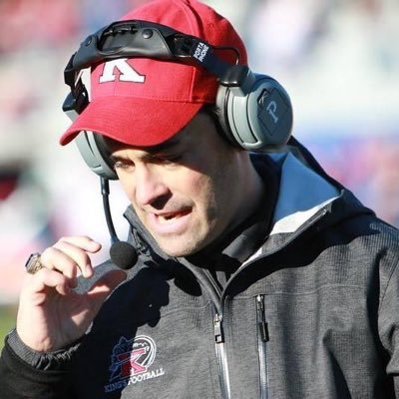
3
Core Principles

Slide 18

#1) ‘Anchor’ Your
Fundraising Calendar
Build around revenue-generating activities.
  Appeals (set in stone)
  Newsletters and ‘Donor Reports’

Slide 19

#2) Schedule ‘Asks’
BEFORE Needs
Make sure the ‘ask’ is understandable.

Slide 20

#2) Schedule ‘Asks’
BEFORE Needs
  Define as specific a problem as possible that the donor can solve; an outcome they can fund.
  Create a sense of urgency.
  Build in lead time (and lead up!).
  Schedule print appeals 1 month before needs

Slide 21

#3) NEVER go dark!
  Ensure communication with donors every month, if possible.
  Fill in the ‘gaps’ with relevant, donor-focused, communication (e.g. e-stories of success (and mini-reports, e-appeals), etc.)
  Stay top-of-mind!

Slide 22

You cannot overcommunicate.
Increased communication creates the sense and reality that our work is important (and urgent!).
Donor fatigue is a myth.

Slide 23

3
Core Principles
Build your calendar around key ‘anchors’ ($)
Schedule ‘Asks’ BEFORE Needs (that donors can understand)
NEVER go dark.

Slide 24
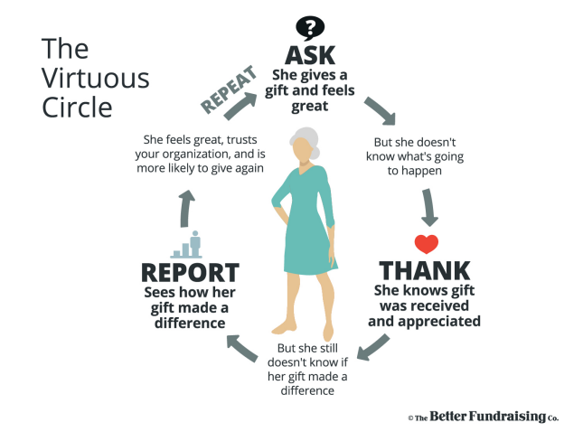

Slide 28


Slide 29
Needs - narrow, specific, understandable (and focused)
Deadline oriented (stakes! e.g. event, EoY)
Need surge (e.g. situational, seasonal…)
One-time or rare need
‘Slice of an ongoing need’

Slide 30
Schedule the activities
Add needs (narrow, specific, understandable – and focused!)
Add appeals (1 month before needs)
Add email chasers (same day or shortly after appeals)
Add e-appeals (email only)
Add newsletters and reports (steward!)
Add e-stories (of success and impact)
2:1 Ratio. 2 asks to 1 ‘report’

Slide 31
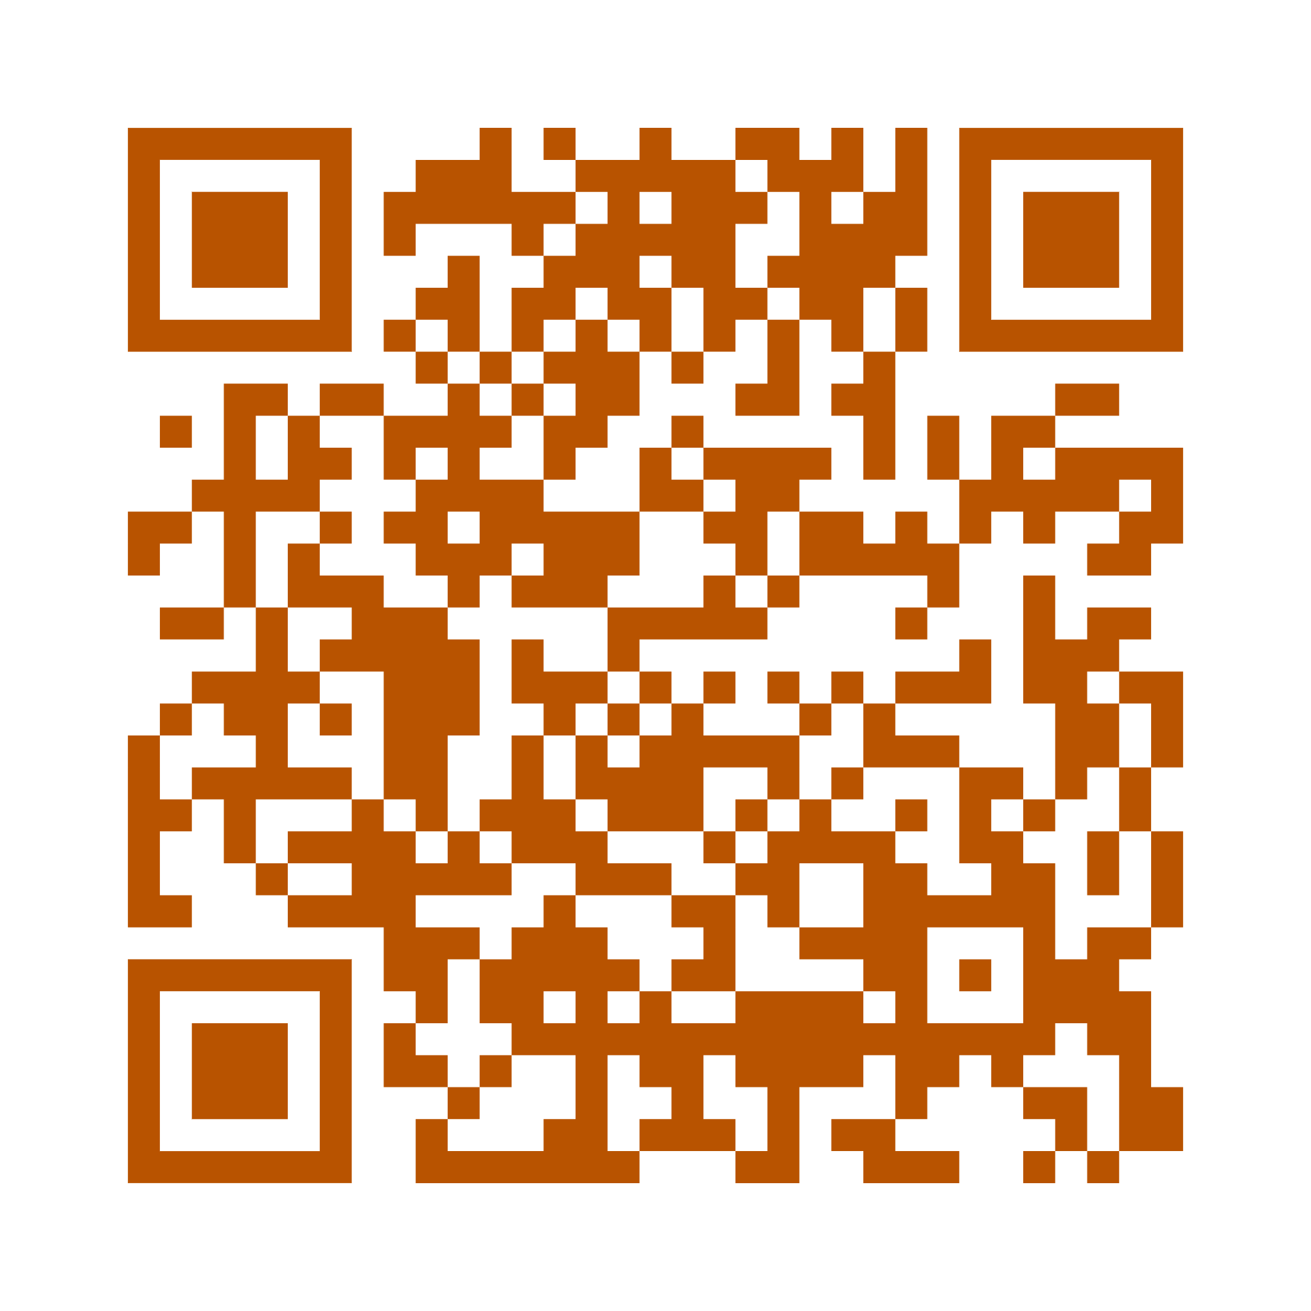


Slide 32
Fundraising Amidst Uncertainty
Or ‘the Importance of a Simple Plan’

