Slide 1





CACFP
at the Food Bank of Alaska

Slide 2
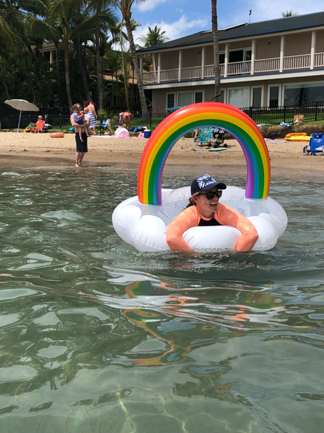

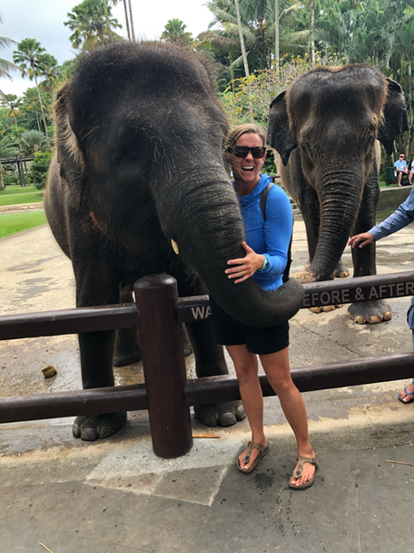

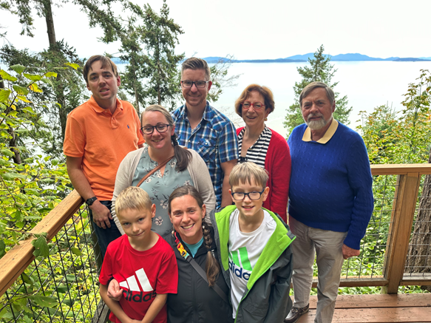
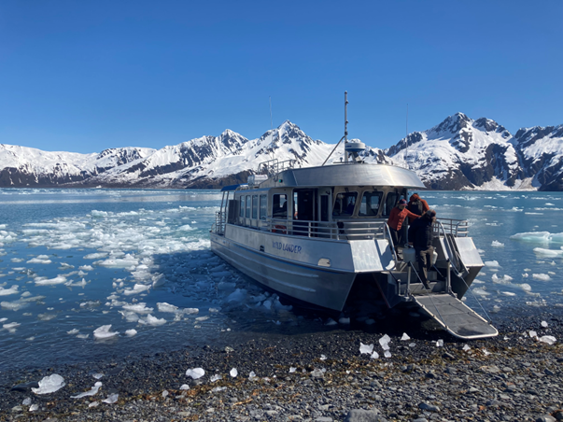
GILLIAN

Slide 3



CHILD AND ADULT CARE FOOD PROGRAM

Slide 4
THE NEED
1 IN 6 ALASKAN CHILDREN FACE HUNGER
COST OF FOOD IN RURAL ALASKA
-1 GALLON OF MILK: $12
-1 LOAF OF BREAD : $9
-1 BOX OF CEREAL: $9
Notes:
1in 6 Alaskan Children face hunger- Feeding America

Slide 5
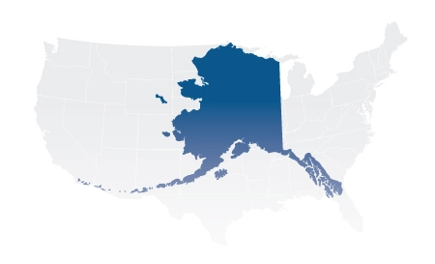
SERVING ALASKA
Notes:
Federal Reimbursable program that is run in child care centers, family care home, adult day care center for older adults or adults with disabilities, afterschool programs and emergency shelters.
The FBA runs afterschool programs in at-risk areas which translates as in areas lower income and higher amount of food insecurity like rural AK.
Open sites where any child can come on in

Slide 6

TIMING:
OCTOBER -MAY

Slide 7

TYPE OF SITES

Slide 8

SERVE CHILDREN 6-12

Slide 9

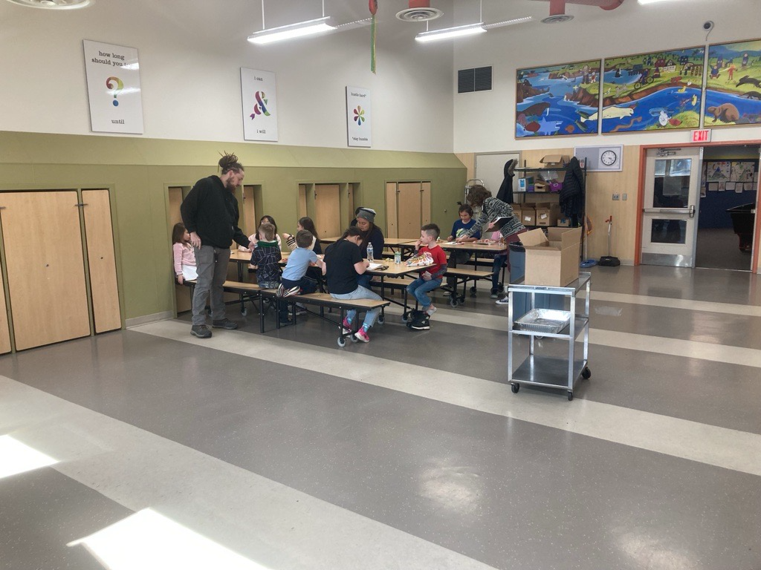
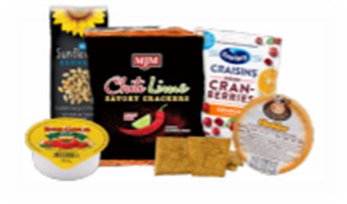
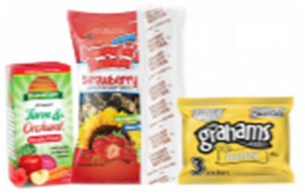
MEAL TIME

Slide 10
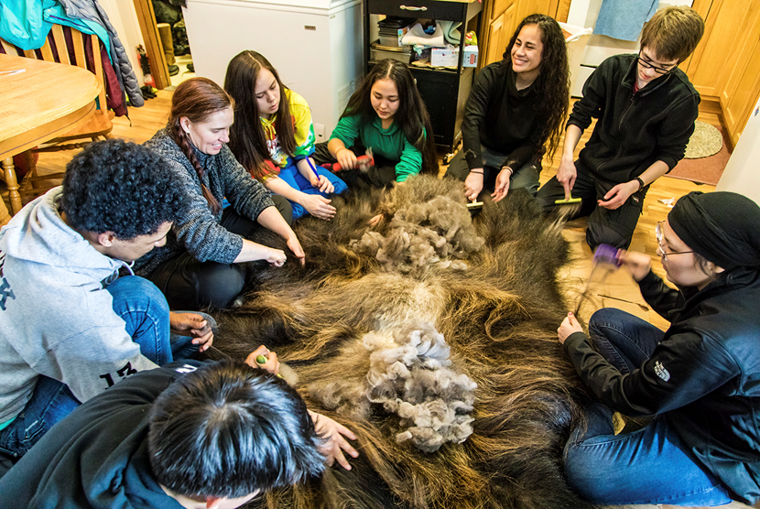
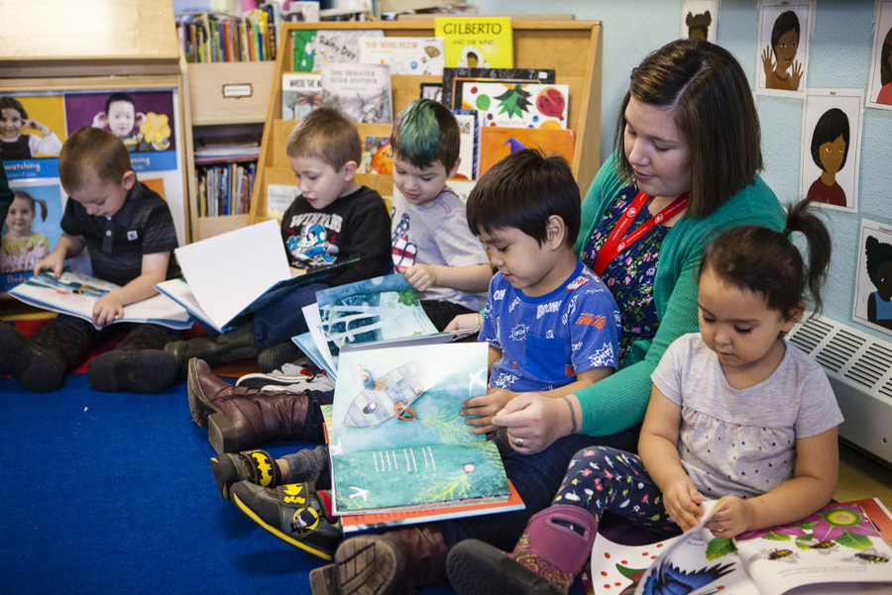
ACTIVITY

Slide 11

IMPACT
CACFP 24-25 program year:
Number of sites: 2
Number of meals served: 1,215
Average daily attendance: 40
Notes:
Running 4 or 5 days a week
In past the FBA has had up to 5-10 sites on average but there has been a reduction of staff to run these program throughout AK

Slide 12

Traditional SFSP
Understanding The Program

Slide 13
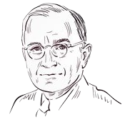
Brief History
The Special Food Service Program for Children was created as an amendment to the National School Lunch Act (NSLA) in 1968 and was initially a 3-year pilot.
  Summer
  Child Care
Summer Food Service Plan was established in 1975
  Poor economic conditions was expanded to 50% from 33% in 1981
  “In the long view, no nation is any healthier than its children or more
  prosperous than its farmers…” – President Harry S. Truman
Notes:
NSLP established in 1946 by Truman
The legislation came in response to claims that many American men had been rejected for World War II military service because of diet-related health problems

Slide 14
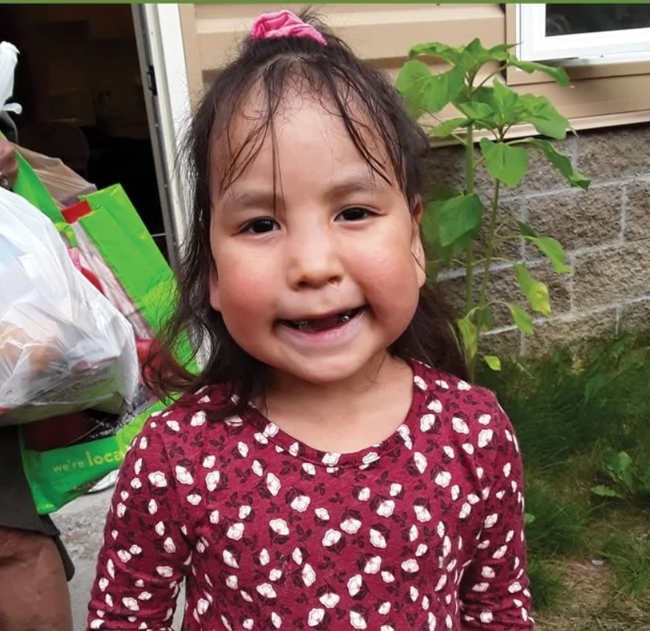
Who can administer the program?
Public and private non-profit groups
Government entities
Private non-profit organizations
Public and private non-profit camps
Public and private non-profit universities and colleges
Notes:
Boys and Girls Clubs
Kenai Community library
Soldotna United Methodist Church
Native entities- Mcgrath Native Village Council, Traditional Council of Togiak, Grayling

Slide 15
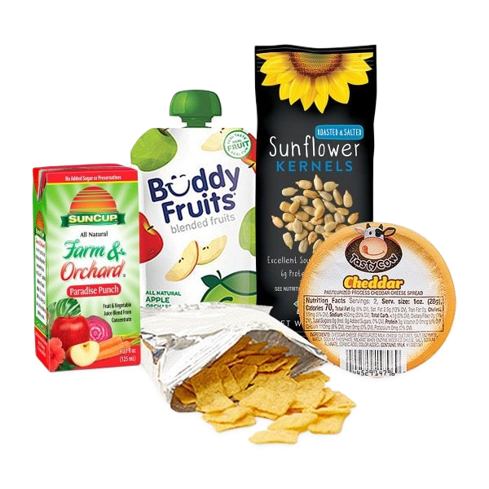
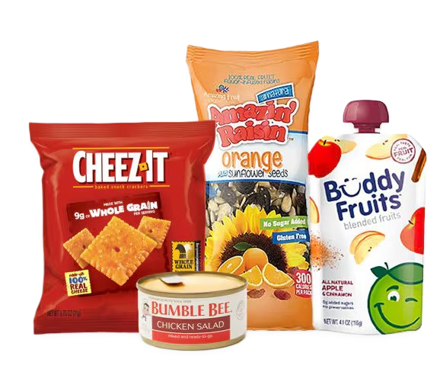
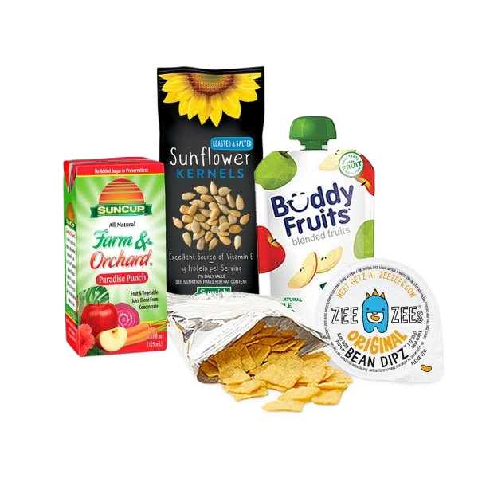
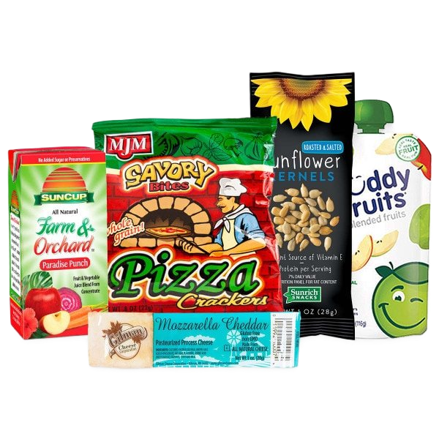
Meal Pattern Requirements
1 milk | 1 cup | 8 fluid oz milk
2 fruits/ vegetables | 3/4 cup | Juice, fruit and/or vegetable
1 grains/bread | 1/2 cup | Bread or cornbread or biscuit or roll or muffin or pasta or noodles or grains
1 meat/meat alternate | 2 oz | Lean meat or poultry or fish or alternate protein product or cheese or cooked dry beans or peanut or other nut or seed butter or nuts and/or seeds
Notes:
All meals meet FDA requirements
Moving towards accommodating diets that are different than the rest of the country

Slide 16

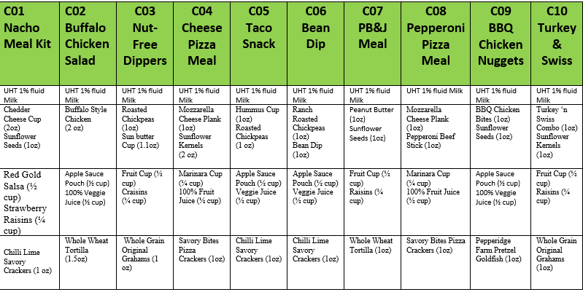
SFSP Cycle Menu Food Bank of Alaska 2025
Notes:
Favorites-PB&J, bbq chicken bites, pepperoni pizza meal
Not so much.... Buffalo chicken salad, bean dip, nut free dippers, "anything spicy"-from our partner in Bethel
Milk can be hit or miss. Lactose intolerance is high in rural Alaska according to some partners.

Slide 17

Food Bank of Alaska and Child Nutrition Roles
Outreach
Eligibility
Onboarding
Training
Collect forms
Place orders
Customer service

Slide 18
Types of Sites
A site is the physical location, approved by the state agency, where program meals are served during a supervised period.
Open
Closed enrolled
Camp
Migrant
Meal service sites can be located in a variety of settings, including schools, rec centers, playgrounds, parks, churches, community centers, libraries, day camps, housing projects, migrant centers or on Indian reservations.
Notes:
FBA only works with open sites for SFSP

Slide 19

Reimbursement
The following meals are eligible for federal reimbursement:
All meals served to children 18 years of age or younger who attend approved open site, closed enrolled site, or migrant site
Meals served to enrolled children who are individually eligible for free or reduced-price school meals
Meals served to individuals over age 18 who are enrolled in school programs for persons with disabilities
Notes:
Any meals outside of these parameters FBA cannot claim

Slide 20
Congregate
Bethel/Owl Park
Dillingham 4-H*
Grayling IRA
Northeast BGC*
Togiak, Traditional Council of
Woodland Park BGC

Slide 21

Rural Non-Congregate
Multi-day distribution
Parent/guardian pick-up
Delivery options
2025 Non-Congregate Sites
  Anchor Point Food Pantry
  Kenai Community Library
  Nome Food Bank
  Soldotna United Methodist Church
  Togiak Traditional Council

Slide 22
Meals To You
“Delivering Nutritious Meals to Rural Communities”
Janee Wilson

Slide 23
Agenda
Introduction
.
Food Insecurity
.
2024 & 2025
.
How it works
.
The future of MTY
.

Slide 24
History of MTY
Meals to You started in 2019 as a three-year demonstration project by Baylor University with a goal in mind to alleviate food insecurity among children who won’t have access to school meals during the out of school season. This program is specifically meant to reach children in rural areas by utilizing a home delivery method for the food boxes received by participants.

Slide 25
History of MTY (cont)
In 2023, the Baylor Collaborative completed its fifth and final year of the MTY program. Throughout these five years, this program served more than 2.5 million meals to nearly 31,000 children in school districts across Texas, Alaska, Utah and New Mexico.

Slide 26
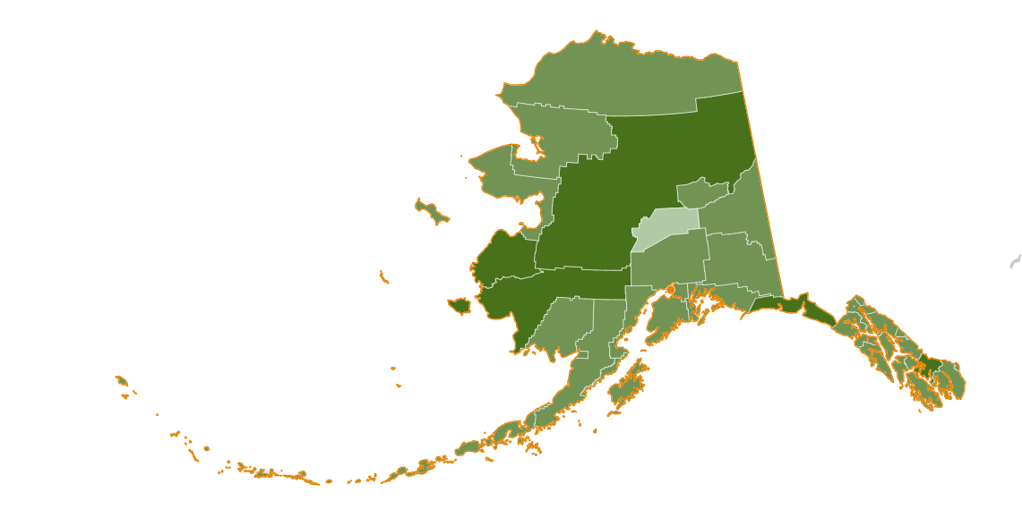
Food Insecurity in AK
17.8% of Alaskan children are food insecure
This translates to about 31,030 children who are dealing with food insecurity
67% of children in Alaska are income eligible for federal nutrition programs with incomes at or below 185% of poverty.
Although it may look different in each rural community, subsistence is an integral way of life for a lot of Alaskans. And what can’t be harvested must be purchased.

Slide 27
Food Insecurity (cont)
13.5 percent (18.0 million) of U.S. households were food insecure at some time during 2023.
7.2 million children lived in food-insecure households in which children, along with adults, were food insecure.
2023, the typical U.S. household spent $75.00 per person per week for food
“Households with very low food security among children reported that children were hungry, skipped a meal, or did not eat for a whole day because there was not enough money for food.”

Slide 28
MTY in 2024
In 2024, the FBA Meals to You program
Included 13 School Districts
Served 5,300 participants
Sent out 53,406 boxes
  Provided 534,060 Meals
    The equivalent of 731,662.2 lbs. of food

Slide 29
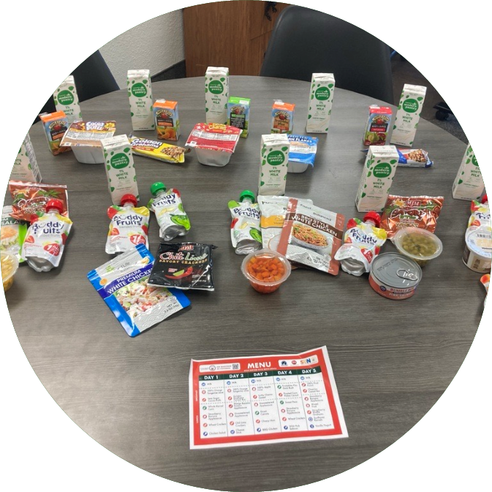
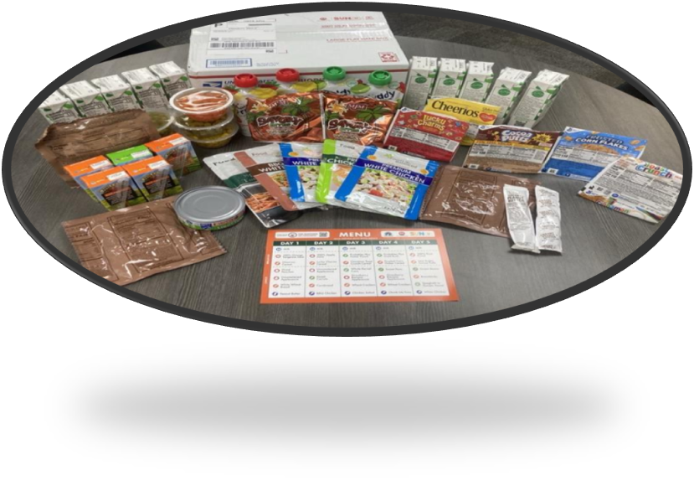
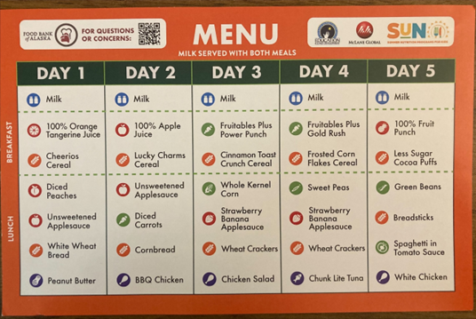
MTY in 2025
In 2025 the FBA Meals to You program…
Included 31 school districts
Served over 9,000 participants
And delivered an estimated total of over one million meals

Slide 30
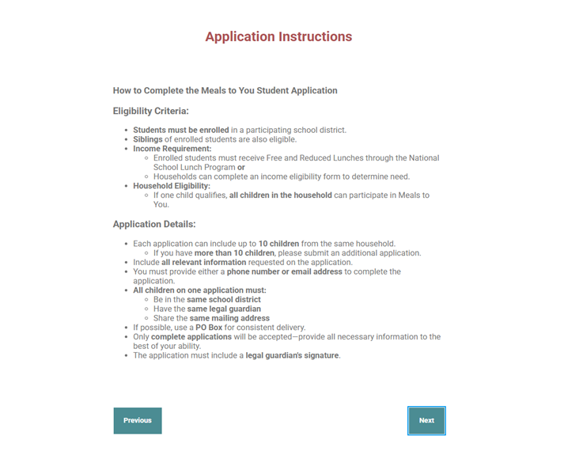
How does it work?
Application Process
Parents fill out an application and provide us with their child’s school, date of birth, address, etc
If a school does not have NSLP data, then the parents fill out an income eligibility form
After the application is submitted, children are verified by a school district representative, and the information is entered into our Salesforce database

Slide 31
The future of MTY
Some overall goals/areas of improvement
Diversifying our menu and methods of collecting feedback from participants
Improving our application database
Text message updates
Including homeschooled children
Working with more school districts

Slide 32
“Food” for Thought
“Our differences are polarities between which can spark possibilities for a future we cannot even now imagine, when we acknowledge that we share a unifying vision, no matter how differently expressed​; a vision which supposes a future where we may all flourish, as well as a living earth upon which to support our choices. We must define our differences so that we may someday live beyond them, rather than change them.”
- Audre Lorde
​

Slide 33
Questions??

