Slide 1







MAKING THE MOST OF
CO-OP
CO-OPERATIVE PURCHASE PROGRAM
Accessing Affordable, Reliable Food Through Food Bank of Alaska

Slide 2

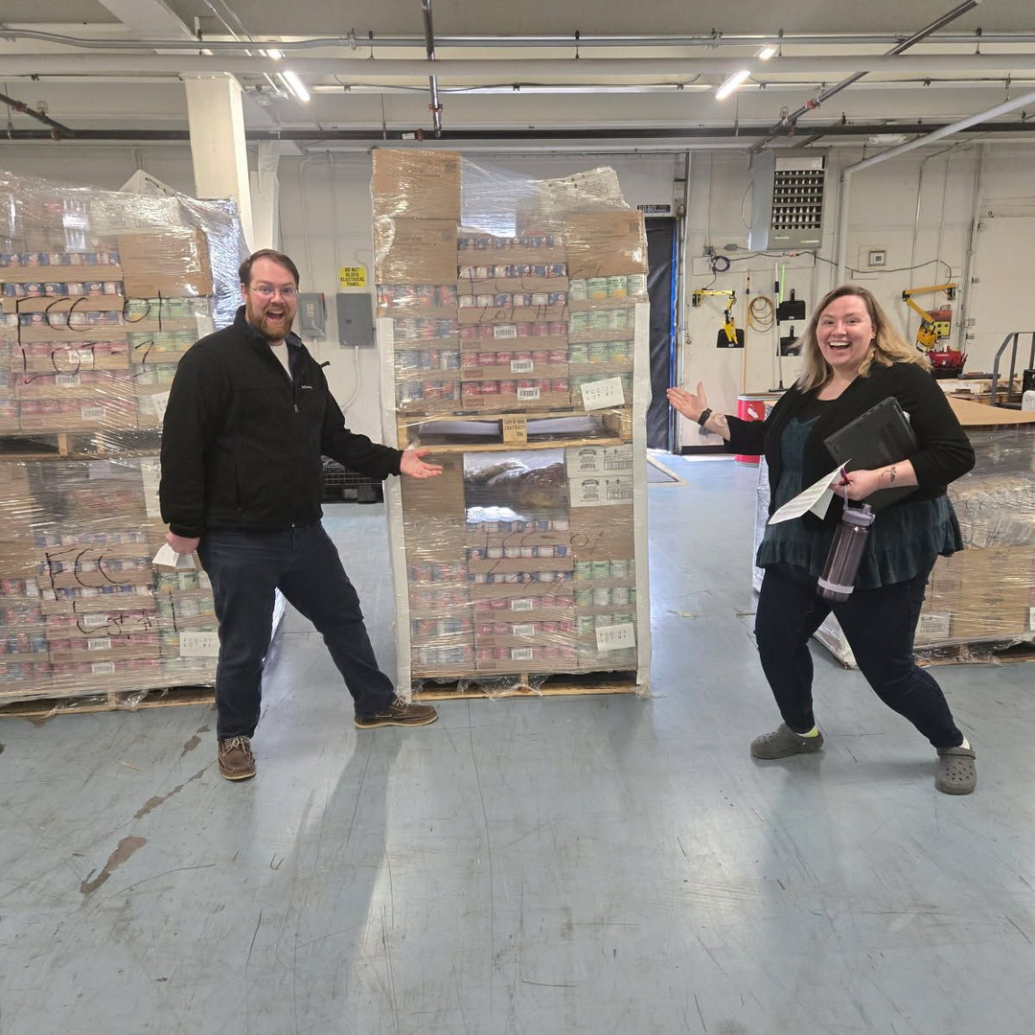
Welcome & Introductions
Anthony Reinert
Chief Programs Officer
Rebecca Guyer
Director of Programs

Slide 3
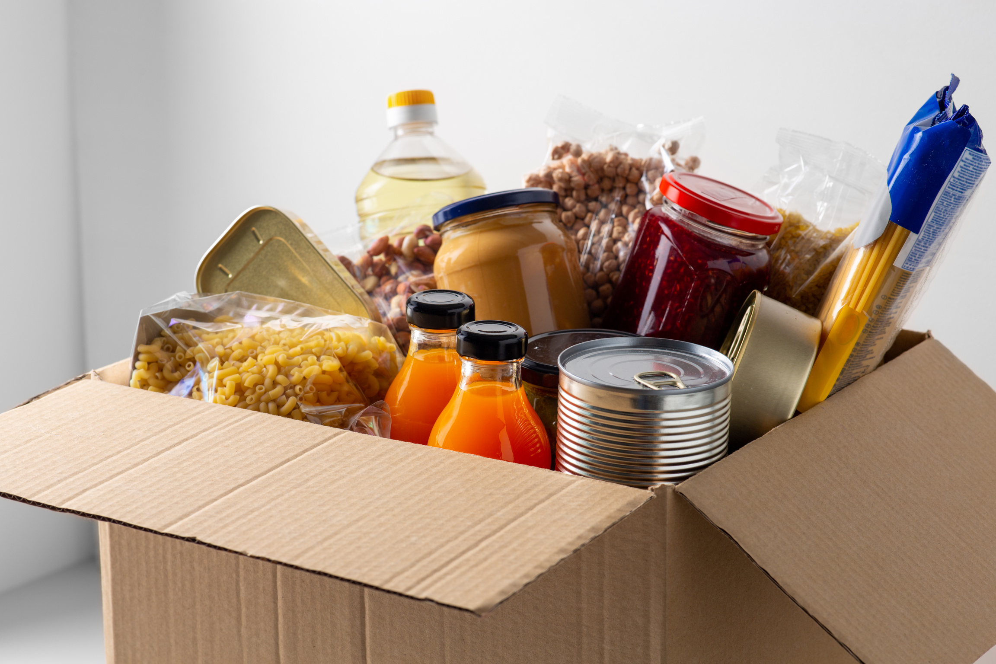
Who’s in the Room?
Experienced Purchasers
“I’ve purchased food before for my organization.”
New/Getting Strarted
“I’m learning about Co-Op for the first time.”
Exploring Options
“Not sure yet, just here to learn.”

Slide 4
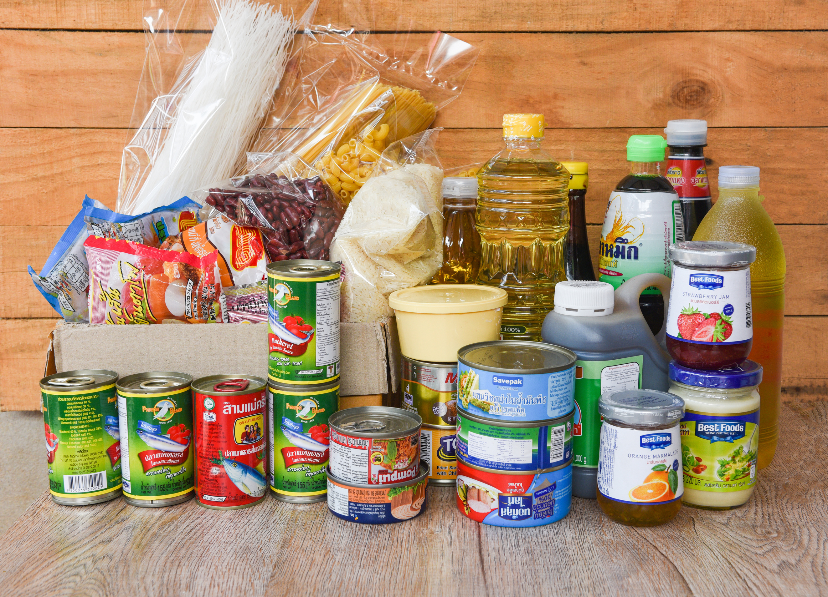

Co-Op is a program designed to give partners access to affordable, high-demand foods. Unlike donated or TEFAP food, Co-Op items are reliable and consistent. It’s a tool to help you fill gaps and plan ahead for your community’s needs.
What is Co-Op?
Low-Cost & High Demand Foods
Supplements donated & TEFAP foods
Reduces the capacity burden on the partner

Slide 5

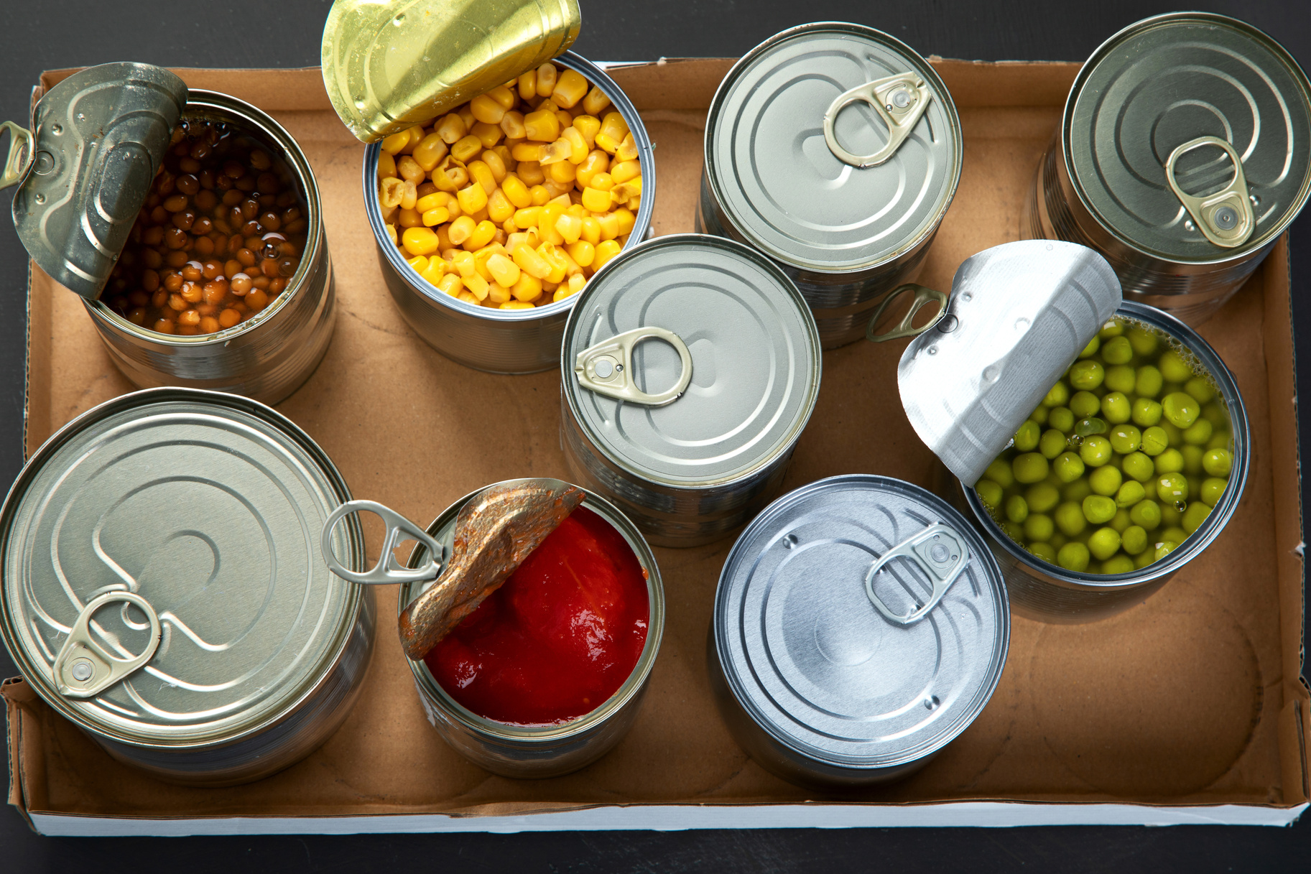

Co-Op by the Numbers
94%
47%
INCREASE IN FOOD DISTRIBUTED
INCREASE IN PARTNER PARTICIPATION
151,176 LBS.
293,812 LBS.
Distributed in FY24
Distributed in FY25
21 PARTNERS
31 PARTNERS

Slide 6





What Kind of Food is Offered?
Assembled Variety Boxes 01
Weekend Backpacks 02
  Disaster Food Box
  Healthy Choices Food Box
  Family Meals Food Box
  Diabetic Friendly Food Box
  Holiday Food Box
  Mediterranean Food Box
  8 bags per case
MANY OPTIONS
Non-Food 03
Shelf-Stable 04
  Deodorant
  Toothpaste
  Body Wash
  Toothbrush
  Mouthwash
  Beans
  Juice
  Soups
  Pasta
  Rice
  Canned Protien
  Snacks
  Spices
  Canned Vegetables & Fruit

Slide 7

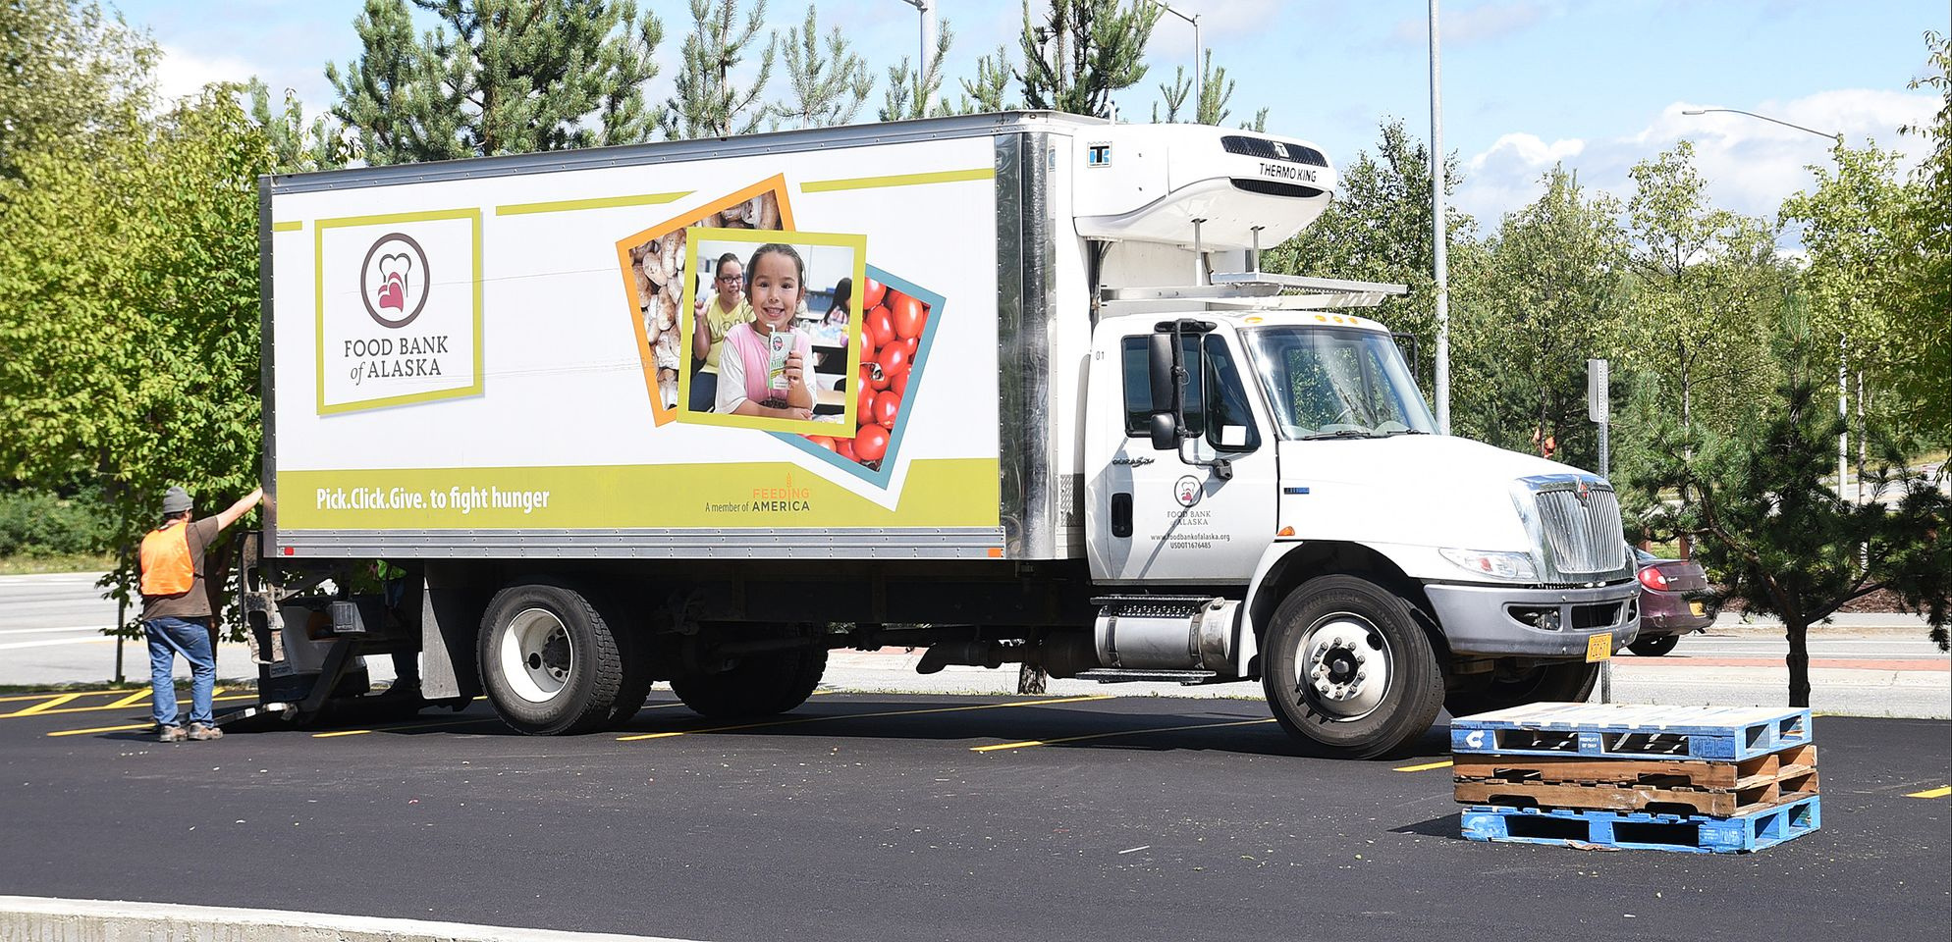
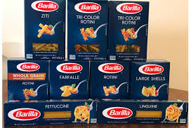
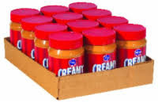
How it Works
01.
Become a partner
02.
Identify Funding
03.
Place an order
04.
Get commodities

Slide 8

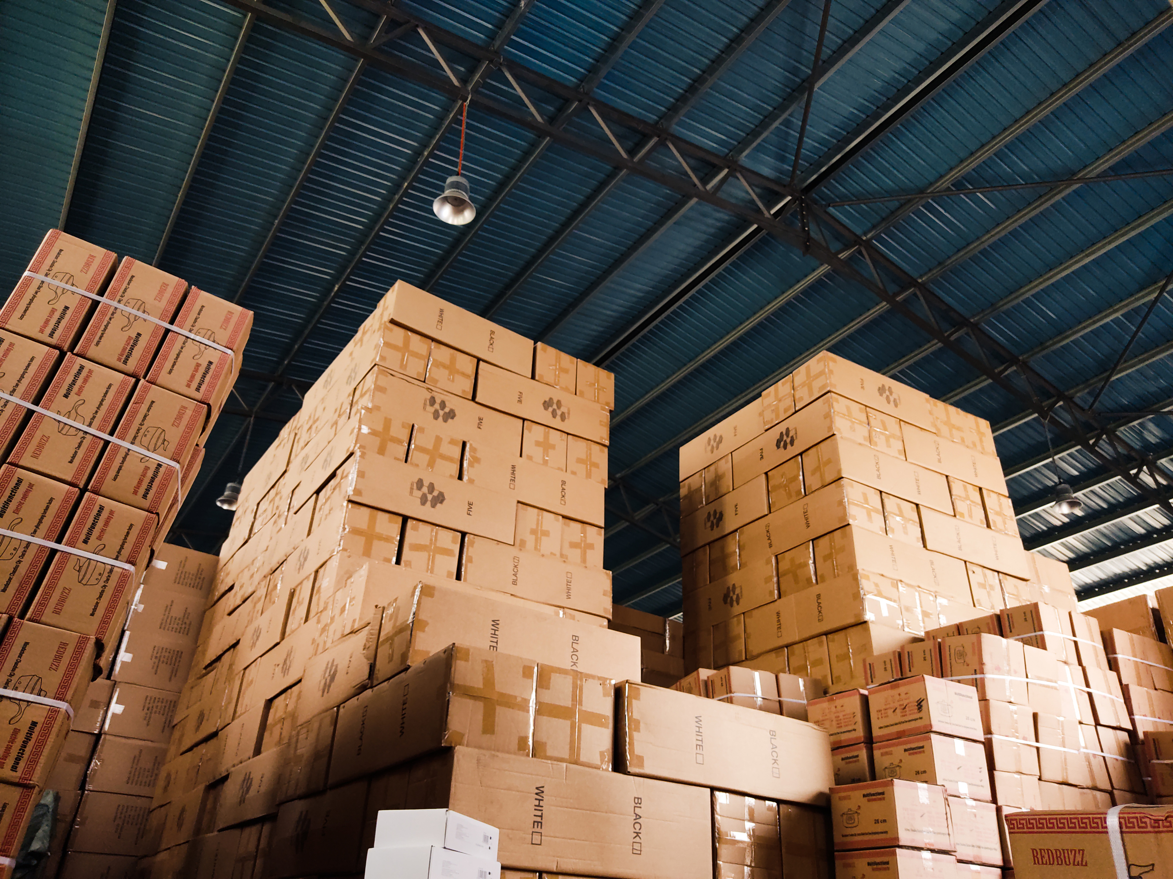
Questions
Anthony Reinert
Chief Programs Officer
07-222-3104
areinert@foodbankofalaska.org
Rebecca Guyer
Director of Programs
907-222-3100
rguyer@foodbankofalaska.org

