Slide 1

The Emergency Food Assistance Program
Annual Training
FY2026

Slide 2



Key Players
Danielle Caldwell
Program Coordinator - TEFAP
Rebecca Guyer
Director of Programs
Nicholas Gee
Logistics Manager
Notes:
So, here is the key players of TEFAP, especially those new to the TEFAP program! Firstly, there is me, Danielle Caldwell, I will be your main contact for coordinating TEFAP at the Food Bank of Alaska. Our other wonderful Lady, who kept this program rolling smoothly, is our shinning star Rebecca Guyer. She was the one y'all probably used to holler at for TEFAP stuff, but now she's our Director of Programs. She's been holding it down at the food bank for 5 years and some! She is still very much in the mix. Next, we've got Nick, our new Logistics Manager. He's the man behind the scenes making sure all those shipments and deliveries get to your sites without a hitch. I am grateful to have an amazing team, and we can't wait to keep working with y'all to make this program the best it can be!

Slide 3
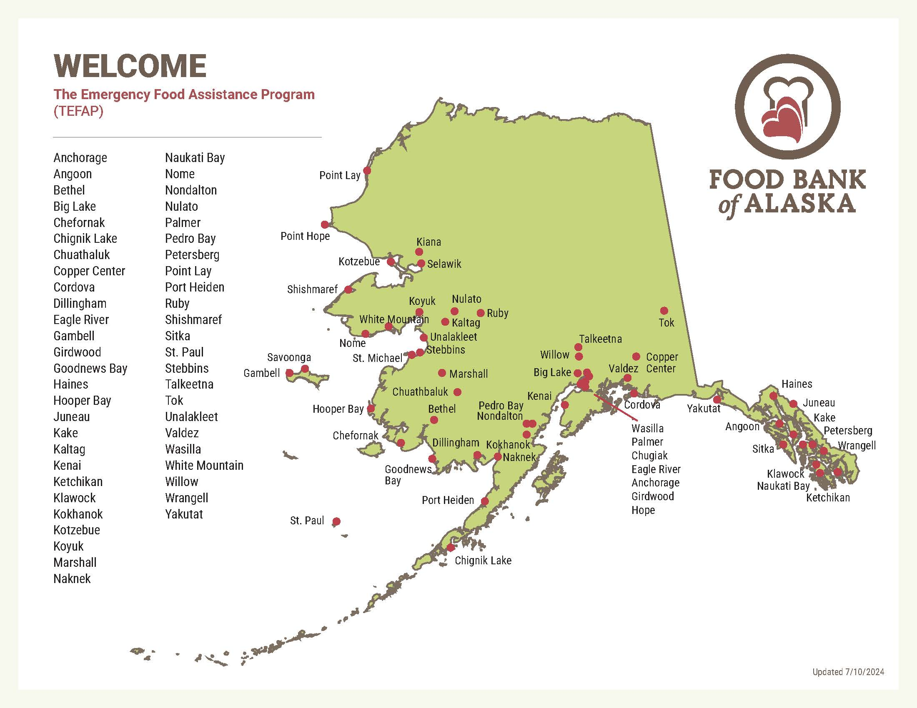






Notes:
Welcome to the Annual TEFAP training for fiscal year 2026. Here is a map of TEFAP partners throughout the state of Alaska, we currently have 61 partners!

Slide 4
Agenda
Welcome
FY26 Overview
What is TEFAP?
FBA’s Role
Partner Agency Roles
Eligibility Requirements
Distribution Requirements
Inventory Management
Reporting & Recordkeeping
Additional Requirements
SAM.gov
Notes:
Here is a quick overview of what the training will intel.

Slide 5
Statistics
Notes:
Here is some statistics for the last six fiscal years!

Slide 6
How does TEFAP work?
Food pantries, soup kitchens, etc.
USDA
U.S. Department of Agriculture
FNS Regional Offices
USDA Food & Nutrition Service Western Regional Office
State Agencies
Department of Early Education Development (DEED)
Food Banks
Food Bank of Alaska
TEFAP Partner Agencies
People you serve!
Notes:
TEFAP is a federal program that steps in to support low-income individuals by providing emergency food. So those in need can keep a nutritional balanced diet when times are tough.
We start with USDA – they purchases a variety of nutritious, high-quality USDA foods
Then USDA Food and Nutrition Service – makes those foods available for state agencies by allocating money to each state for food purchases based on a formula of 60% population in poverty and 40% of unemployment
The State Agencies – For Alaska, is the Department of Early Education Development also known as DEED, who orders and allocates the food items to the food banks. Sometimes USDA has bonus items available, a bonus is in the form of funds($) to purchase truckloads(more) of TEFAP food.
Next the Food Banks – as in us, FBA, receives the TEFAP food and send it out to our partner agencies, You guys!
Partner Agencies – distribute the TEFAP food to people that are income eligible for the program!

Slide 7
State TEFAP Coordinator

Slide 8
State TEFAP Coordinator
Monitor FBA’s administrative funds spending
Manage grant activities & payments
Orders USDA foods that will be distributed
Conduct mandatory onsite reviews of TEFAP agencies

Slide 9
FBA’s Responsibilities
Confirming TEFAP foods from DEED
Receiving and storing TEFAP Food
Coordinate orders and deliveries with agencies
Ensure that all TEFAP Foods are handled properly by agencies
Collect and maintain records
Notes:
FBA responsibilities is to confirm TEFAP Food from DEED >1) DEED (Department of Early Education Development) notifies FBA when they have purchased food items for us to order,
Then we receive and store TEFAP food that get allocated % wise to agencies(you)> 2) meaning after we receive the food items- we allocate a percentage to our agencies(you guys) based on area population and capacity amounts.
>3) I then reach out to our partner agencies (you) and coordinate the delivery for your TEFAP order. As well as when you want to deliver.
>4) We make sure that all TEFAP food is being handled correctly by agencies.
And lastly, we collect and maintain records >5)From your monthly reports, we submit a quarterly report to DEED along with a detailed report of our inventory on hand.

Slide 10
Agency’s Responsibilities
Staff & Volunteers are trained in TEFAP, Civil Rights, and Food Safety
Receive, store and maintain inventory
Collect applications
“And Justice for All” Poster
Distribute TEFAP
Complete monthly reports
Keep records on file

Slide 11
Eligibility
How do people qualify?

Slide 12
Enrolling
Applications
Requirements
Completed annually for the new year of October 1, 2025 – September 30, 2026.
Households can be of any size.
Proof of income is NOT required.
Reside in Alaska.
Have an annual income at or below the income guidelines.
One application per household.
Applicant picking up should be listed as the head of household.
A proxy can be listed on the application.
Notes:
TEFAP applications are completed annually
The new fiscal year starts October 1, 2025, and end September 30, 2026.
For instance,
*A household consist of a group of related or unrelated individuals who are living as one economic unit (i.e., using pooled resources to purchase food together)
According to
*Per Federal Regulation 7 CFR – partner agencies must accept self-declaration as proof of income and residence status. So, you Do not require any further information such as picture identification or proof of address for households that are seeking the distribution of TEFAP. However, if you need to request proof of Id to help with a language barrier you can just as long as you don’t turn people away for not having id.
So, an
Annual income is money received by any member of the household BEFORE tax and social security deductions
This includes salary or wages; earnings from self-employment, including fishing and farming; strike benefits, unemployment, and welfare (but not SNAP- food stamp benefits); child support and alimony, Social Security, pensions, retirement and disability payments; Permanent Fund Dividend and other cash income received.
Requirements people must…(look at slide 10)
For a proxy,
There is a proxy line on the application, if someone other than the applicant is not listed on the application and needs to pick up for the household, the proxy must bring a written note from the applicant along with their ID to pick up the TEFAP food.

Slide 13
Income Guidelines & Program Benefits
Household Size | Annual Income
1 | $58,650
2 | $79,290
3 | $99,930
4 | $120,570
5 | $141,210
6 | $161,850
7 | $ 182,490
8* | $203,130
SNAP (food stamps)
Tribal TANF/ATAP
SSI or Medicaid
CSFP or FDPIR
NSLP Lunch Free or Reduced
*For each additional household member, add $20,640*
Notes:
Another way to qualify is if the applicant is participating in one of the program benefits listed. People then are automatically eligible for TEFAP due to having the same or lower income guidelines.

Slide 14
Example Application
Signature is required on the application
Intake works should sign the bottom and mark eligible or ineligible
Notes:
Here is an example application. Signatures are required on the application.
To fill out, circle how many people are in the household, fill out the name, zip, phone number, and proxy section (if needed). Next, ask if they are already receiving any of the benefits listed on the application. If they say no, you can continue to the income scale and circle or write based on their household size. Does anyone in the household receive a PFD? Make sure you are filling out the bottom of the application and signing.
These must be kept on file for 3 years plus the current year. Any questions? ☺

Slide 15
Inventory
Receiving & Distributing

Slide 16
Inventory Management
Ordering TEFAP Food
Receiving TEFAP Food
Storing & Distributing TEFAP Food
Direct Ship Sites
  Email from FBA confirming what’s coming
Count and verify – sign Agency Order Receipt (AOR)
Cases must be marked “TEFAP” & the date received
Inventory should last 3 months
TEFAP must be stored separately from other food
FIFO – First-in, first-out
Food Item Loss Report Form
Individual choice is recommended
Potentially go back to once a month
Non-Direct Ship Sites
  Email from FBA with list of what’s available to order
Notes:
For ordering TEFAP food, you will receive an email from me with a list of items that your agency has available to order, you’ll reply with which items and how many cases you would like. We do require 72 hours notice to place orders. Rural agencies should receive an email confirmation once the order leaves our warehouse. If you do not get an Agency Order Receipt- AOR, please let me know and I can send it to you! The AOR must be signed and returned, if it doesn’t match what you have received, please make a note and notify me as soon as possible so we can investigate.
For those agencies that are direct ship, your items will be shipped by Food Item Forwarders Inc. with a possible second carrier, if it takes longer than 8 weeks to receive your items, please let me know. Most items ship on or around the 15th of each month. We encourage agencies to have at least 3 months inventory in their pantry if they have the capacity(due to the long shipping delivery).
Make sure you mark your TEFAP food upon arrival with the date received(so you can do FIFO), as well as labeling it TEFAP! Also, keep TEFAP separate from all other food programs/donations. TEFAP must be distributed within 6 months to people.
Anchorage/Valley sites – inventory left at FBA longer than three months will be rolled into the Community Pot; the community pot is then available for all agencies to order from.
*** The amount of food we are set to receive this fiscal year is going to be less than what we have seen recently. It is very important to consider based on your inventory levels to go back to once a month if you have been distributing multiple times. It is not a requirement to distribute once a month, but we do see that TEFAP poundage has gone down. You could also evaluate your distribution guidelines if needed. ***

Slide 17
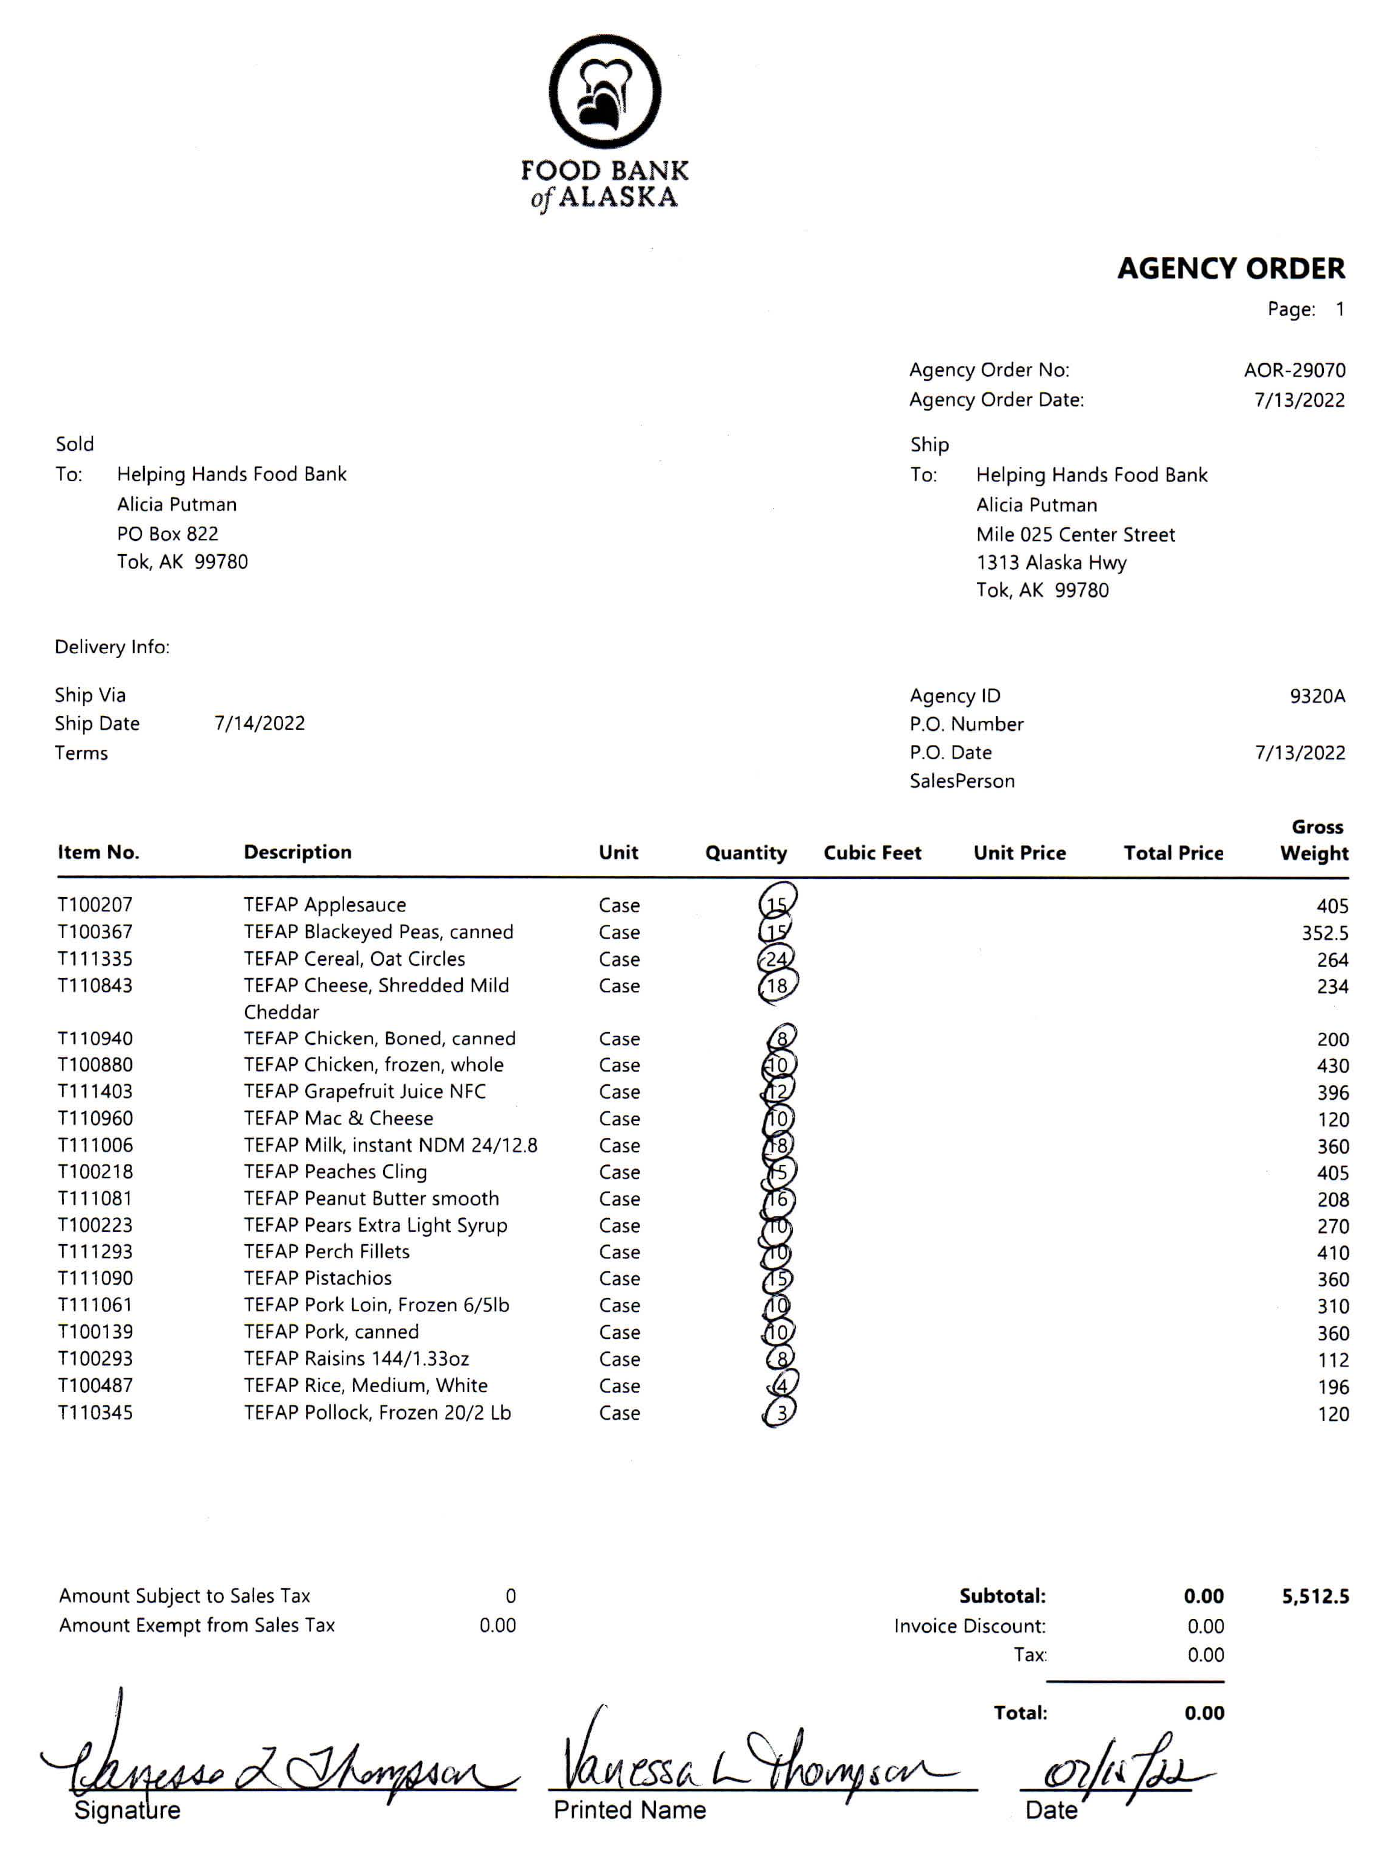
Example Agency Order Receipt (AOR)
Signature is required upon arrival
Notify FBA of any discrepancies
Notes:
Here is an example AOR, that you will receive with your order via on the pallet, from our driver, or through email. Count TEFAP items when arrive, mark cases with date received and label it TEFAP.
Make corrections to the AOR if needed, sign and return to me.

Slide 18
Food Shipment Schedule

Slide 19
Quarter 1
Item | Scheduled to Ship
CHICKEN WHOLE BAGGED FRZ CTN-36-43 LB | 9/15/2025
BEANS GREAT NORTHERN DRY PKG-24/1 LB | 9/15/2025
PEACHES FRESH BAG PKG–12/2 LB | 9/15/2025
PEARS CAN-24/300 | 10/15/2025
CRANBERRIES DRIED PKG-300/1.16 OZ | 10/31/2025
APPLES FRESH PKG-12/3 LB | 11/5/2025
APPLESAUCE CAN-24/300 | 11/15/2025
Notes:
Here is more of Quarter 1.

Slide 20
Quarter 1 – continued
Item | Scheduled to Ship
MIXED FRUIT CAN-24/300 | 11/15/2025
FISH AK PLCK FILLETS FRZ PKG-20/2 LB | 11/15/2025
STRAWBERRY WHOLE UNSWT IQF CTN-12/1 LB | 11/15/2025
MILK 1% MILKFAT UHT 1500 BOX-12/32 FL OZ | 12/15/2025
PEACHES CLING SLICES CAN-24/300 | 12/15/2025
CHICKEN DRUMSTICKS FROZEN PKG‐8/5 LB | 12/15/2025
PEARS CAN-24/300 | 12/31/2025
Notes:
Here is more of Quarter 1.

Slide 21
Quarter 2
Item | Type
APPLES FRESH PKG-12/3 LB | 1/14/2026
SPAGHETTI SAUCE MEATLESS CAN-24/300 | 1/15/2026
PASTA SPAGHETTI BOX-20/1 LB | 1/15/2026
BEANS PINTO DRY PKG-12/2 LB | 2/15/2026
FISH AK POLLOCK NUGGETS FRZ PKG-20/2 LB | 2/15/2026
CHICKEN BONED POUCH-36/10 OZ | 2/15/2026
PEACHES CLING SLICES CAN-24/300 | 2/15/2026
PEARS CAN-24/300 | 3/15/2026
CRANBERRIES DRIED PKG-300/1.16 OZ | 3/15/2026
RICE US#2 LONG GRAIN PKG-24/2 LB | 3/15/2026

Slide 22
Quarter 3
Item | Type
MIXED FRUIT CAN-24/300 | 4/15/2026
FISH AK POLLOCK STICKS FRZ PKG-20/2 LB | 4/15/2026
CEREAL CORN FLKS 1248 PKG-12/18 OZ | 4/15/2026
PEACHES CLING SLICES CAN-24/300 | 5/15/2026
MILK 1% MILKFAT UHT 1500 BOX-12/32 FL OZ | 5/15/2026
MACARONI AND CHEESE PKG-24/7.25 OZ | 5/15/2026
CHICKEN DRUMSTICKS FROZEN PKG‐8/5 LB | 6/15/2026
BEEF STEW CAN-24/24 OZ | 6/15/2026

Slide 23
Quarter 4
Item | Type
PORK CHOPS BNLS FRZ PKG-40/1 LB | 7/15/2026
FISH AK PLCK FILLETS FRZ PKG-20/2 LB | 9/15/2026
BEANS BLACK TURTLE DRY PKG-12/2 LB | 9/15/2026
MILK 1% MILKFAT UHT 1500 BOX-12/32 FL OZ | 10/15/2026
CORN WHOLE KERNEL CAN-24/300 | 10/15/2026
CHICKEN DRUMSTICKS FROZEN PKG‐8/5 LB | 11/15/2026
FISH AK POLLOCK NUGGETS FRZ PKG-20/2 LB | 12/15/2026

Slide 24
Reporting

Slide 25
Monthly Reports
Due to FBA by the 5th of each month
Monthly Inventory Report
Certification of TEFAP Food
Printed or typed signature is required at the bottom
Any losses over 10 should have a Food Item Loss report form
Item number is optional
Signatures are not required
Printed name and household size is required
Tracking inventory per person is now optional
Notes:
The MIR(Monthly Inventory Report) and TEFAP Distribution List (applicant page with how many in household) are due to me “FBA” by the 5th of each month and are considered delinquent on the 6th, your access to TEFAP will be suspended and multiple delinquent reports will result in hold or shut down status from the program. **Both templates are in your TEFAP materials folder that was emailed out last week.
We are required to report to DEED on a month basis for inventory, and quarterly, with participation numbers. Please make sure you get your reports in on a timely manor or contact me if you have special circumstances.

Slide 26
Example Monthly Inventory Report
Signature is required upon arrival
Notify FBA of any discrepancies
Notes:
MIR instructions are on the second tab of the Excel document
The food item number has now been included on the MIR; this will help with tracking items that are similar but have a different item number. The item numbers will now be listed when you receive your ordering email, and they will be listed on the AOR.
Inventory should be hand counted(in eaches not cases) between distributions
The quantity at the end of the month should match the beginning inventory of the next month
The total distributed for each item on your MIR should match the totals from your sign in sheets(Distribution List)
Ensure that you are recording the number of items distributed correctly
Ensure that the number you have on your inventory report is what you have on the shelf
Only account for items lost or damaged in the “loss/gain” column
Please make sure you are signing the MIR at the bottom.

Slide 27
Example Distribution List of TEFAP Food
Option 1 – no inventory
Notes:
Signatures are not required on the TEFAP Distribution List form and tracking inventory per person is not required. However, if you would like to track, we now have the two options available. Here is an example with no inventory tracking.
Option 1 or 2 is required for every agency unless you are a congregate site. If you provide a meal with TEFAP this form is not required!

Slide 28
Example Certification of TEFAP Food
Option 2 – with inventory
Available in portrait or landscape
Notes:
Here is option 2 with tracking inventory and will be available in portrait or landscape.
Please send this in every month with your monthly inventory report, DEED will want to review these if your agency is chosen for an administrative review.
List the items you are distributing fill out the household name, household size and the amount of each item that household is receiving. Totals should be added at the bottom of the page; these numbers will help with finishing your MIR for the month.

Slide 29
Additional Requirements

Slide 30
Recordkeeping
Must be kept on file for 3 years plus the current year.
TEFAP Agreement
Civil Rights Training Form
Monthly Inventory Reports (2)
TEFAP Applications
Food Item Loss Report(s)
Notes:
The following listed must be kept on file for 3 years plus the current year, organized by fiscal year. Anything before FY23 can be shredded, you should have FY23 – current

Slide 31
“This institution is an equal opportunity provider.”
USDA Nondiscrimination Statement must be used on any advertising materials.
Notes:
This should used on websites, fliers, anytime you are advertising TEFAP! Font size should be no smaller than the text.

Slide 32
Food Safety Certification
Food Bank of Alaska’s Class
Municipality of Anchorage
Department of Environmental Conservation
Cost: Free
For any community
Cost: $10.00
Cost: $10.00
For Communities outside of Anchorage
Notes:
All pantry managers and regular volunteers must have current food safety training on file with FBA. All partners have the option to take our Food Safety Class on the second Tuesday of every month, however, please keep in mind that you must fulfil any food safety requirements of any jurisdiction (city, borough, etc.) you are in as well. Anchorage partners can take the municipality of anchorage’s food safety training. Partners outside of Anchorage can take the State of Alaska’s Department of Environmental Conservation food safety class.
We will be reaching out to those that need training and will provide links to all class options.

Slide 33
Basic Food Safety
Cool Storage: 36°F-41°F
Freeze Storage: -10°F–0°F
Temperature Logs
Secured and Protected
Clean & Dry
Dry Storage: 50°F-70°F
6 inches off the floor
Notes:
Here are some basic food safety regulations. Please make sure the TEFAP foods are set in the correct storage temperatures, temperature logs must be used on refrigerator and freezer units, keep the area clean and free of harm, all TEFAP food must be 6 inches off the floor and 2-4 inches from the wall.
During our food safety class, we do provide extra materials regarding to food safety, temperature logs, hand washing signs, etc.

Slide 34
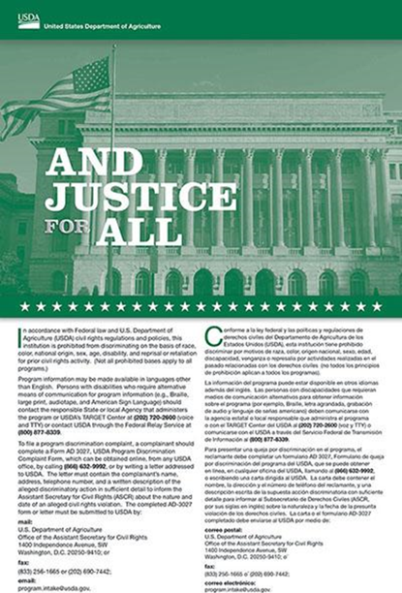

Civil Rights & Notice of Rights
Staff and volunteers must complete Civil Rights training.
Written Notice of Beneficiary Rights flyer is required for ALL Organizations/Partners
Notes:
Civil Rights training is completed every year, “And justice for all” poster must be displayed where people can view. If someone has a complaint, you can direct them to FBA or directly to USDA from the information listed on the poster. If your agency does not have a current poster, please let us know. We do have some available.
Also, the “Written Notice of Beneficiary Rights” flyer is required for all partners as well!

Slide 35
Food Establishment Permit
Anchorage Area
Outside of Anchorage
Apply through Municipality of Anchorage’s Health Department
Apply through State of Alaska’s Division of Environmental Health
Notes:
The State of Alaska/DEED requires all TEFAP sites to have a Food Establishment Permit. If you have any questions, please reach out to your local DEC representative or Muni representative. This should be renewed every year.

Slide 36
UEI NUMBER
Unique Entity Identifier Number is required!
THERE IS NO COST!
Maintain your SAM.gov account!
Notes:
In April 2022 federal agencies transitioned from use of the DUNS number to the Unique Entity Identifier (UEI). Any agency who receives federal funding this includes USDA Foods must have a UEI number. This only needs to be obtained one time through SAM.gov but YOU DO NOT NEED TO RENEW, just MAINTAIN AN ACTIVE SAM.GOV REGISTRATION!

Slide 37
Questions?
Danielle Caldwell
Program Coordinator - TEFAP
907-222-3126
dcaldwell@foodbankofalaska.org
Rebecca Guyer
Director of Programs
907-222-3100
rguyer@foodbankofalaska.org
Notes:
All FY26 materials are due next week, the agreement and any additional paperwork must be turned in. We will follow up with this training via email. If you have anyone that needs to take this training, we are also offering this training virtual next week, let us know after the session and we can get you the registration link.
Are there any other questions?

