Slide 1

Storytelling and Appeals
that Inspire Action

Slide 2

In the next ~50 minutes ...
Tips and recommendations to immediately put to work to drive giving.
186%
Fundraising Rule #1:
Donors fund outcomes (and impact).
Not process.
$
Rule #'1.2':
Donors want to know what that impact was (and to know the part they played).

Slide 3
Different Types of Appeals

Slide 4
Common Types of Fundraising Appeals
By Donor Relationship
Acquisition Appeal
Renewal Appeal
Lapsed Donor Appeal
Upgrade Appeal
Monthly Giving Appeal
By Framing
Shortfall Appeal
Challenge / Match Appeal
Urgency Appeal
Holiday / Year-End Appeal
By Campaign or Project
Capital Campaign Appeal
Special Project Appeal
Commemorative Appeal
By Tone
Gratitude Appeal
Mission Appeal
Impact Appeal
Notes:
Donors act on feeling first

Slide 5
The Rhythm of Donor Communication
(and the importance of having a plan)

Slide 6





The Virtuous Cycle
An evidence-based fundraising communication system

Slide 7
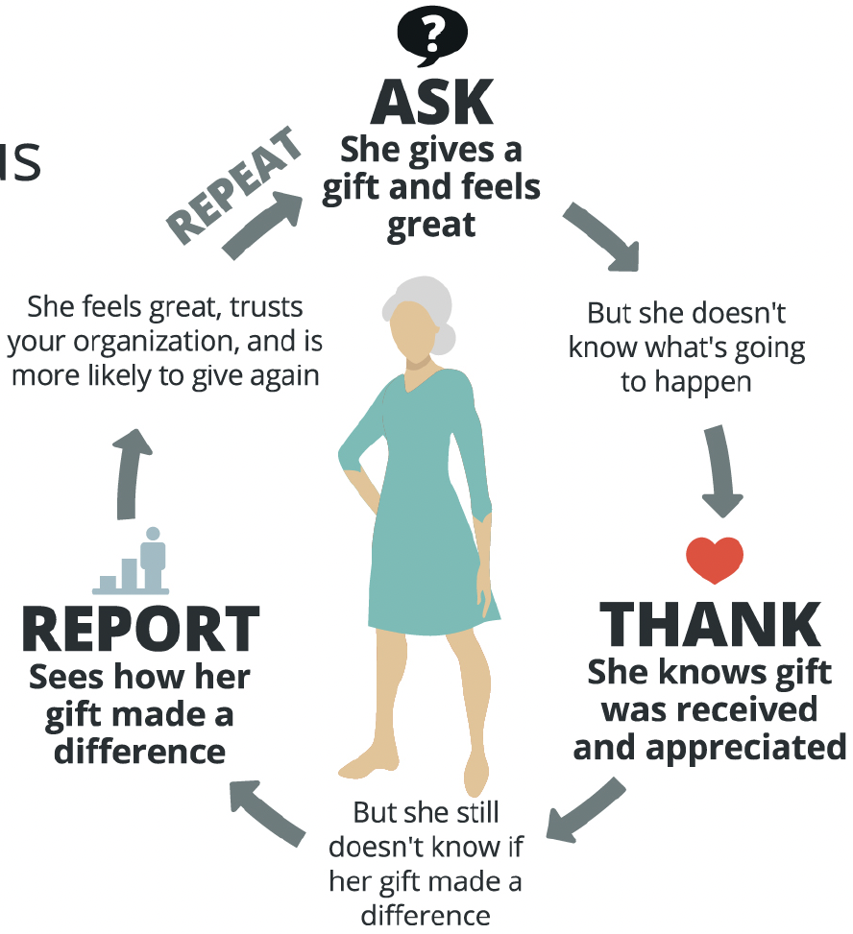
The Virtuous Cycle
An evidence-based fundraising communication system

Slide 8
Types of Stories
(and when to use them)

Slide 9
How you tell a story is less important than what story you tell and when you tell it.

Slide 10
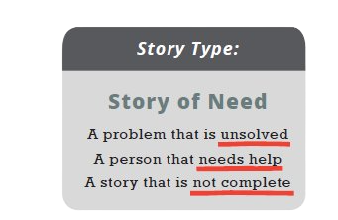
#1
Your story should be unfinished. The need still exists and the person in need (or someone like them) still needs help!
When you tell a story of need, a story without an outcome, your donor still has a powerful role that she can play.

Slide 11
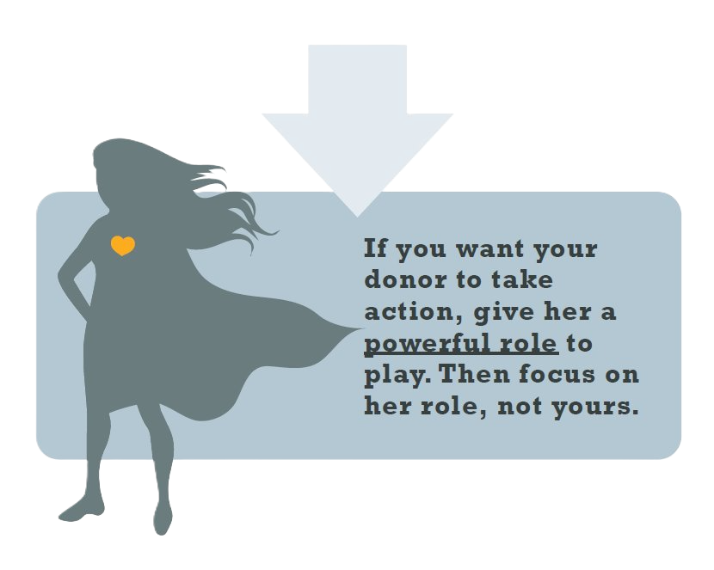
The objective is to share an emotionally moving need and tell your donor what the solution is.

Slide 12
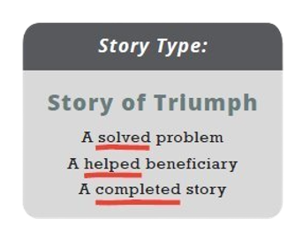
#2
This is where you complete the story. "Reporting" is the foundation for donor retention.
The key to reporting well?
Give credit to your donor.​

Slide 13
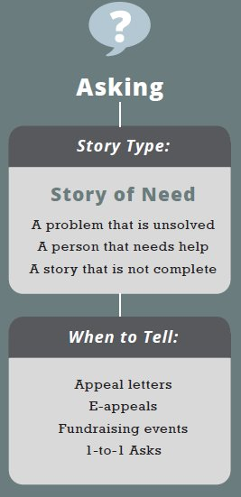
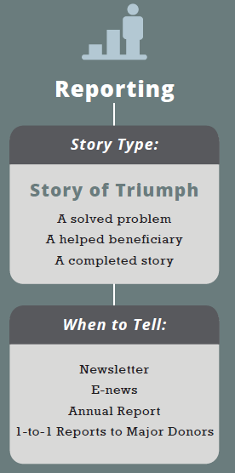
Where do these stories apply?

Slide 15
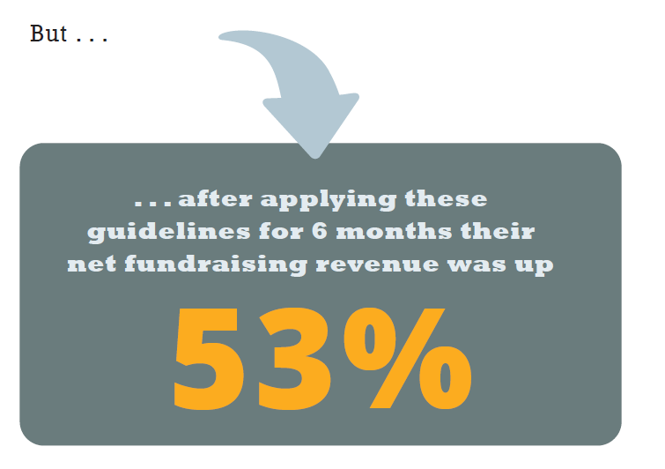

Slide 16
Using Clear and
Bold Language

Slide 17
Be Bold, Be Clear
Most nonprofits don’t realize that they Ask weakly:
“Will you please consider sending in a gift today?”
“Will you help us do more of this good work?”
“Please partner with us by…”
“Become a supporter and…”
👎

Slide 18

Fundraisers are afraid that boldly asking for a gift will “turn people off” or “make us look desperate” or “make us look like we don’t manage money well.”
Donors
Directness

Slide 19
Don't Accidentally
Hide the Need, It Creates a
Barrier to Giving

Slide 20

Learning about your food pantry is not
what the donor is in it for.
Donors are more interested in helping someone than they are interested in how your organization does the helping.

Slide 21
Real Examples
& Practical Tips

Slide 22
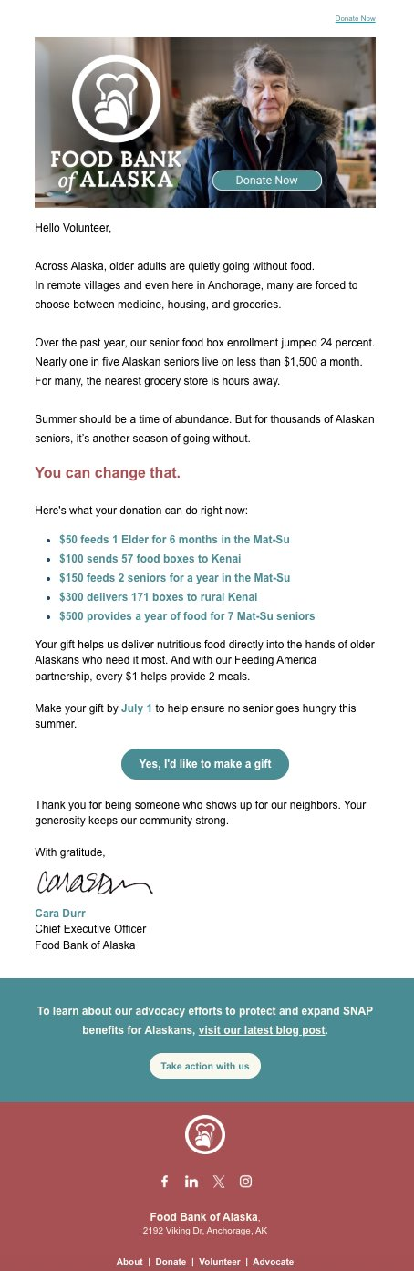
Example 1: E-Appeal
Sent to 2,456 people
Raised $210
2 gifts

Slide 23
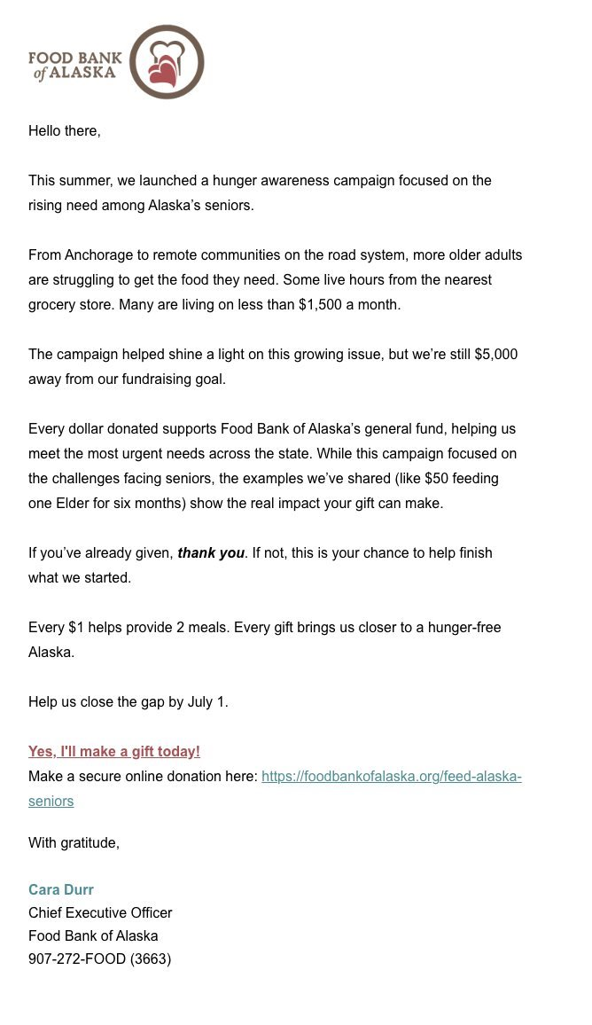
Follow-Up Shortfall
E-Appeal
Sent to 2,456 people
Raised $13,480
14 gifts

Slide 24
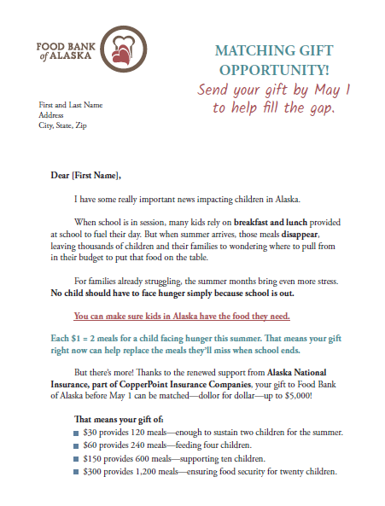
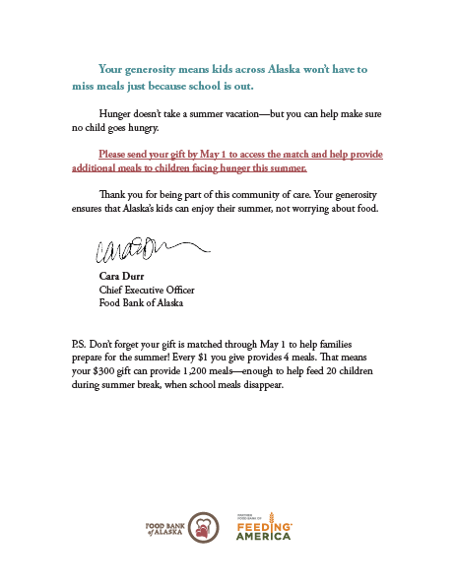

Slide 25
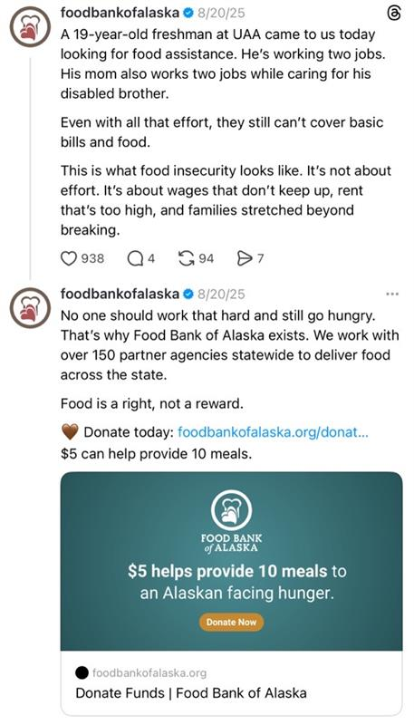
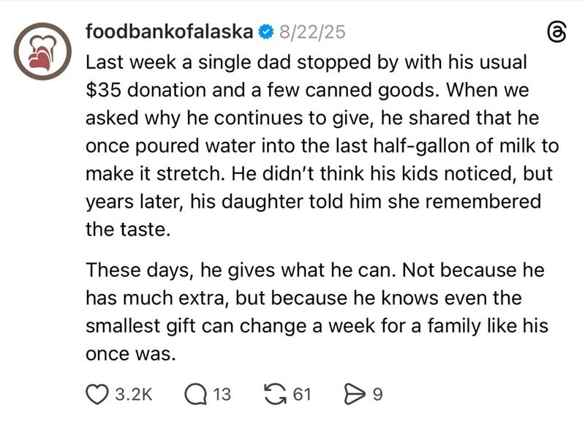
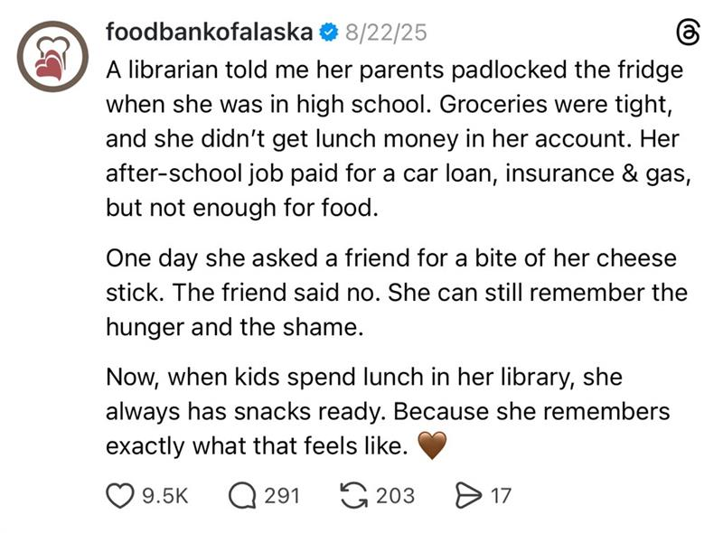
Social Media

Slide 26
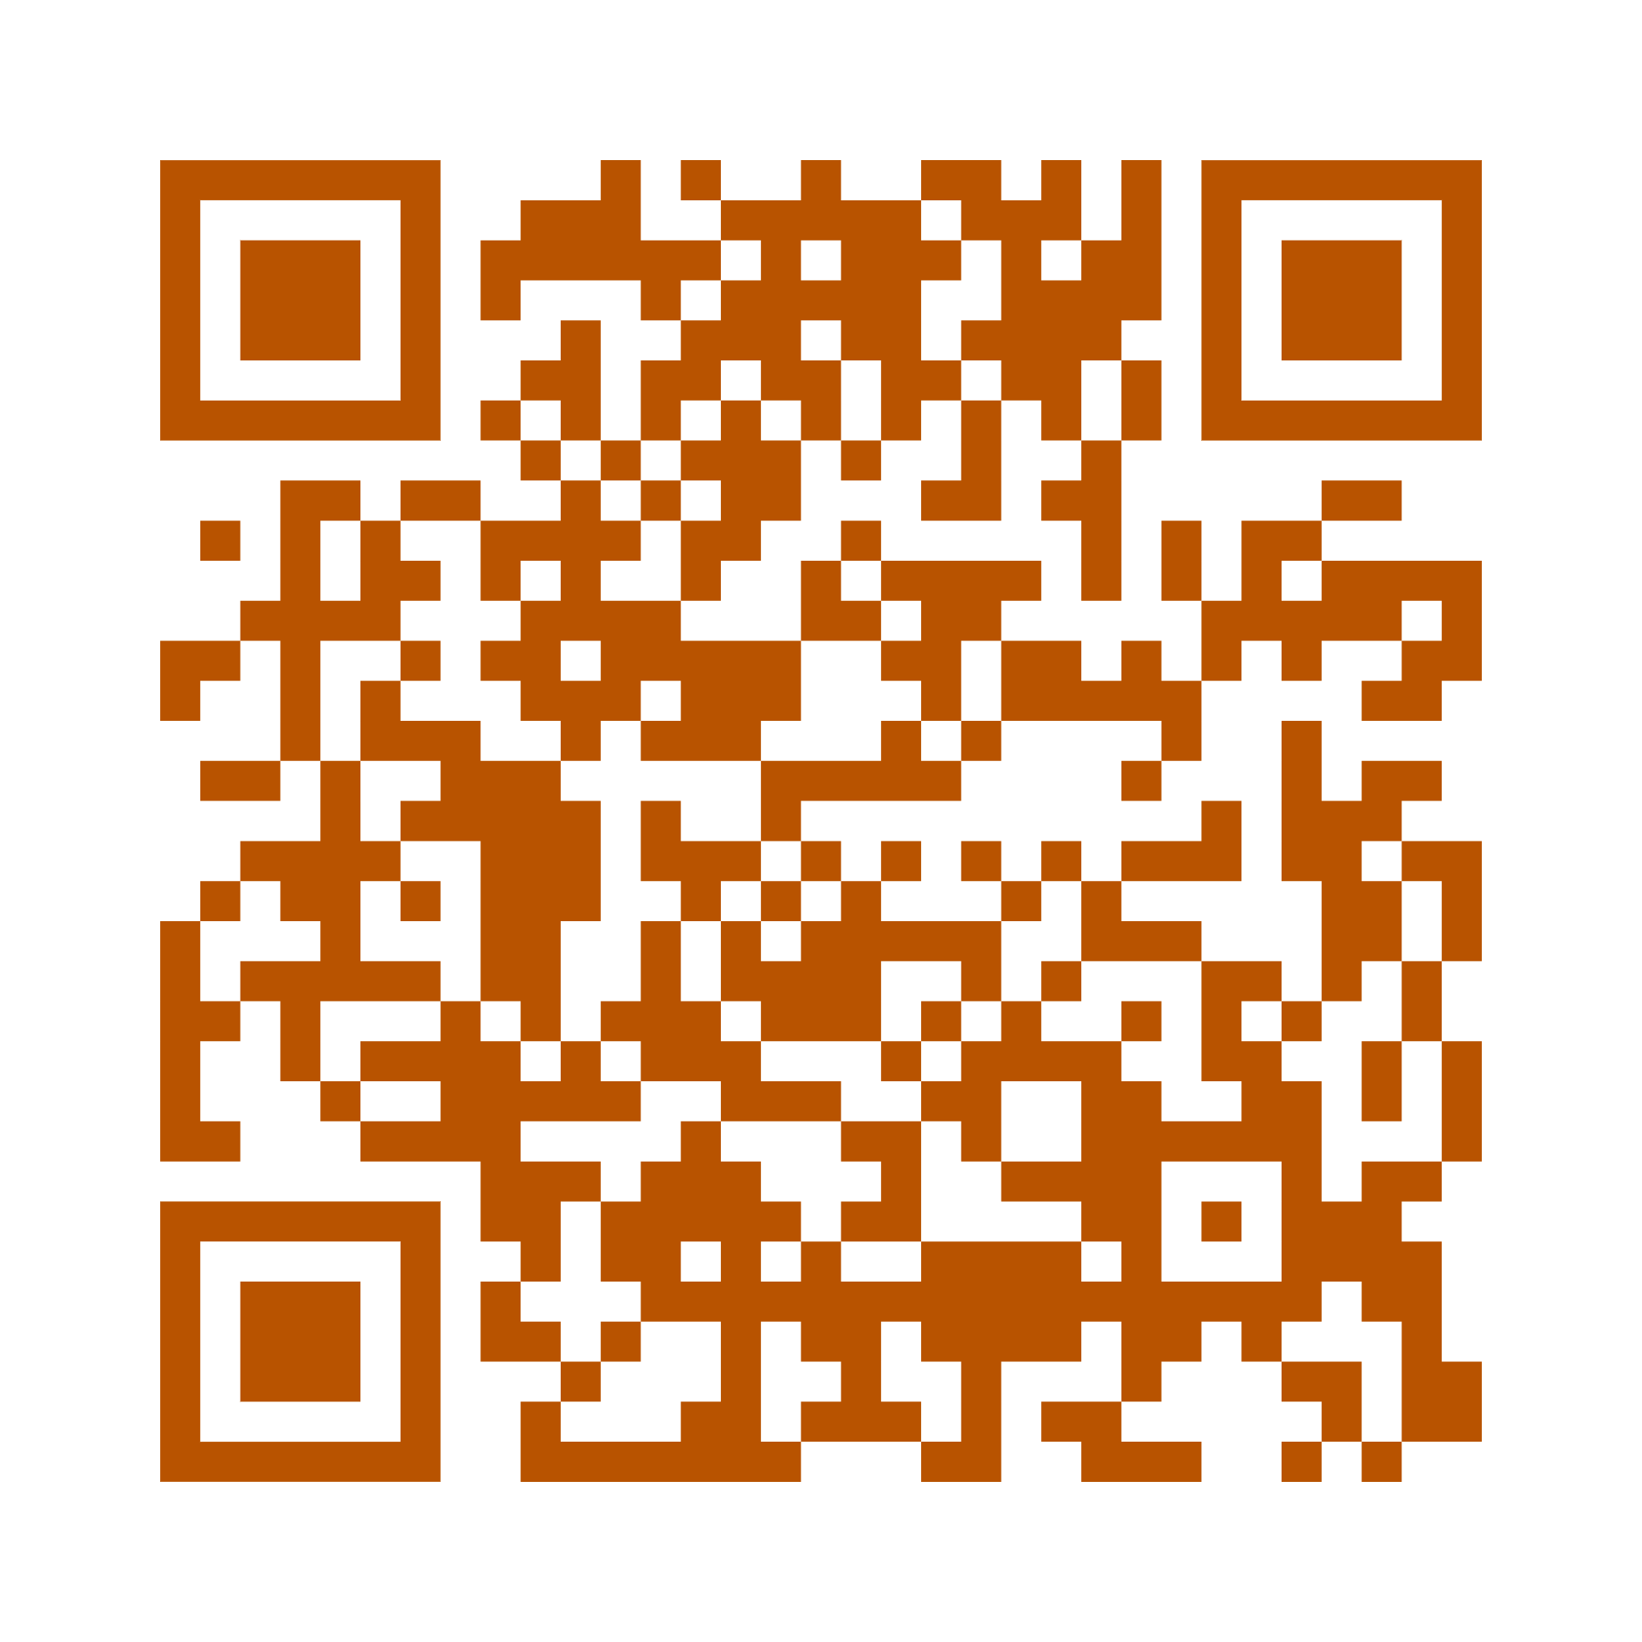
Discussion & Takeaways
Download resources
From this session

