Slide 1
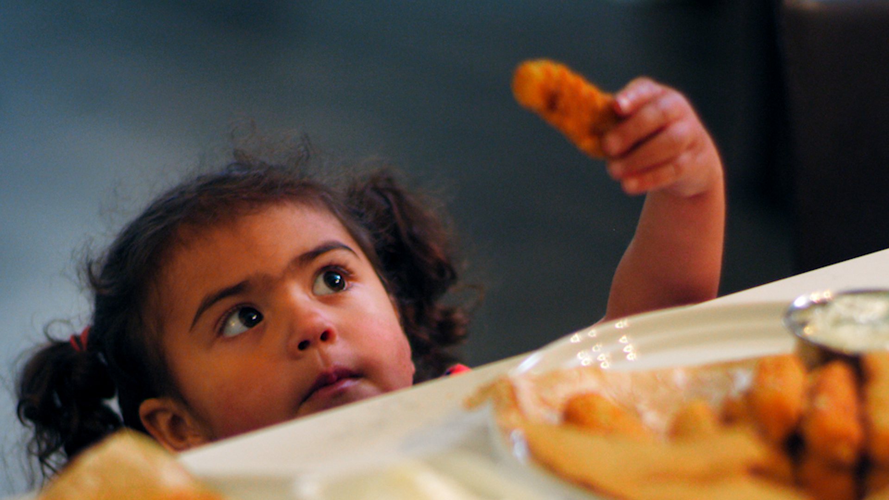

The Seafood Industry’s Response to Hunger
Hannah Lindoff, Executive Director

Slide 3
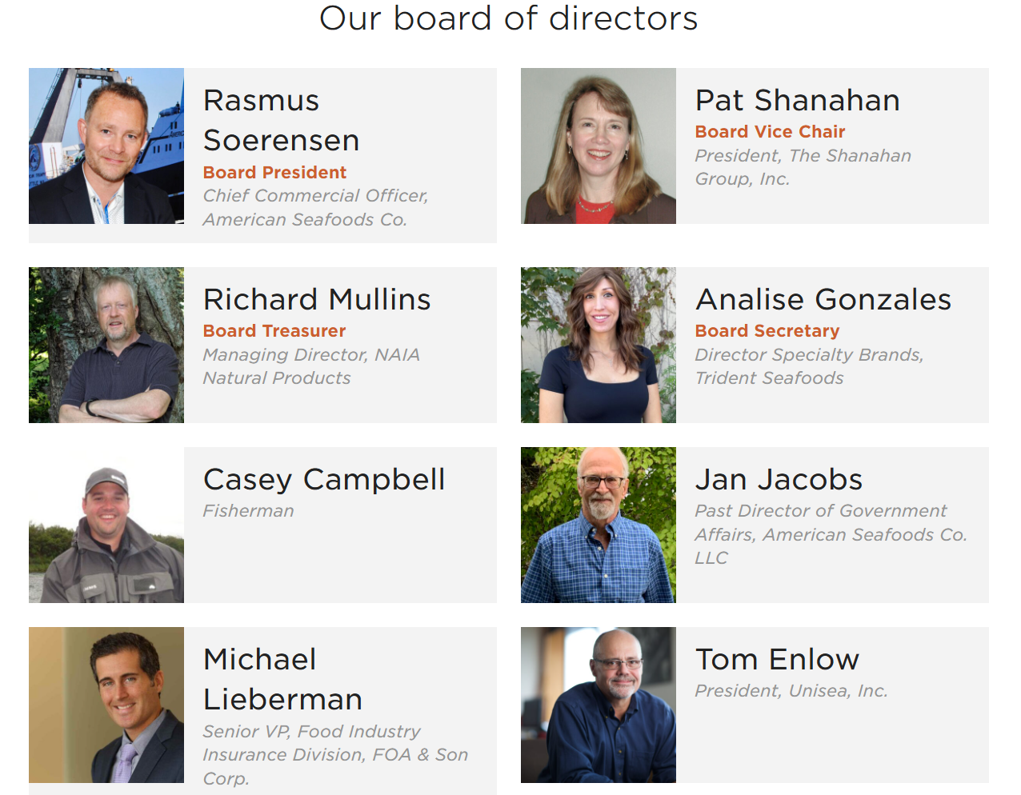
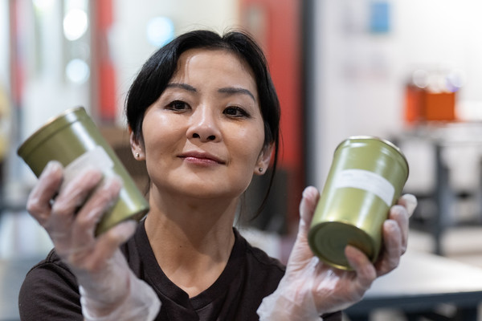
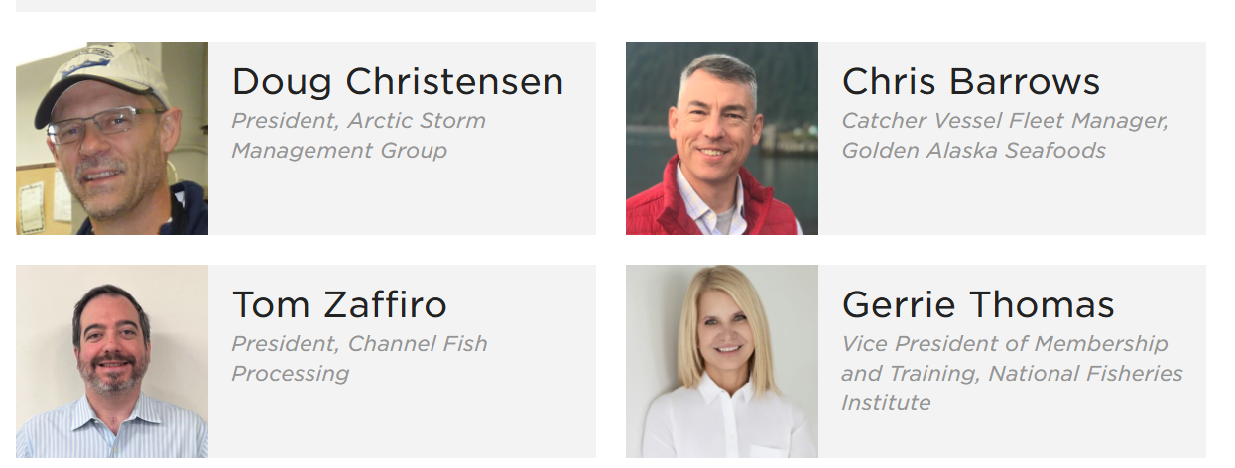
Industry Committees
Marketing Committee:
MSC, Cherryhill Aqua Farms, Channel Fish, High Liner,
Fundraising Committee:
Grobest, Fishes & Dishes, SGS Global, Southstream, Under Current News
Alaska Committee:
ASMI, UAA, Board members

Slide 4





















Slide 5
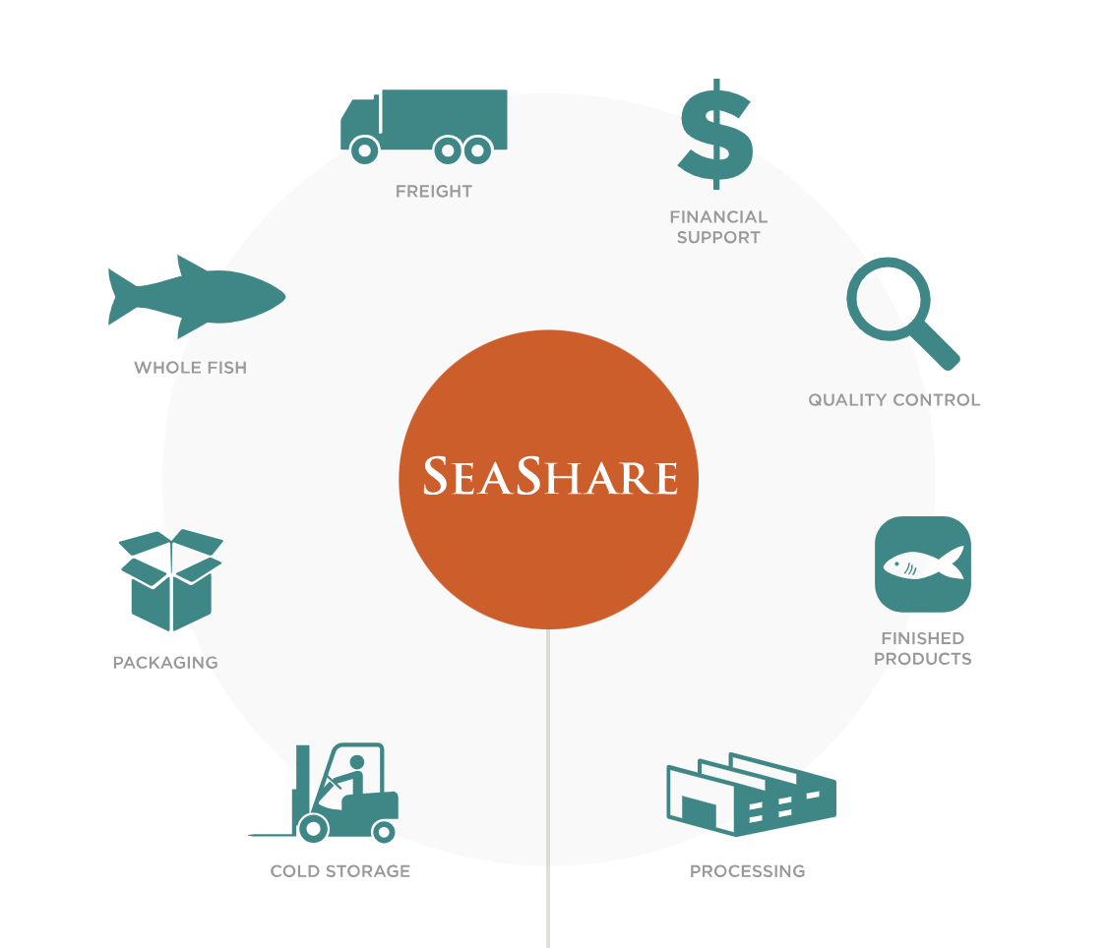

Slide 6
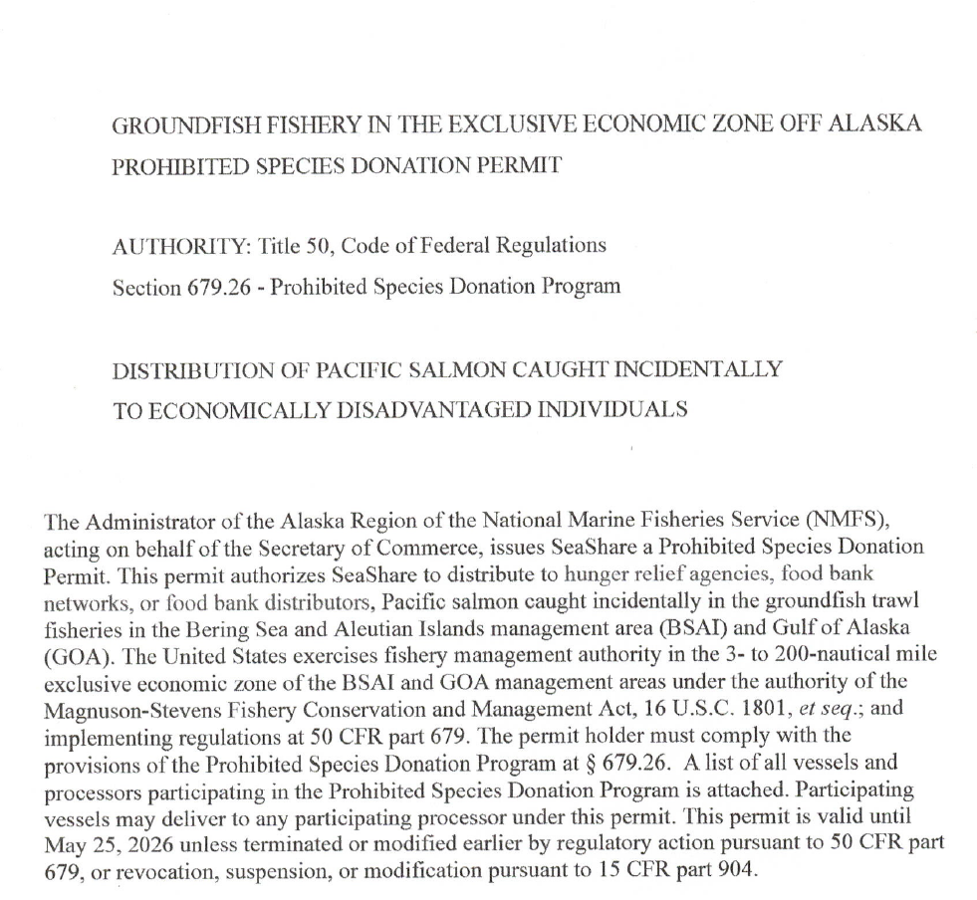
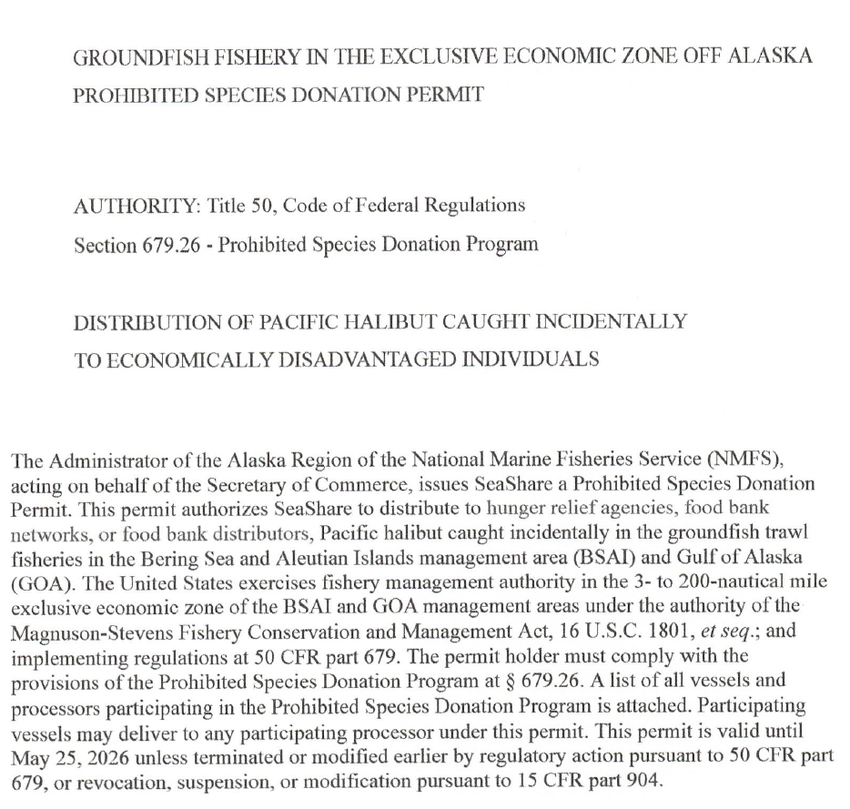
Prohibited Species Donation Program (Prohib)

Slide 7

Donation “Buckets”
APA million meal
Other Donations
Grant funded purchases
Prohib
King Salmon
Chum Salmon
Halibut
Rockfish
lingcod
crab
Breaded pollock squares
Off-size
Off-color
Non-spec
Acceptably dented
Old packaging
Etc.
Alaska = Alaska seafood
Lower 48 = inexpensive items

Slide 8
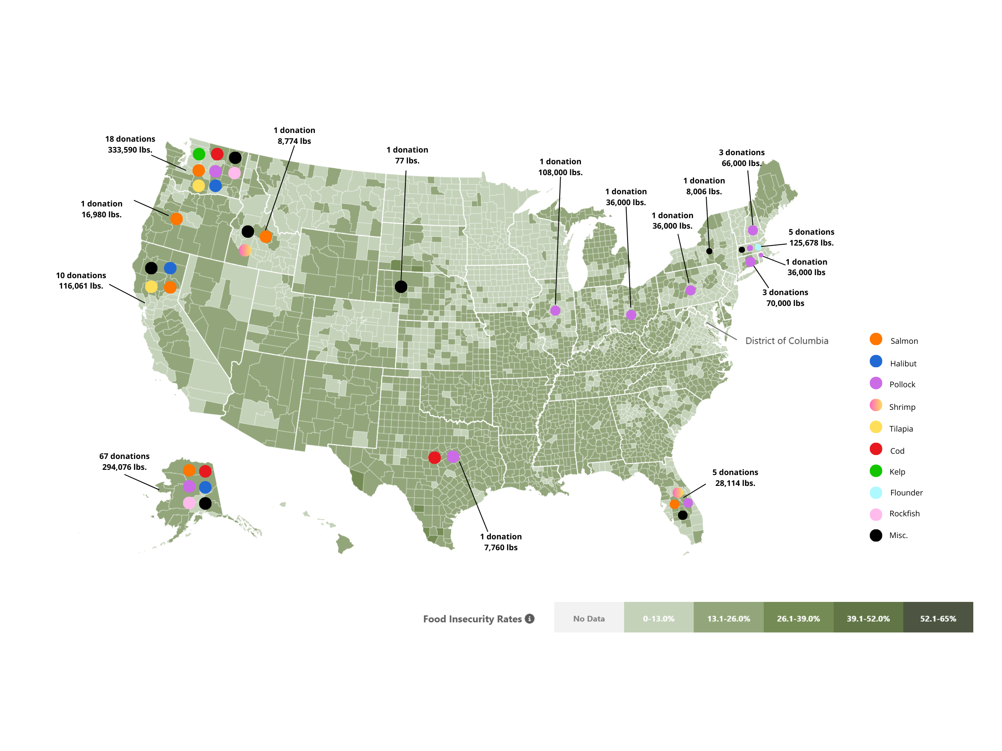

Slide 9
Seafood Food Security &
Processing Sector Resiliency
Objective 1 – Seafood supply & demand
Purchase “oversupply,” which drains resources, and distributing to communities with established freezer capacity and feeding programs.
Frequent purchases were irregular sized sockeye portions, “sockeye burger meat,” “cod pieces,” small lots of ‘23 product or ‘24 product as the summer salmon season ramped up. Canned pinks.

Slide 10
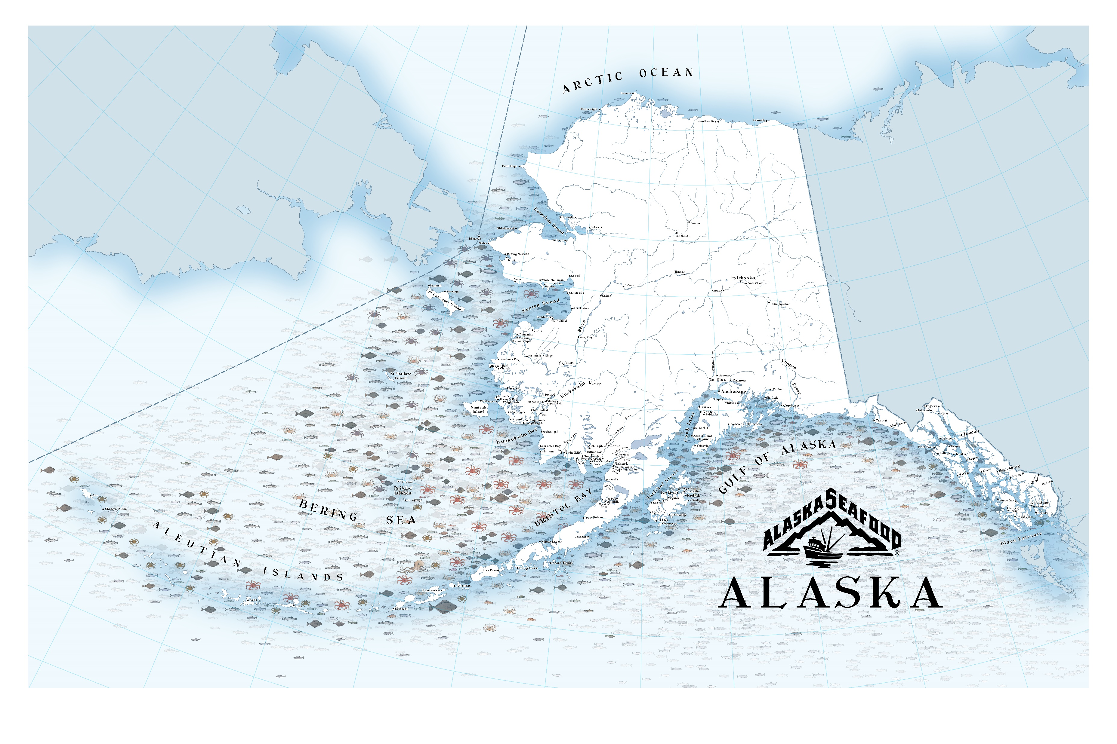
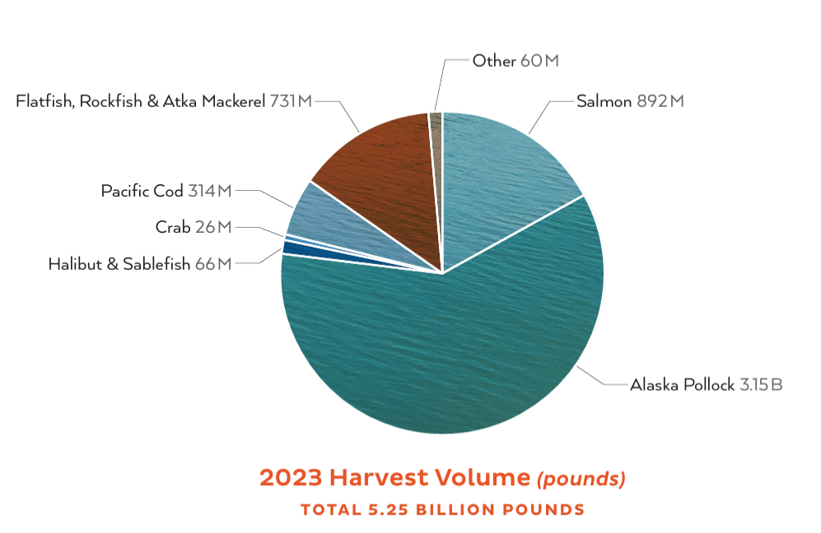

Slide 11
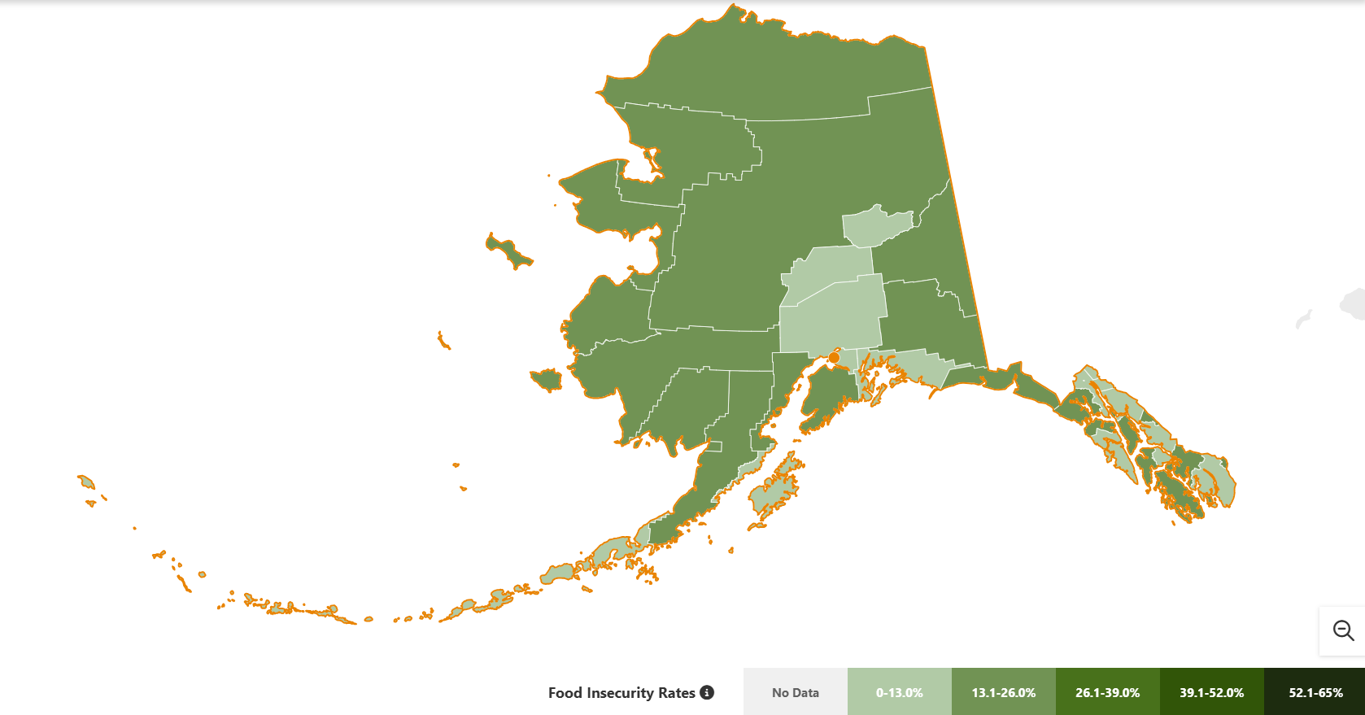

Slide 12
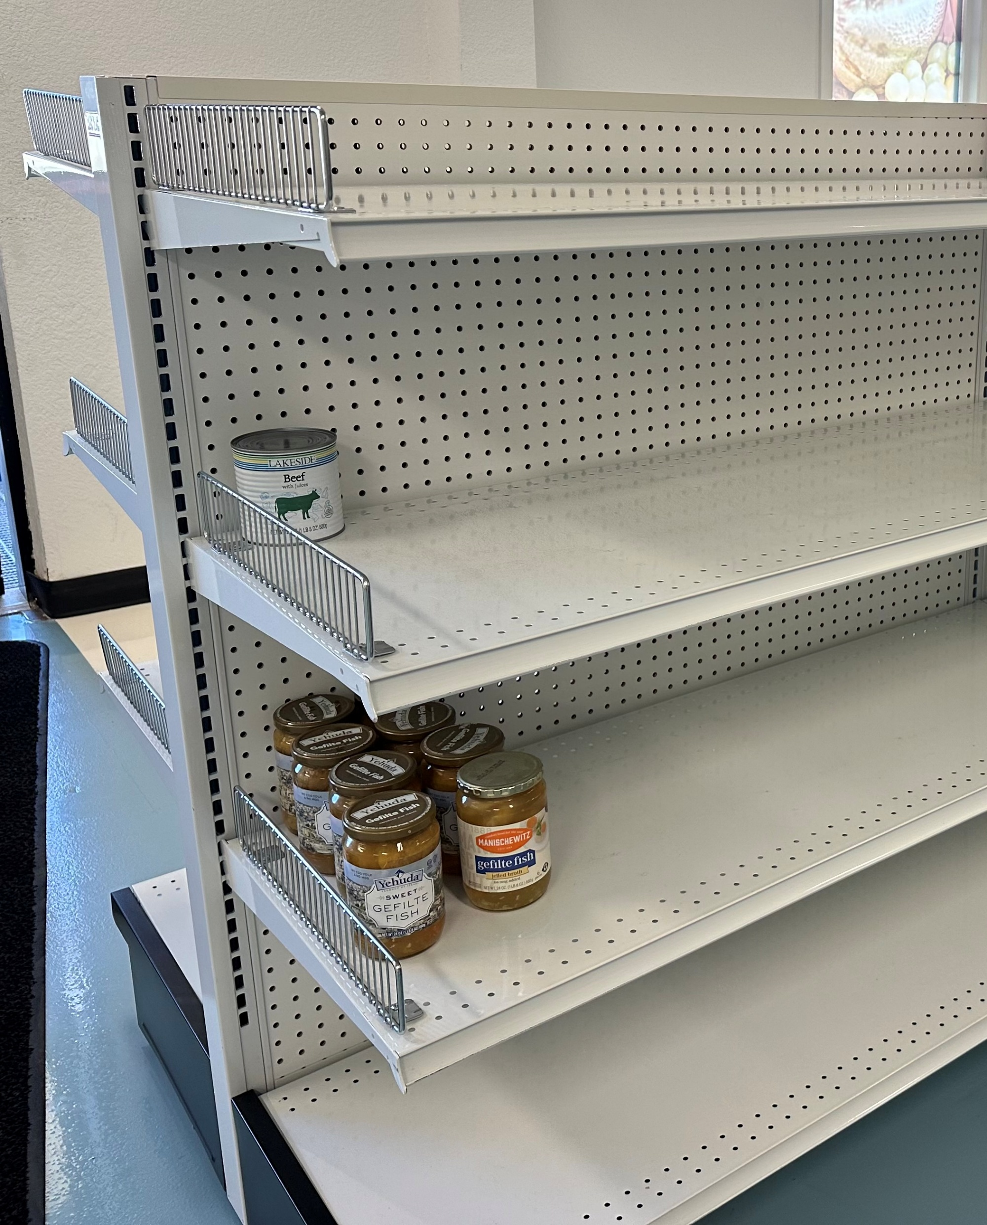


Slide 13
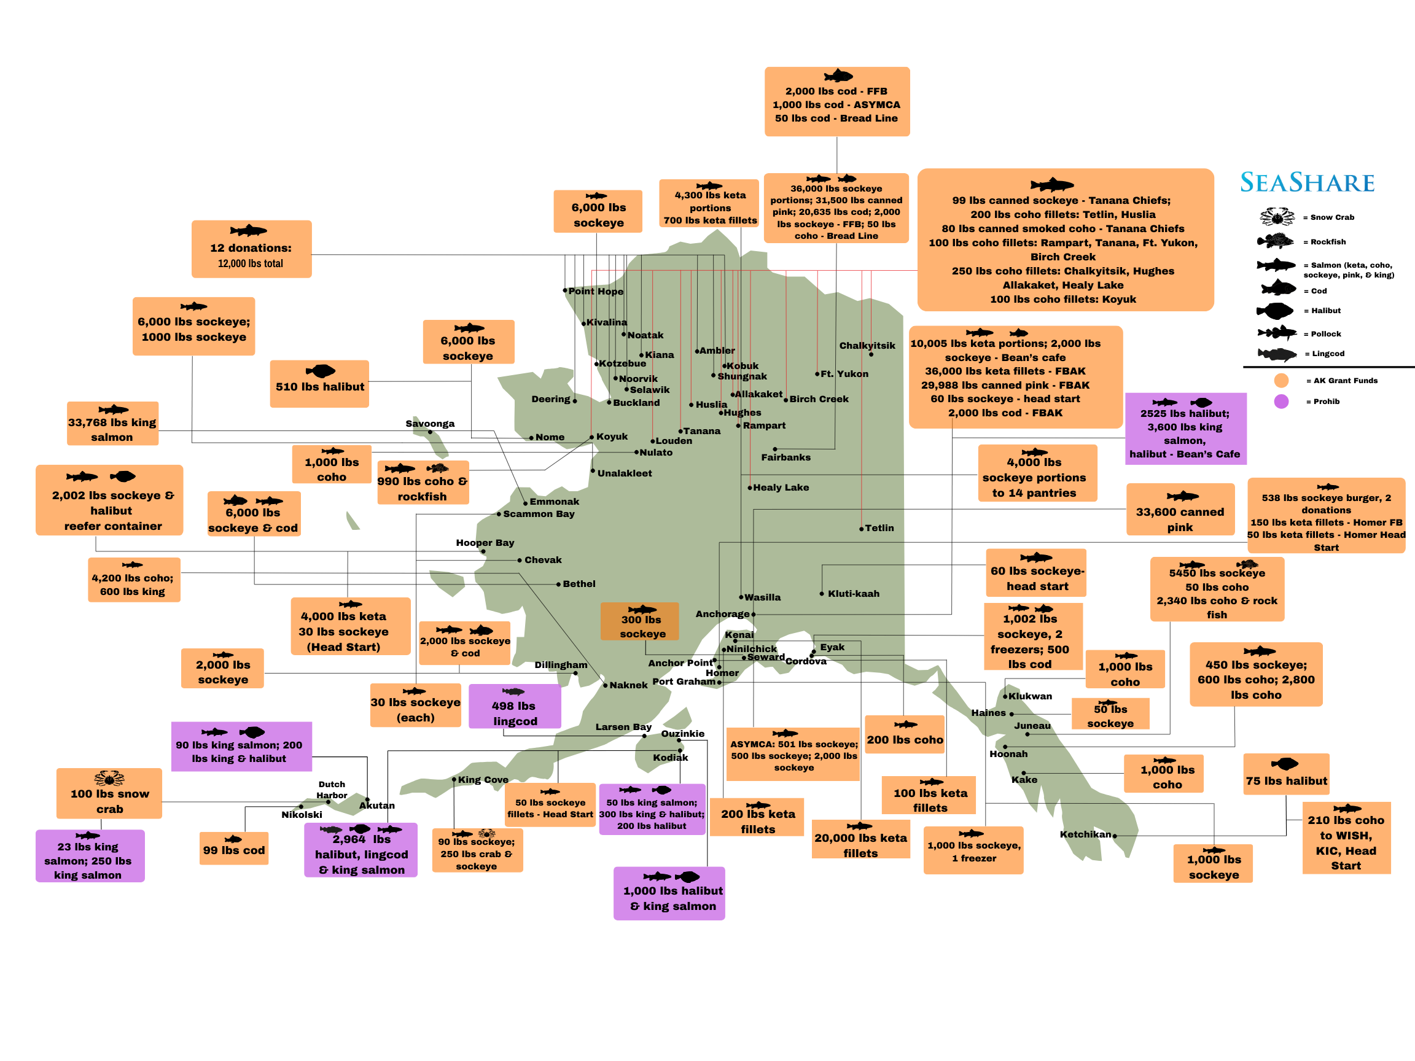

Slide 14
Objective 2 – Local food security
Improve food security throughout Alaska by facilitating energy-efficient freezer purchases for additional Alaskan communities
Create a broader network of food distribution and transportation partners throughout the state.

Slide 15
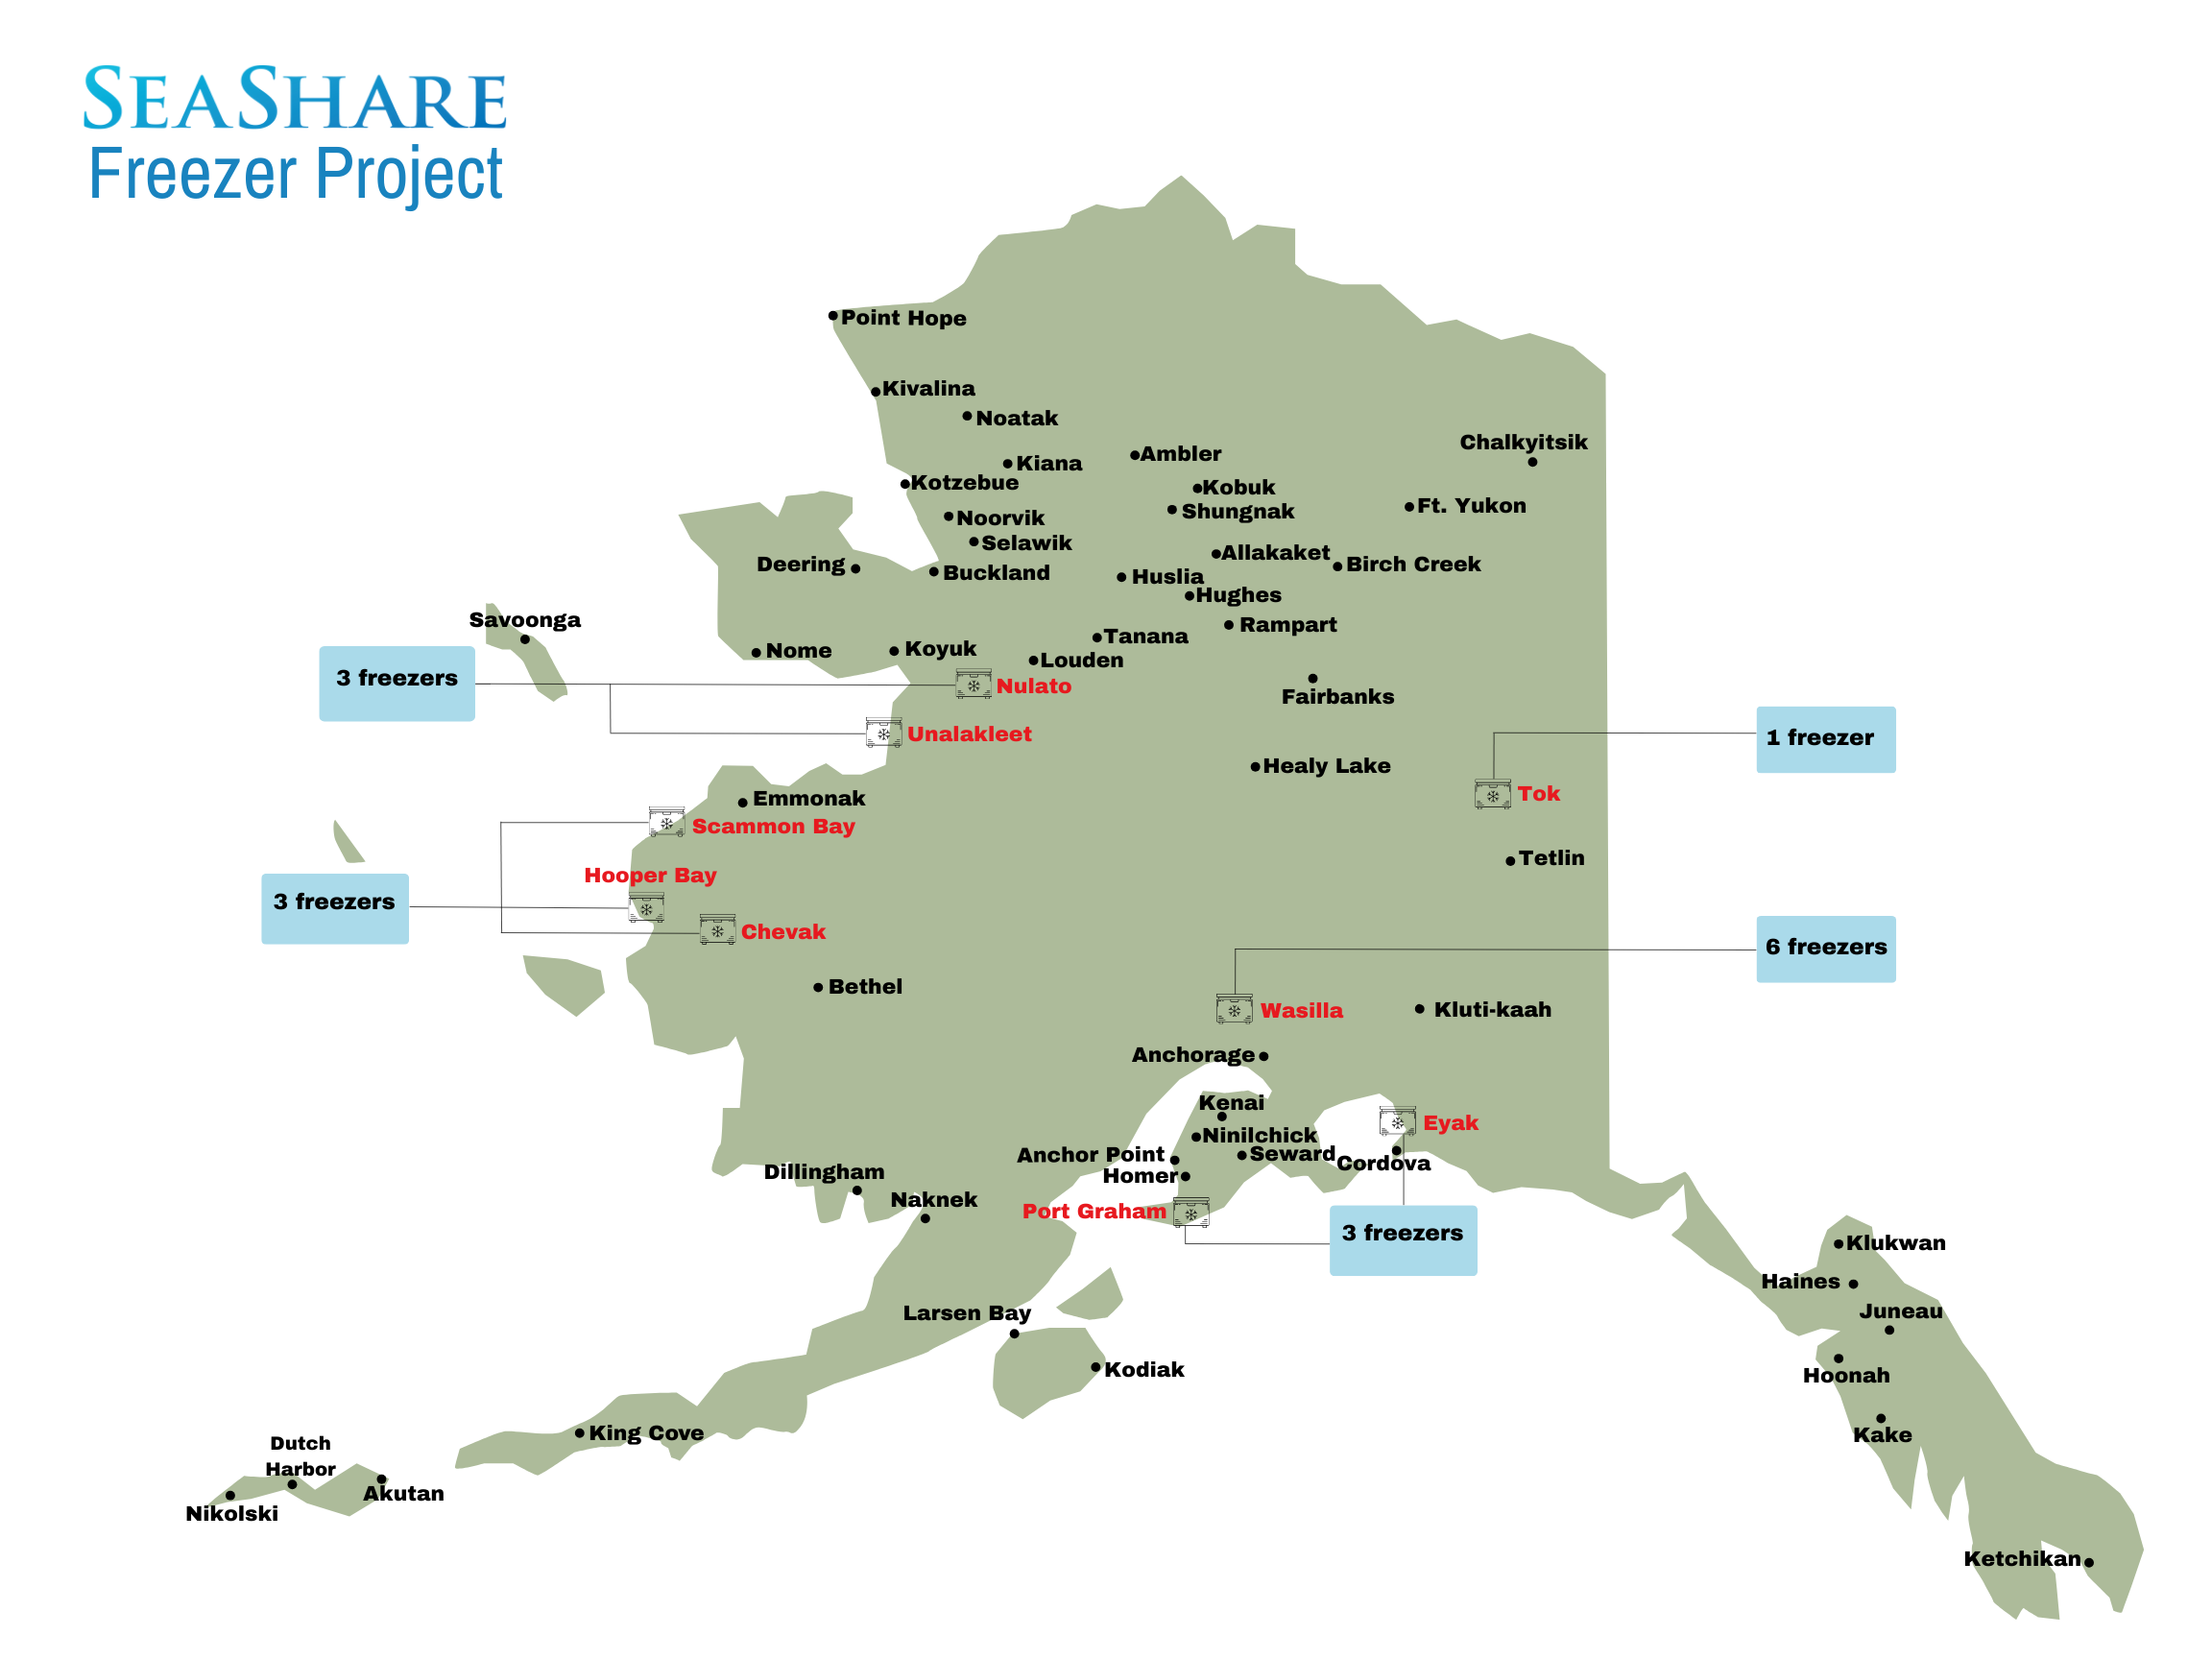
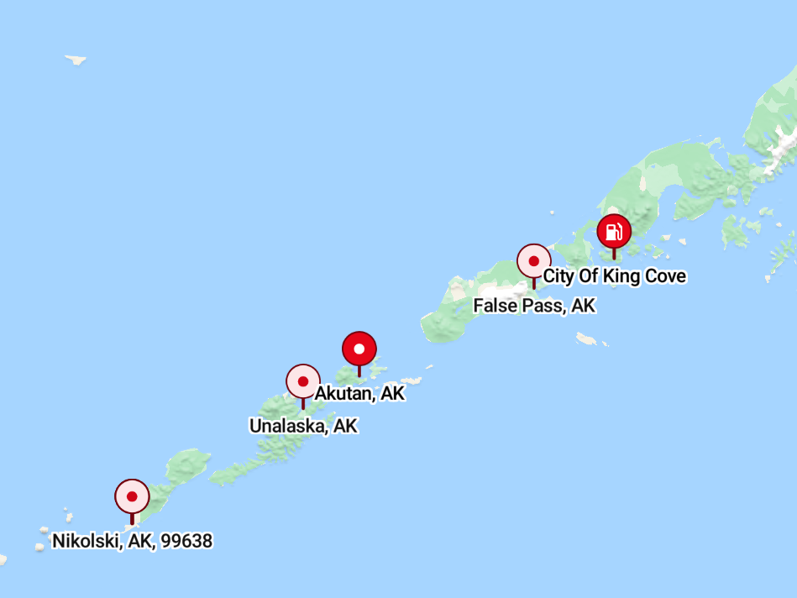

Slide 16
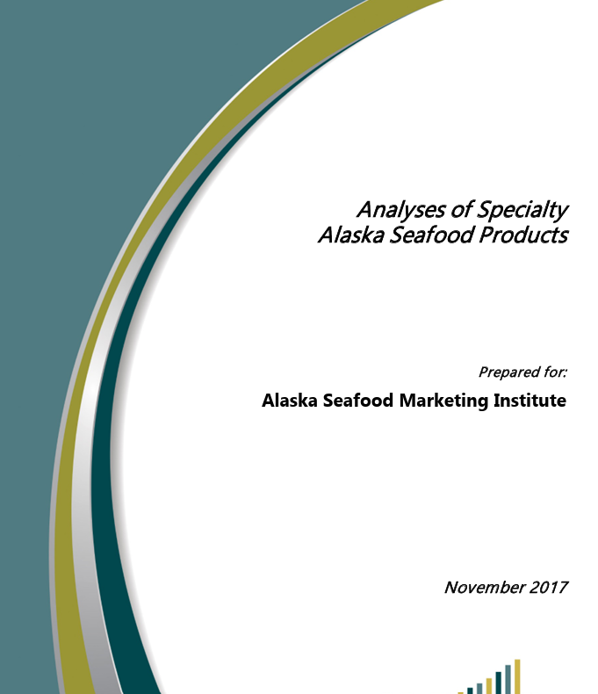
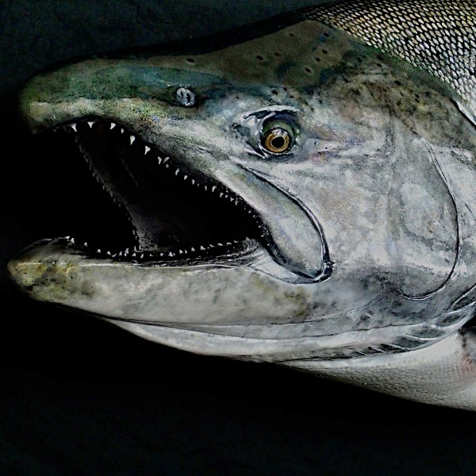
Objective 3
SeaShare will use funding to supply small Alaska processors with equipment that would allow for full utilization, such as processing trim meat into burgers, which would then provide a long-term source of inexpensive, healthy seafood items processed and distributed within Alaska.
This will enhance access to affordable, quality food within Alaska, adding to the long-term food security of the state. SeaShare has successfully partnered in this manner in the past with Alaska seafood producers.
$850,000 allocated

Slide 17
Questions?

