Slide 1

Food Banking 101

Slide 2
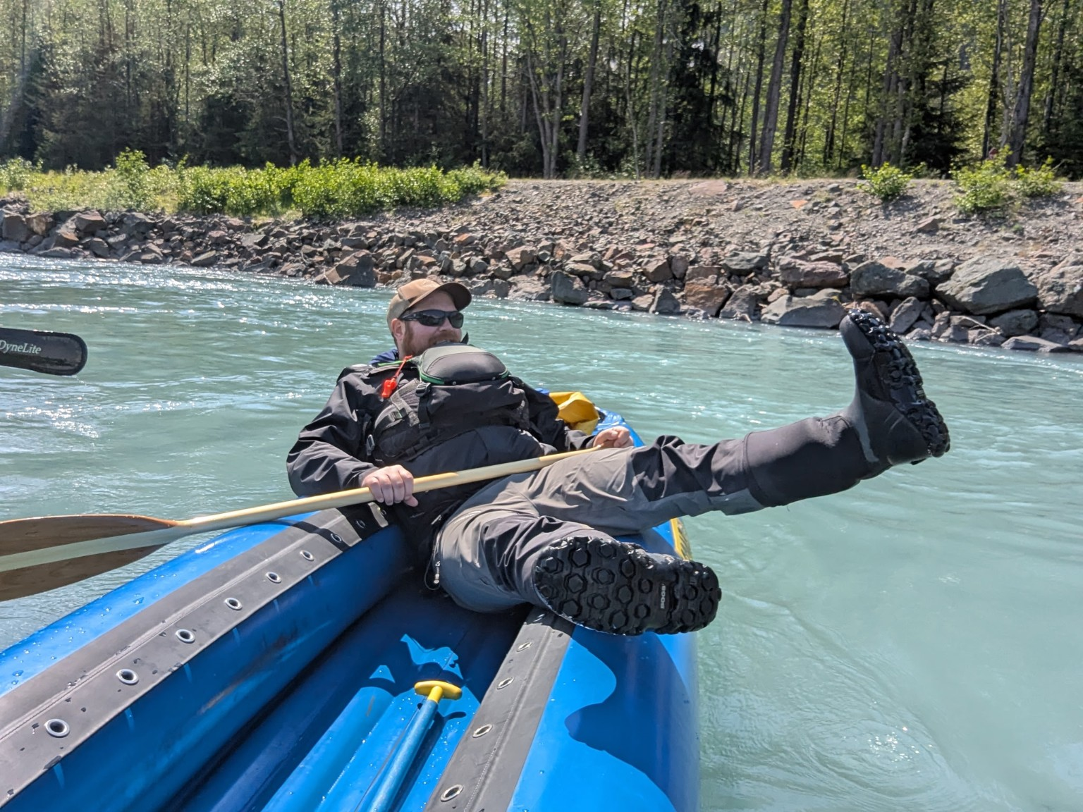
Introductions
Anthony Reinert
Food Bank of Alaska- 5 years
  Chief Program Officer
  Director of Programs
  SNAP Outreach Manager

Slide 3
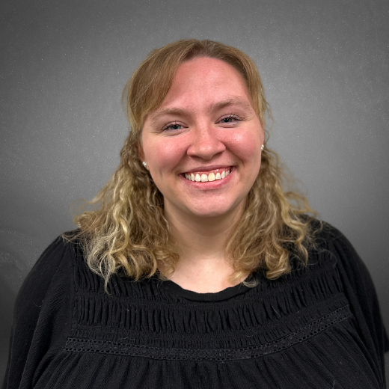
Introductions
Rebecca Guyer
Food Bank of Alaska- 6 years
  Director of Programs
  Partner Services Manager
  Lead Program Coordinator
  Program Coordinator: TEFAP

Slide 4
Food Banking 101: Goals
Create a shared understanding
Introduce Food Bank of Alaska
Orient to the broader network

Slide 5
Who We serve
Neighbors

Slide 6
Why We serve
No one deserves to be hungry
Hunger affects everyone

Slide 7
Key Players
Feeding America
Food Bank of Alaska (FBA)
Affiliate Food Bank
Reginal Distribution Organization (RDO)
Distribution Partner
State Partners
Advocates

Slide 8
Feeding America
National Network
Food Safety
Accountability
Corporate Relationships
National Advocacy

Slide 9
What is a Food Bank?
Food Sourcing
Food Distribution
Agency Relations
Fundraising
Communication
Advocacy

Slide 10
Sourcing Food
Grocery Recovery
Donations
Federal Commodities
Purchased

Slide 11
Distributing Food
Food Service
Pantries
Residential Programs
Delivery
Mobile Food Pantries
Direct Service
Affiliates
RDO

Slide 12
FBA Programs
Donated Food Program
Mobile Food Program (MFP)
Cooperative Purchasing Program (CO-OP)
Weekend Backpack Program (WBP)
Grant Programs
Thanksgiving Blessing
Emergency Response

Slide 13
FBA Federal Programs
The Emergency Food Assistance Program (TEFAP)
The Commodity Supplemental Food Program (CSFP)
Senior Farmers Market Nutrition Program (SFMNP)
Summer Food Service Program (SFSP)
Meals To You Alaska (MTYA)
Child & Adult Care Food Program (CACFP)
Food Distribution Program on Indian Reservations (FDPIR)

Slide 14
Policy & Advocacy
SNAP Outreach- Supplemental Nutrition Assistance Program
AFC- Alaska Food Coalition
Root Cause Work
Food Systems Work

Slide 15

Questions
Inquiries
Queries
Items for clarification
Points of curiosity
Follow-ups
Thoughts
Wonderings
Things on your mind
What’s unclear
Anything you’re curious about
Reflections
Explorations
Feedback
Reactions
Observations

