Slide 1
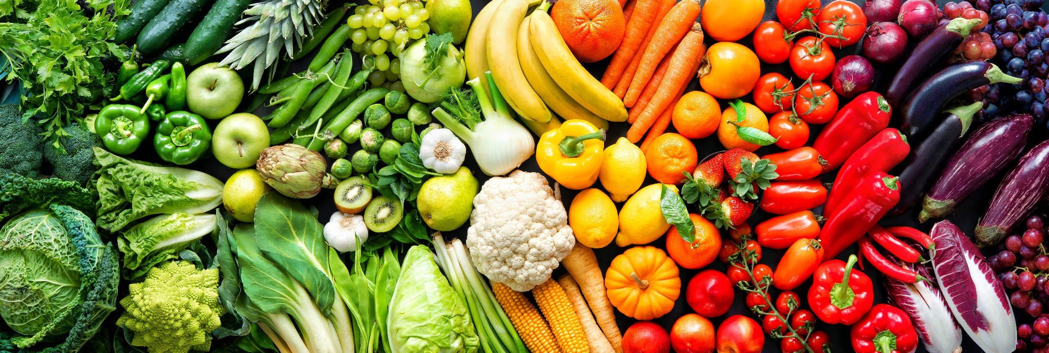
Alaska Anti-Hunger Network Conference ~ Produce Prescriptions, Nutrition Incentives and Food is Medicine ~ September 17, 2025
Karol Fink, MS RDN
Dietitian, Alaska Department of Health, Physical Activity and Nutrition Unit (PAN)

Slide 2

Physical Activity and Nutrition Unit Alaska Dept of Health, Section of Chronic Disease Prevention and Health Promotion
One of our goals:
With financial support from the Centers for Disease Control and Prevention
Support new or enhance existing nutrition incentive and produce prescription programs

Slide 3
Alaska Dept of Health contracts with the Food Bank of Alaska to:
Coordinate and advance local and statewide nutrition incentive, produce prescription and Food is Medicine initiatives.
Convene a coalition. Conduct landscape assessment. Provide consultation, training, technical assistance and resources. Create and implement a 5-year strategic plan. Support a pilot project.
Funding: CDC State Physical Activity and Nutrition (SPAN) funds

Slide 4
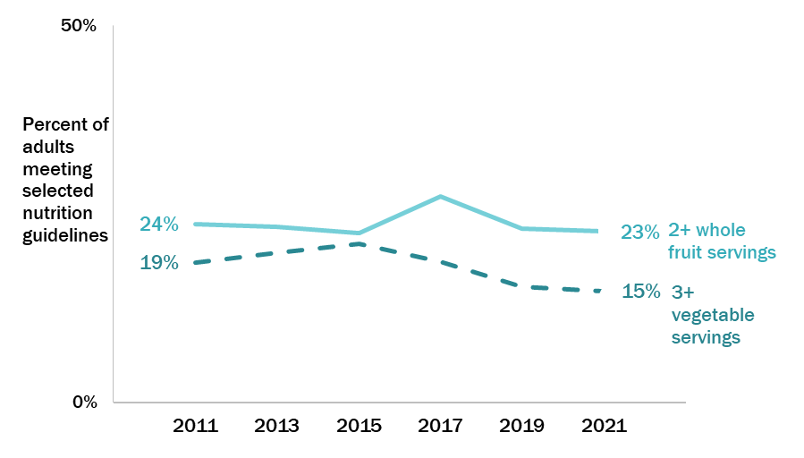
Few Alaskans eat the recommended amounts of fruits and veggies
Source: Alaska BRFSS
Notes:
Fewer than one in 10 Alaska adults (8%) consume both the recommended daily servings of fruit (2 a day) and vegetables (3 a day) in 2021.
There are no significant differences in meeting vegetable consumption guidelines by race/ethnicity groups or income status. Those with higher household income level are more likely to meet fruit consumption guidelines than those with a household income at or below 185% of the poverty guideline(29% vs 23%).
Women (17%) are more likely than men (13%) to eat the recommended average daily 3 or more servings of vegetables (data not shown). Women (29%) are more likely than men (25%) to get the recommended average daily 2 or more servings of fruit (data not shown).
Adults in Southwest Alaska (8%) are significantly less likely to eat 3 or more vegetable servings daily than adults in any other region except Northern Alaska (11%); other regions ranged from 14-16% (data not shown).
There are no significant differences in meeting fruit consumption guidelines by region (data not shown).

Slide 5
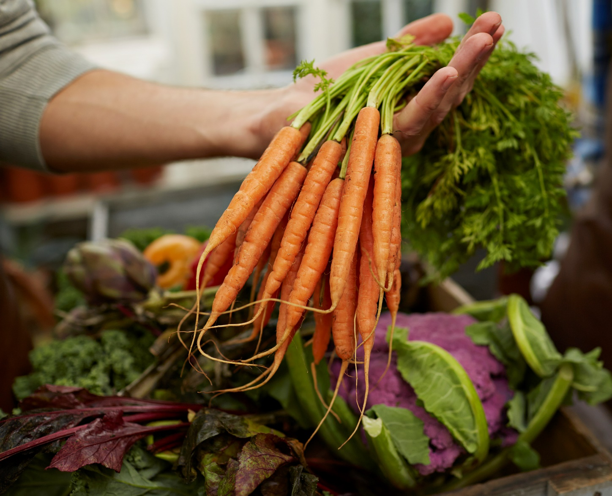
Many Alaskan adults have diet-related health conditions
69% have overweight or obesity
31% have high blood pressure
27% have high cholesterol
8% have diabetes
5% have heart disease^
15% of all Alaskans experience food insecurity, 18% of children*
*https://map.feedingamerica.org/county/2023/overall/alaska
^Alaska Chronic Disease Facts: 2024 Brief Report. Alaska Department of Health. October 2024.

Slide 6
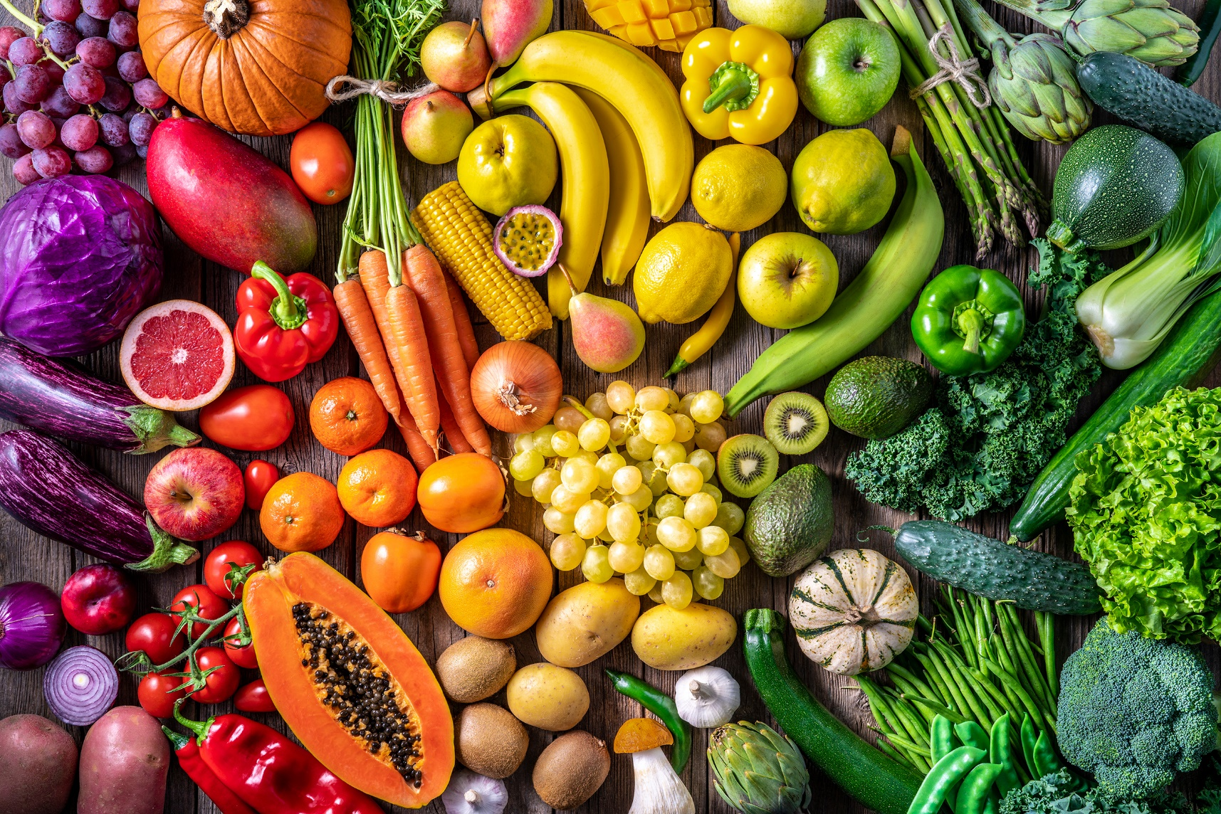
Fruits and vegetables are good for health
Protective against:
Weight gain
Stroke
Type 2 diabetes
Heart disease
Cancer

Slide 7
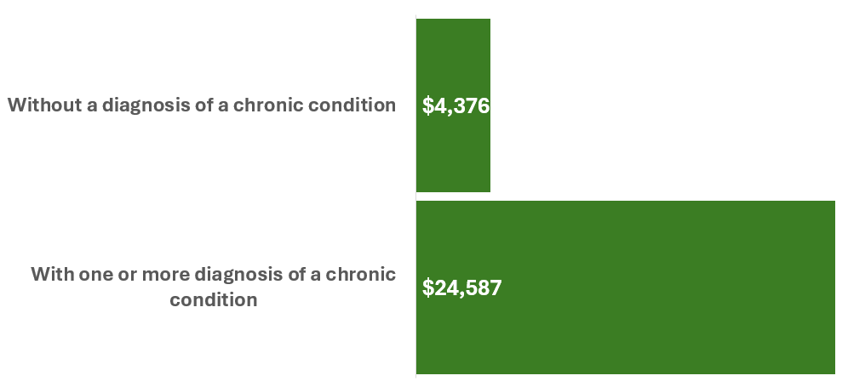
Alaska Medicaid Annual Cost is 6X more with a chronic condition
Source: Long-Term Forecast of Medicaid Enrollment and Spending in Alaska: SFY2024-2044, Alaska State Fiscal Year 2023

Slide 8
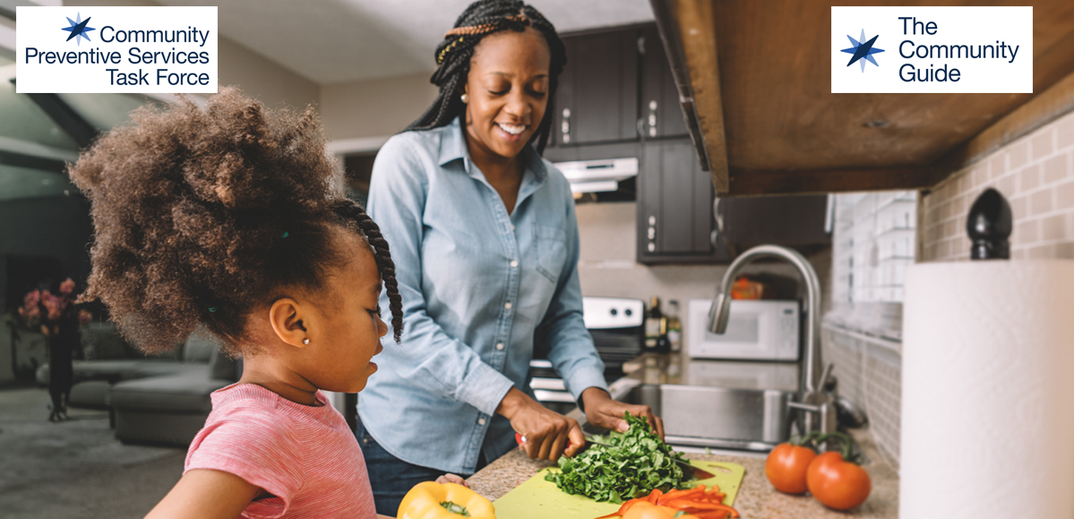
Fruits and veggies incentives and prescriptions
Increase fruit and vegetable consumption
Reduce food insecurity
Notes:
About the Community Preventive Services Task Force
The Community Preventive Services Task Force (CPSTF) works to improve the health of communities by issuing evidence-based recommendations and findings on public health interventions designed to improve health and safety.
Who We Are
The U.S. Department of Health and Human Services (DHHS) established CPSTF in 1996 to develop guidance on which community-based health promotion and disease prevention intervention approaches work and which do not work, based on available scientific evidence.
CPSTF is an independent, nonfederal panel of 15 public health and prevention experts who represent a broad range of scientific, practice, and policy expertise in community prevention services, public health, health promotion, and disease prevention. Members are appointed by the director of the Centers for Disease Control and Prevention (CDC). CDC’s Community Guide Program provides administrative, scientific, and technical support for the CPSTF.

Slide 9

Senior and WIC Farmers Market
Run by Alaska Division of Public Assistance in 2025
Low-income seniors and WIC $45 to spend on fruits and veggies
Complete application then use the Healthy Together app for payment
~60 farmers
~40 sale locations
13 communities
Funded by USDA and Alaska Farmers Market Association
Senior Agency list: https://health.alaska.gov/media/ckyj4c5q/2025-senior-agency-list.pdf
Farmer's list: https://health.alaska.gov/media/fcpcwt3y/2025-authorized-farmers.pdf
Notes:
8.6.25. We are thrilled to announce that we have successfully rolled out eFMNP statewide. We have been diligent in ensuring that the post-rollout phase has also been a success. We collaborated closely with Healthy Together to address any bugs and issues that arose. I am pleased to report that in week three, our helpdesk has experienced a significant reduction in tickets related to eFMNP. We are thankful to the agencies and farmers, as their contributions were crucial to this achievement. The feedback, real-time communication, and rapid responses from our vendor have brought us to this point. We are confident that our eFMNP will enhance participation among both applicants and farmers, and that its ease of use will soon become second nature..
WIC FMNP site location link: https://health.alaska.gov/en/services/farmers-market/
List of farms, farm stands, farms that authorized to accept WIC Farmer’s Market Nutrition program benefits
https://health.alaska.gov/en/services/farmers-market/
https://health.alaska.gov/media/ckyj4c5q/2025-senior-agency-list.pdf
Of the $45, is $30 still from USDA and $15 from the AFMA?
Indeed, you are right; our partner, the Alaska Farmers Market Association, is covering the extra $15 per participant this year, while the remaining $30 is provided by the USDA.
I realize it just launched for July 22, but are you able to share any numbers of enrollees or any feedback?
In the second week, we were thrilled to receive a report from a farmer indicating 85% error-free transactions, which was a significant improvement compared to week one.
Do you have any flyers or announcements; images you can share with me?
Authorized Farmers’/Farmstands
https://health.alaska.gov/media/fcpcwt3y/2025-authorized-farmers.pdf
Senior Agency list
https://health.alaska.gov/media/ckyj4c5q/2025-senior-agency-list.pdf
Guides for participants (Senior and WIC)
https://health.alaska.gov/media/yailqjzo/steps-to-access-your-electronic-senior-farmers-market-electronic-food-benefits.pdf
https://health.alaska.gov/media/cbxh1p3s/steps-to-access-your-wic-electronic-benefits.pdf
Currently we do not have flyers; however, we do offer guides on our website to help participants understand how to access their benefits.
https://health.alaska.gov/media/cbxh1p3s/steps-to-access-your-wic-electronic-benefits.pdf
Anchorage,
Eagle River,
Fairbanks,
Delta Junction,
Homer,
Kenai,
Palmer,
Wasilla,
Willow,
Soldotna,
Kodiak,
Juneau and
Sitka.
A’isha Jackson
Phone: 907-465-3100
Cell: 907-419-4164
Project Assistant | FMNP & SFMNP Coordinator

Slide 10
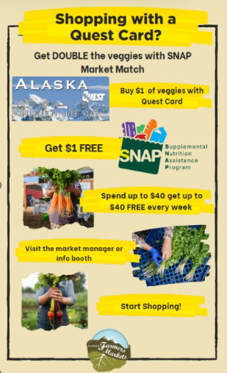
Example of a Match Program
Run by Alaska Farmer's Market Association
SNAP recipients
Up to $40 match every week
Show SNAP card and ID
Paper coupons/tokens to spend at farmers markets
5 locations (Homer, Mat-Su, Fairbanks, Anchorage)
Funded by legislative appropriation
Notes:
Double Your SNAP Dollars at Farmers Markets – 2025 updated info
If you shop with SNAP (formerly food stamps), you can double your buying power at participating farmers markets all season long. Here’s how it works:
Spend up to $40 with your Quest Card. Get up to $40 more in free fruits and vegetables. Repeat every week
That means $40 turns into $80 in fresh, local produce grown by Alaska farmers. Just stop by the info booth or market manager table when you arrive, and they’ll walk you through it. Participating markets include:
For a full list of markets, visit alaskafarmersmarkets.org
DOUBLE SNAP AT
THESE MARKETS
Grow North Farm Market|
Thursday 4-7PM
3601 Mountain View Dr, AnchorageJune 26th- September 25th.
Matanuska Community Farmers Market|Wednesday 4-7pm
713 S Denali St PalmerJune 11th - September 24th
Homer Farmers Market|Wednesday 2-5pm & Saturday 10-3PM
1155 Ocean Drive, HomerMay 24th - September 27th
Tanana Valley Farmers Market|Wednesday 11-4pm & Saturday 9-4PM
South Side Community Farmers Market|Tuesday 4-6:30pm
720 25th Ave Fairbanks June 10th-September 30th(weather permitting)

Slide 11
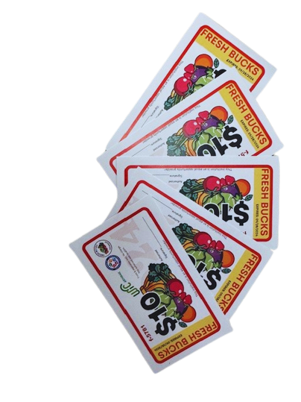



Fresh Bucks Nutrition Incentive Program
Anchorage Muni run program
WIC and SNAP recipients
Show ID and get $30 of paper coupon every week
Buy fruits and veggies at
Muldoon Farmers Market
Grow North Farm
Funded by alcohol tax fund
Notes:
Confirmed in 2025

Slide 12

Produce Prescription
Involves the health care system
Many chronic conditions can be managed through nutrition
Good nutrition will:
reduce healthcare costs
readmission
improve treatment responses
Reduce recovery times.
Food is Medicine includes Produce Prescription, Medically Tailored Groceries and Medically Tailored Meals
2020–2030 Strategic Plan for National Institute of Health Nutrition Research A Report of the NIH Nutrition Research Task Force ttps://dpcpsi.nih.gov/sites/default/files/2020NutritionStrategicPlan_508.pdf

Slide 13
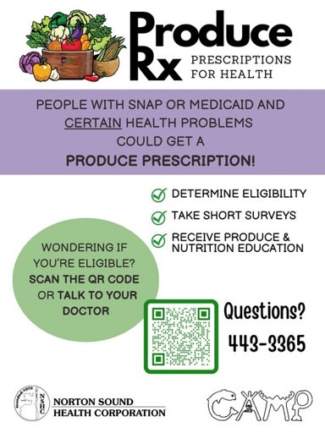
Example of Produce Prescription Program
Norton Sound Health Corporation
Health care provider
SNAP or Medicaid and certain health issue
Weekly produce box delivered
USDA Nutrition Incentive Program Grant
Notes:
GusNIPP funded program

Slide 14

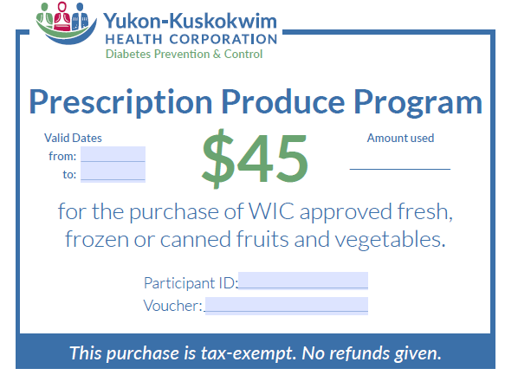
Example of Produce Prescription Program
Qualifying diagnosis:
Food insecurity, older than 18
Patient can select either:
$45 voucher or
produce box delivery
USDA Nutrition Incentive Grant

Slide 15
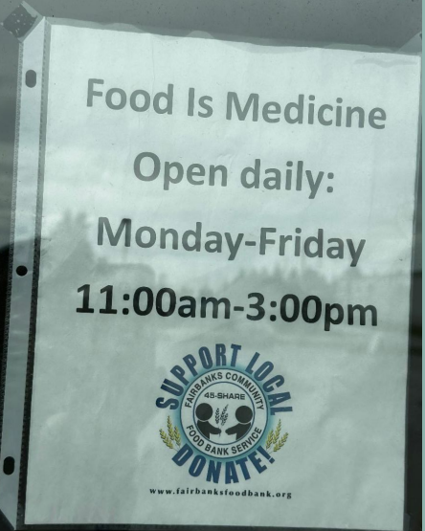
Example of Prescription Program
2025
Run by Food Bank
Must be medically referred into the program.
Up to 30 pounds of fresh produce each week
Funded by donations
https://fairbanksfoodbank.org/programs/food-is-medicine/
Notes:
Donation funded program

Slide 16
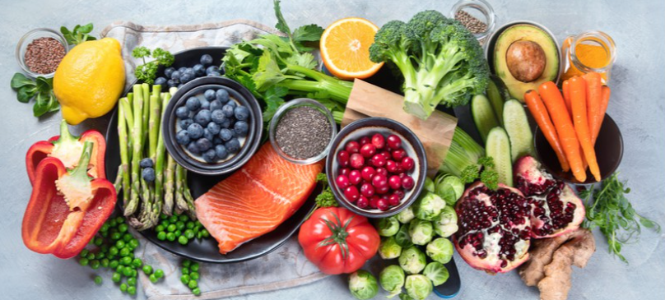
Produce Prescriptions
Produce Prescriptions address diet-related chronic conditions for specific individuals in a health care setting.
Food is Medicine, which includes Produce Prescription, includes medically tailored groceries and medically tailored meals.

Slide 17
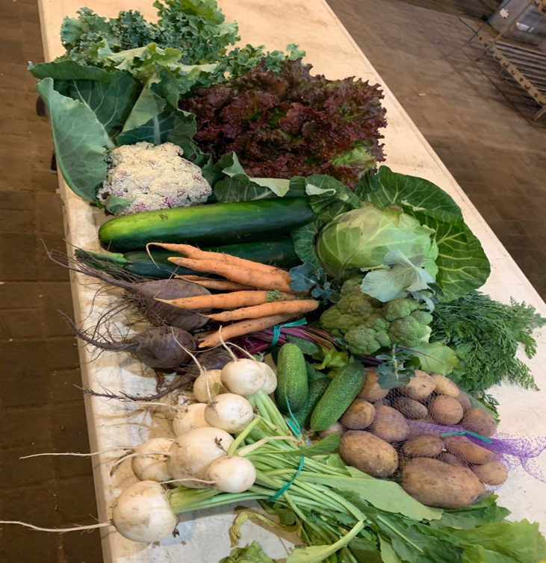
Since CDC SPAN funds can’t buy produce, how do we fund these new and enhanced programs?
State legislative appropriation
Alcohol taxes fund
Tribal Health Organizations, Health Care providers, Health Care agencies
Corporate contribution – e.g. grocery store
Foundations
Non-profits, Food Banks and Pantries
Federal USDA
Gus Shumacher Nutrition Incentive Program (GUSNIP) Grant aka Food Insecurity Nutrition Incentives (FINI) Program
Federal Centers for Disease Control and Prevention (CDC)
disease specific funding – e.g. Diabetes Prevention, Comprehensive Cancer
Federal Medicaid
1115 Waiver

Slide 18
Medicaid Section 1115 waiver
As of May 2024,
23 states have 1115 waivers or proposals that include nutrition services
14 of those include direct provision of food.
Potential funding opportunity the Food is Medicine coalition will be learning more about.
Notes:
As of May 2024, 23 states have 1115 waivers or proposals that include coverage for nutrition services (e.g., screening for food insecurity, nutrition education, and/or provision of food) and 14 of those include coverage of the direct provision of food.

Slide 19
Karol Fink, MS RDN
Dietitian
Alaska Department of Health
Physical Activity and Nutrition Unit (PAN)
Karol Fink, MS RDN
Karol.Fink@alaska.gov
907.269.8447

Slide 20
Contact info:
Karol will stop presentation here

Slide 21
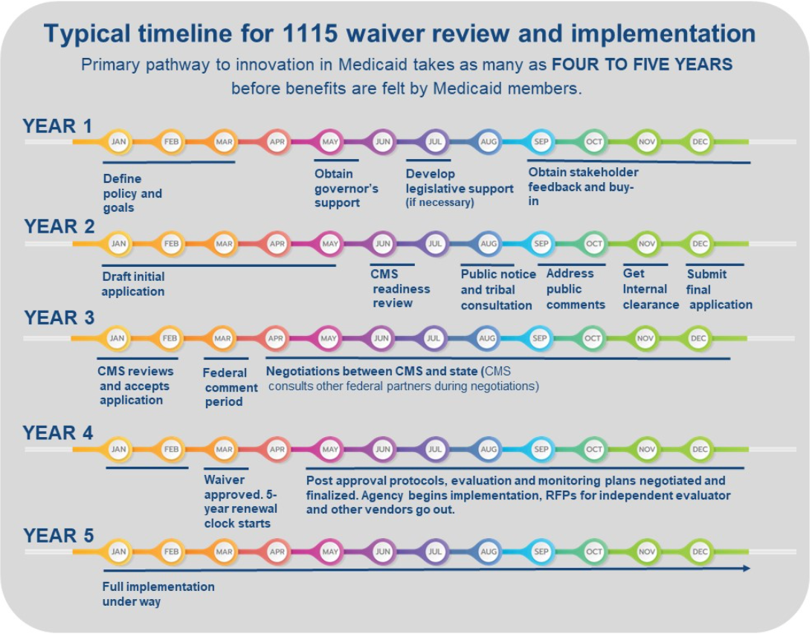
Alaska is here
https://medicaiddirectors.org/resource/how-1115-waivers-work/

Slide 22
Medicaid Section 1115 waiver
1115 authorizes the Centers for Medicare & Medicaid Services (CMS) to approve experimental, pilot, or demonstration projects.
As of May 2024,
23 states have 1115 waivers or proposals that include nutrition services
14 of those include direct provision of food.
Notes:
As of May 2024, 23 states have 1115 waivers or proposals that include coverage for nutrition services (e.g., screening for food insecurity, nutrition education, and/or provision of food) and 14 of those include coverage of the direct provision of food.

Slide 23
1115 waiver is not sufficient to meet the needs of Alaska
We don’t yet know the eligible population
Not everyone has a health care provider
Many recipients live in remote places where implementation will be challenging
Some don’t want government involvement in their lives
Short duration, not long-term solution
Generally, its only a 6-month prescription with one renewal
Implementation in Alaska will be challenging due to transportation logistics and costs.

Slide 24
Examples of Terminology
Nutrition
Incentives*
Food is Medicine (involves health care system)
*Nutrition Incentive is a subsidy (monetary award, match, discount, rebate, subsidy, voucher) that reduces the price of healthy foods, making fruits and vegetables more affordable.

Slide 25
Examples of Terminology
Nutrition
Incentives*
Food is Medicine (involves health care system)
Fruit and Vegetables/ Produce Incentives
*Nutrition Incentive is a subsidy (monetary award, match, discount, rebate, subsidy, voucher) that make fruits and vegetables more affordable.

Slide 26
Examples of Terminology
Nutrition
Incentives*
Food is Medicine (involves health care system)
Fruit and Vegetables/ Produce Incentives
Fruit and Vegetable/ Produce Prescription
Medically Tailored Groceries​
Medically Tailored Meals​
*Nutrition Incentive is a subsidy (monetary award, match, discount, rebate, subsidy, voucher) that make fruits and vegetables more affordable.

Slide 27
Examples of Terminology
Nutrition
Incentives*
Food is Medicine (involves health care system)
Fruit and Vegetables/ Produce Incentives
Matches (e.g., money tied to the dollar amount spent)​
Fruit and Vegetable/ Produce Prescription
Fresh produce prescription​
Point-of-sale discounts (e.g., percentage off regular price)​
Rebates (e.g., cash back for future purchases)​
Subsidies (e.g., a fixed amount of money for purchase)​
Vouchers for certain dollar amount
F&V (produce) bags​
F&V (produce) boxes​
F&V (produce) prescription​
F&V (produce) shopping (x pounds)​
Produce prescription
Medically Tailored Groceries​
Grocery provision​
Healthy food boxes​
Healthy food pack ​
Medically Tailored Food Boxes​
Medically Tailored Food Packages​
Nutritionally appropriate food boxes​
Pantry stocking​
Protein boxes​
Short term grocery provision​
Medically tailored food prescription
Medically Tailored Meals​
Clinically appropriate meals ​
Healthy home delivered meals​
Home delivered meals​
Medically tailored home delivered meals​
Nutritionally appropriate home delivered meals​
*Nutrition Incentive is a subsidy (monetary award, match, discount, rebate, subsidy, voucher) that reduces the price of healthy foods, making fruits and vegetables more affordable.

Slide 28
Goal is to have all types of programs
Program
Example
Purpose
Population-healthy food policies
Farm Bill, Smart Snacks in Schools, etc.
Nutrition Security Programs
SNAP, WIC, School Meals, CACFP, etc.
Food and nutrition insecure people
Reach
Population
Improve public health
100% of US
Everyone living in US
Improve public health
Greater than 10%
Food banks, pantries meal services
Church pantry, food closet at UAA
Those not eligible for security programs
Increase food security
Unknown %
Nutrition Incentive
SNAP Double bucks, Fresh Bucks
Those eligible for security programs
Improve nutrition security
Unknown %
Food is Medicine
Medical criteria – cancer, heart disease, etc.
Unknown %
Produce prescription, Medically tailored meals
Promote healing and health
Notes:
Federal food and nutrition assistance programs in the US are largely designed to address food insecurity (that is, the household-level social or economic condition of limited access to sufficient food).​
In contrast, Food Is Medicine interventions are intended to address diet-related chronic conditions for specific individuals in a health care setting. ​
Food Is Medicine should work in tandem with food and nutrition assistance programs and population-level food policies to support a healthier population overall. ​

Slide 29
Goal is to have all types of programs
Program
Example
Purpose
Population-healthy food policies
Farm Bill, Smart Snacks in Schools, etc.
Nutrition Security Programs
SNAP, WIC, School Meals, CACFP, etc.
Food and nutrition insecure people
Reach
Population
Improve public health
100% of US
Everyone living in US
Improve public health
Greater than 10%
Food banks, pantries meal services
Church pantry, food closet at UAA
Those not eligible for security programs
Increase food security
Unknown %
Nutrition Incentive
SNAP Double bucks, Fresh Bucks
Those eligible for security programs
Improve nutrition security
Unknown %
Food is Medicine
Medical criteria – cancer, heart disease, etc.
Unknown %
Produce prescription, Medically tailored meals
Promote healing and health
Notes:
Federal food and nutrition assistanceprograms in the US are largely designedto address food insecurity (that is, thehousehold-level social or economiccondition of limited access to sufficientfood).​
In contrast, Food Is Medicineinterventions are intended to addressdiet-related chronic conditions for specificindividuals in a health care setting. ​
Food Is Medicine should work in tandemwith food and nutrition assistanceprograms and population-level foodpolicies to support a healthier populationoverall. ​

Slide 30
Goal is to have all types of programs
Program
Example
Purpose
Population-healthy food policies
Farm Bill, Smart Snacks in Schools, etc.
Nutrition Security Programs
SNAP, WIC, School Meals, CACFP, etc.
Food and nutrition insecure people
Reach
Population
Improve public health
100% of US
Everyone living in US
Improve public health
Greater than 10%
Food banks, pantries meal services
Church pantry, food closet at UAA
Those not eligible for security programs
Increase food security
Unknown %
Nutrition Incentive
SNAP Double bucks, Fresh Bucks
Those eligible for security programs
Improve nutrition security
Unknown %
Food is Medicine
Medical criteria – cancer, heart disease, etc.
Unknown %
Produce prescription, Medically tailored meals
Promote healing and health
Notes:
Federal food and nutrition assistanceprograms in the US are largely designedto address food insecurity (that is, thehousehold-level social or economiccondition of limited access to sufficientfood).​
In contrast, Food Is Medicineinterventions are intended to addressdiet-related chronic conditions for specificindividuals in a health care setting. ​
Food Is Medicine should work in tandemwith food and nutrition assistanceprograms and population-level foodpolicies to support a healthier populationoverall. ​

Slide 31
Goal is to have all types of programs
Program
Example
Purpose
Population-healthy food policies
Farm Bill, Smart Snacks in Schools, etc.
Nutrition Security Programs
SNAP, WIC, School Meals, CACFP, etc.
Food and nutrition insecure people
Reach
Population
Improve public health
100% of US
Everyone living in US
Improve public health
Greater than 10%
Food banks, pantries meal services
Church pantry, food closet at UAA
Hungry people
Increase food security
Unknown %
Nutrition Incentive
SNAP Double bucks, Fresh Bucks
Those eligible for security programs
Improve nutrition security
Unknown %
Food is Medicine
Medical criteria – cancer, heart disease, etc.
Unknown %
Produce prescription, Medically tailored meals
Promote healing and health
Notes:
Federal food and nutrition assistanceprograms in the US are largely designedto address food insecurity (that is, thehousehold-level social or economiccondition of limited access to sufficientfood).​
In contrast, Food Is Medicineinterventions are intended to addressdiet-related chronic conditions for specificindividuals in a health care setting. ​
Food Is Medicine should work in tandemwith food and nutrition assistanceprograms and population-level foodpolicies to support a healthier populationoverall. ​

Slide 32
Goal is to have all types of programs
Program
Example
Purpose
Population-healthy food policies
Farm Bill, Smart Snacks in Schools, etc.
Nutrition Security Programs
SNAP, WIC, School Meals, CACFP, etc.
Food and nutrition insecure people
Reach
Population
Improve public health
100% of US
Everyone living in US
Improve public health
Greater than 10%
Food banks, pantries meal services
Church pantry, food closet at UAA
Hungry people
Unknown %
Nutrition Incentive
SNAP Double bucks, Fresh Bucks
Those eligible for security programs
Improve nutrition security
Unknown %
Food is Medicine
Medical criteria – cancer, heart disease, etc.
Unknown %
Produce prescription, Medically tailored meals
Reduce readmission, costs, improve treatment and recovery
Increase food security
Notes:
Federal food and nutrition assistanceprograms in the US are largely designedto address food insecurity (that is, thehousehold-level social or economiccondition of limited access to sufficientfood).​
In contrast, Food Is Medicineinterventions are intended to addressdiet-related chronic conditions for specificindividuals in a health care setting. ​
Food Is Medicine should work in tandemwith food and nutrition assistanceprograms and population-level foodpolicies to support a healthier populationoverall. ​

Slide 33
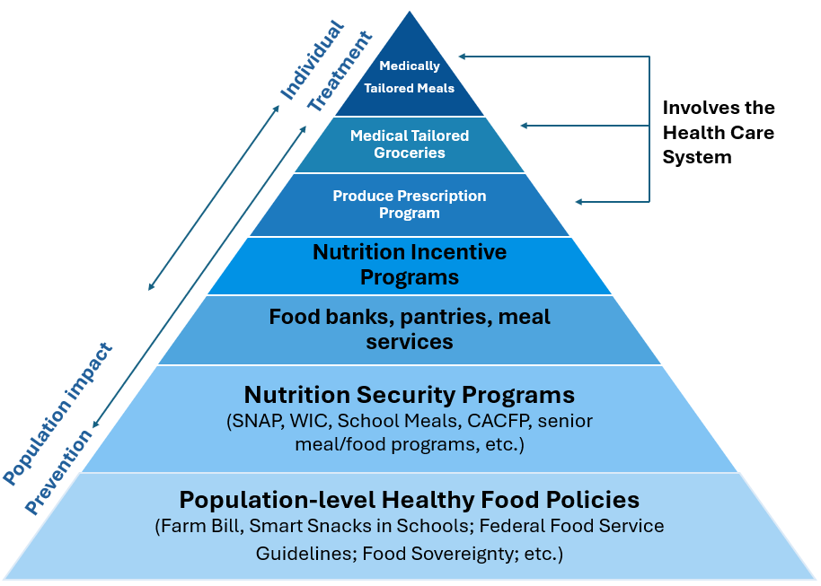


Goal is to have all types of programs
Focus on keeping the bottom layers of the pyramid strong and nutrition incentive and produce prescription programs.

Slide 34
Definition/terminology
Federal food and nutrition assistance programs in the US are largely designed to address food insecurity (that is, the household-level social or economic condition of limited access to sufficient food).
In contrast, Food Is Medicine interventions are intended to address diet-related chronic conditions for specific individuals in a health care setting.
Food Is Medicine should work in tandem with food and nutrition assistance programs and population-level food policies to support a healthier population overall.
Notes:
As of May 2024, 23 states have 1115 waivers or proposals that include coverage for nutrition services (e.g., screening for food insecurity, nutrition education, and/or provision of food) and 14 of those include coverage of the direct provision of food.

Slide 35
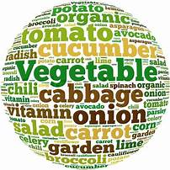
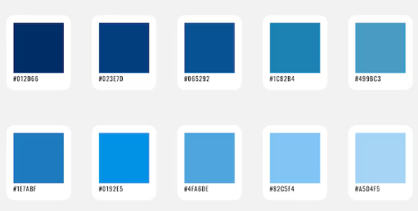
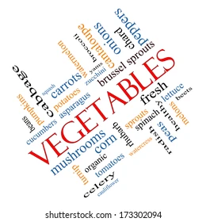
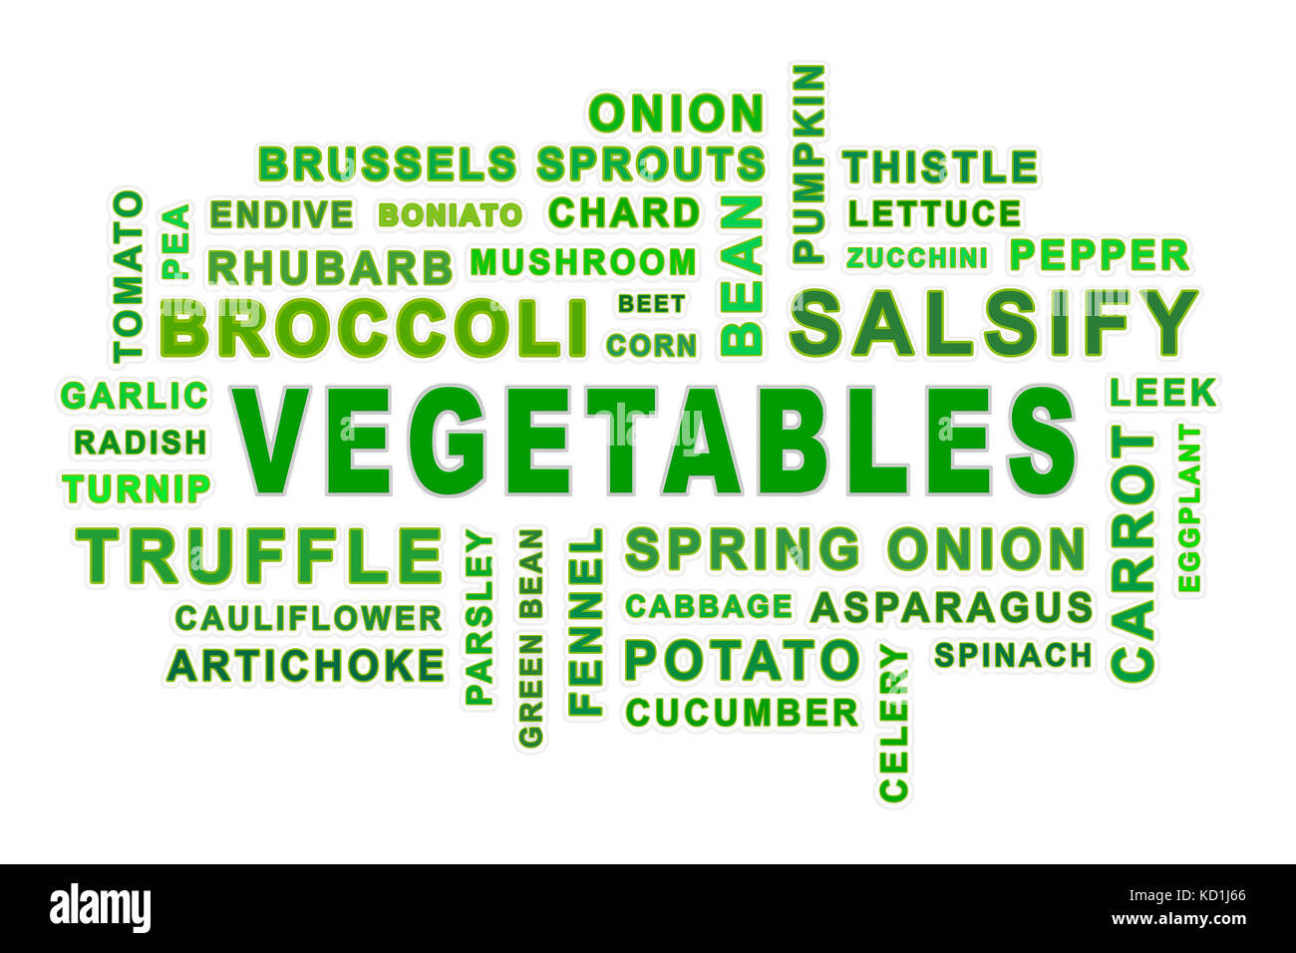
Calbri Heading bold, 44, left justified
Introduction
First
Second
Third
Introduction
First
Second
Third
https://odphp.health.gov/sites/default/files/2024-09/Food%20Is%20Medicine%20Landscape%20Summary%20FINAL%20508.pdf

Slide 36
Nutrition Incentives*
Food is Medicine (involves health care provider)
Fruit and Vegetable (F&V) / Produce
Nutrition Incentives* Prescriptions
Incentives
Medically Tailored Groceries
Medically Tailored Groceries continued
Medically Tailored Meals
Prescription
Medically Tailored Groceries
Matches (e.g., money tied to the dollar amount spent)
Fresh produce prescription
Grocery provision
Nutritionally appropriate food boxes
Clinically appropriate meals
F&V (produce) bags
Point-of-sale discounts (e.g., percentage off regular price)
Healthy food boxes
Pantry stocking
Healthy home delivered meals
F&V (produce) boxes
Healthy food pack
Protein boxes
Home delivered meals
Rebates (e.g., cash back for future purchases)
F&V (produce) prescription
Medically Tailored Food Boxes
Short term grocery provision
Medically tailored home delivered meals
Subsidies (e.g., a fixed amount of money for purchase)
F&V (produce) shopping (x pounds)
Medically Tailored Food Packages
Medically tailored food prescription
Nutritionally appropriate home delivered meals
Vouchers for certain dollar amount
Produce prescription
*Nutrition Incentive as a subsidy (monetary award, match, discount, rebate, subsidy, voucher) that reduces the price of healthy foods, making fruits and vegetables more affordable.

Slide 37
Population impact Individual
Prevention Treatment
Medically
Tailored Meals
Food is Medicine
Involves the Health Care System
Medical Tailored Groceries
Produce Prescription Program
Nutrition Incentive Programs
Food banks, pantries, meal services
Nutrition Security Programs (SNAP, WIC, School Meals, CACFP, senior meal/food programs, etc.)
Population-level Healthy Food Policies (Farm Bill, Smart Snacks in Schools; Federal Food Service Guidelines; Food Sovereignty; etc.)

Slide 38
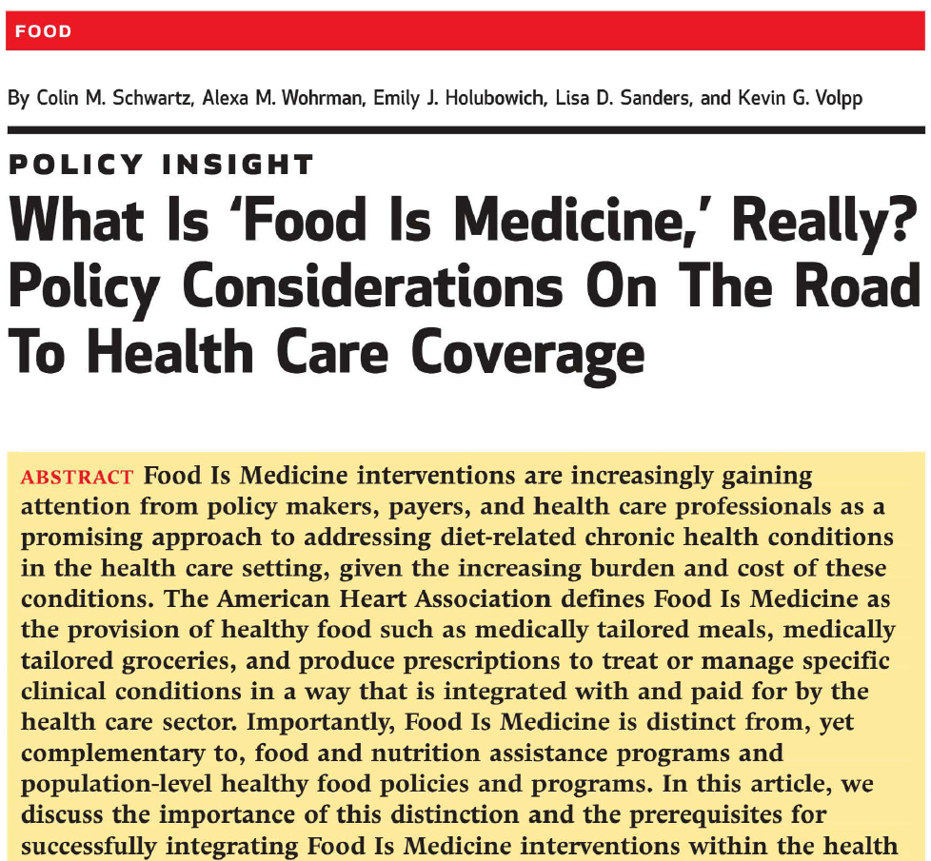
Differentiating Food Is Medicine from other US food and nutrition programs and policies
Complementing and not supplanting existing food and nutrition assistance programs
Need standard definition
produce prescriptions
medically tailored groceries
medically tailored meals
https://www.healthaffairs.org/doi/epdf/10.1377/hlthaff.2024.01343

Slide 39
Women Infant and Children (WIC) Nutrition Incentive Voucher Farmers Market
Run by Alaska Division of Public Assistance
WIC participants
$45 to spend on fruits and veggies
Complete application at local WIC
Use Healthy Together App to make payment
~60 farmers
~40 sale locations
13 communities
Funded by USDA and Alaska Farmers Market Association
Community list: https://health.alaska.gov/en/services/farmers-market/
Farmer's list: https://health.alaska.gov/media/fcpcwt3y/2025-authorized-farmers.pdf
Notes:
8.6.25. We are thrilled to announce that we have successfully rolled out eFMNP statewide. We have been diligent in ensuring that the post-rollout phase has also been a success. We collaborated closely with Healthy Together to address any bugs and issues that arose. I am pleased to report that in week three, our helpdesk has experienced a significant reduction in tickets related to eFMNP. We are thankful to the agencies and farmers, as their contributions were crucial to this achievement. The feedback, real-time communication, and rapid responses from our vendor have brought us to this point. We are confident that our eFMNP will enhance participation among both applicants and farmers, and that its ease of use will soon become second nature..
WIC FMNP site location link: https://health.alaska.gov/en/services/farmers-market/
List of farms, farm stands, farms that authorized to accept WIC Farmer’s Market Nutrition program benefits
https://health.alaska.gov/en/services/farmers-market/
https://health.alaska.gov/media/ckyj4c5q/2025-senior-agency-list.pdf
Of the $45, is $30 still from USDA and $15 from the AFMA?
Indeed, you are right; our partner, the Alaska Farmers Market Association, is covering the extra $15 per participant this year, while the remaining $30 is provided by the USDA.
I realize it just launched for July 22, but are you able to share any numbers of enrollees or any feedback?
In the second week, we were thrilled to receive a report from a farmer indicating 85% error-free transactions, which was a significant improvement compared to week one.
Do you have any flyers or announcements; images you can share with me?
Authorized Farmers’/Farmstands
https://health.alaska.gov/media/fcpcwt3y/2025-authorized-farmers.pdf
Senior Agency list
https://health.alaska.gov/media/ckyj4c5q/2025-senior-agency-list.pdf
Guides for participants (Senior and WIC)
https://health.alaska.gov/media/yailqjzo/steps-to-access-your-electronic-senior-farmers-market-electronic-food-benefits.pdf
https://health.alaska.gov/media/cbxh1p3s/steps-to-access-your-wic-electronic-benefits.pdf
Currently we do not have flyers; however, we do offer guides on our website to help participants understand how to access their benefits.
https://health.alaska.gov/media/cbxh1p3s/steps-to-access-your-wic-electronic-benefits.pdf
Anchorage,
Eagle River,
Fairbanks,
Delta Junction,
Homer,
Kenai,
Palmer,
Wasilla,
Willow,
Soldotna,
Kodiak,
Juneau and
Sitka.
A’isha Jackson
Phone: 907-465-3100
Cell: 907-419-4164
Project Assistant | FMNP & SFMNP Coordinator

Slide 40

Example of Incentive Rebate Program Not available in 2025
Run by Carrs
SNAP recipients
Up to $20 match every check-out
Receipt coupon can be used next visit
Funded by ?
Notes:
Point of purchase example.

Slide 41
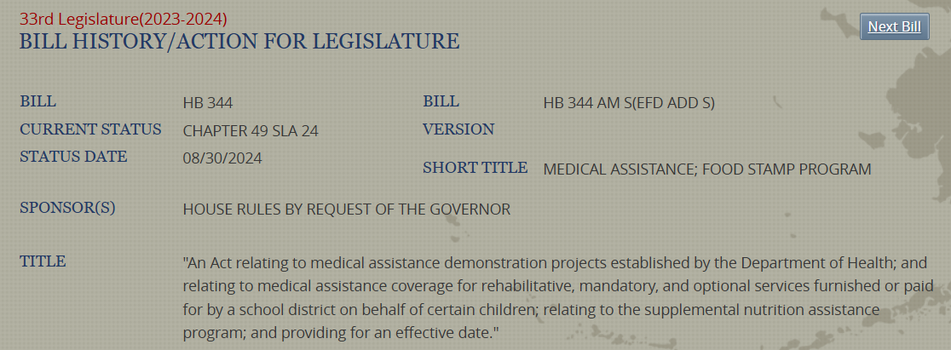
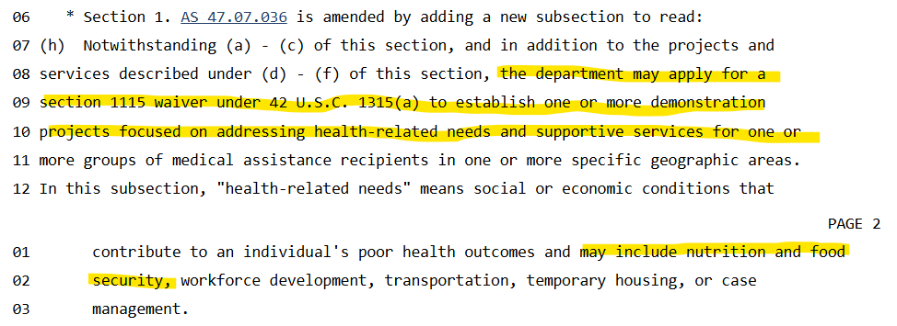
33rd Alaska State Legislature: HB344
Became law October of 2024
https://www.akleg.gov/basis/Bill/Text/33?Hsid=HB0344Z

