Slide 1



WELCOME

Slide 2


MEALS TO YOU ALASKA

Slide 3
MEALS TO YOU ALASKA
1 MILLION MEALS!

Slide 4
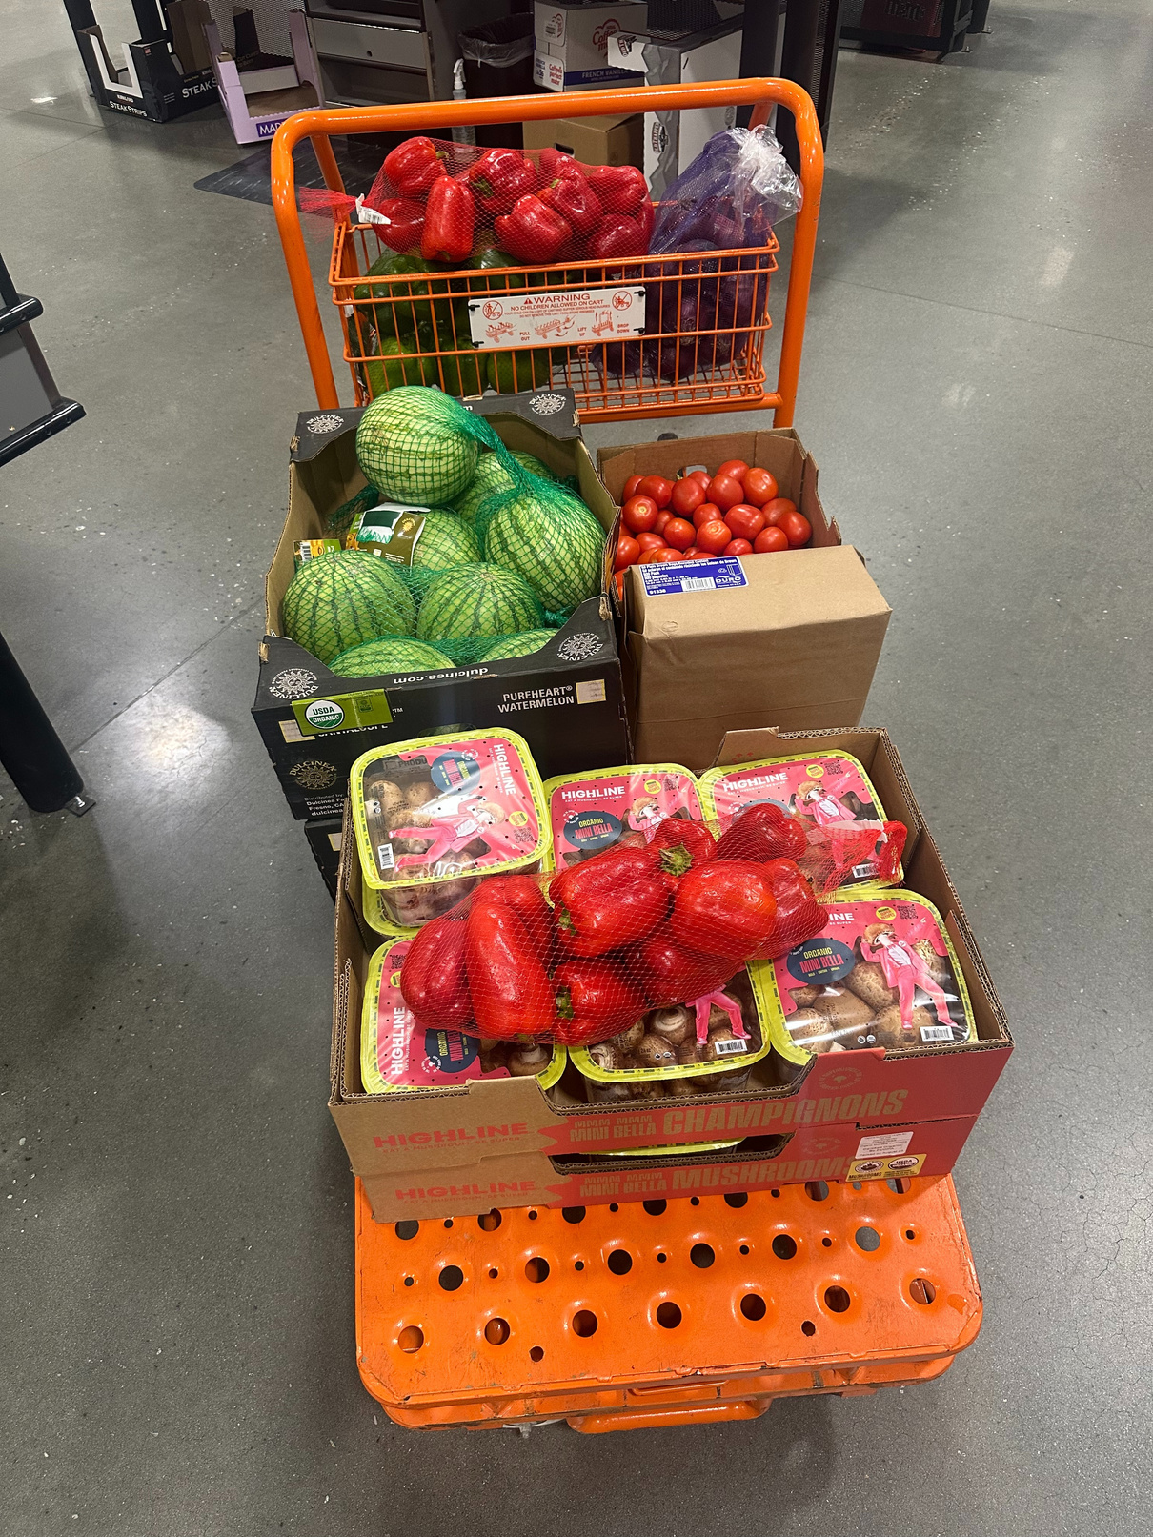

FOOD IS MEDICINE

Slide 5
FOOD IS MEDICINE
Launched!

Slide 6
NETWORK INFRASTRUCTURE UPGRADES

Slide 7
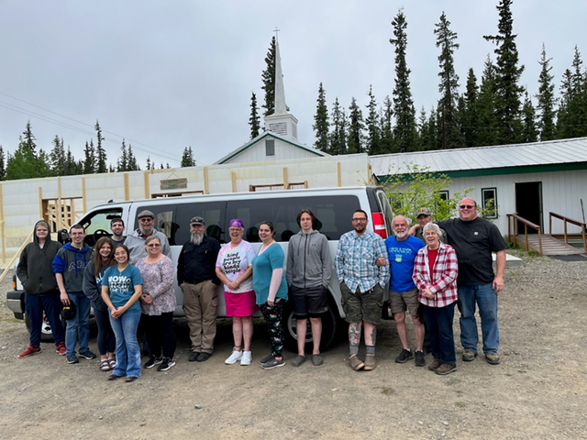
NETWORK INFRASTRUCTURE UPGRADES

Slide 8
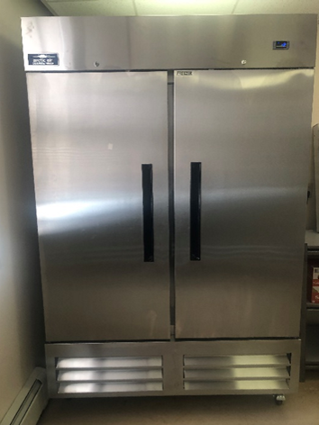
NETWORK INFRASTRUCTURE UPGRADES

Slide 9
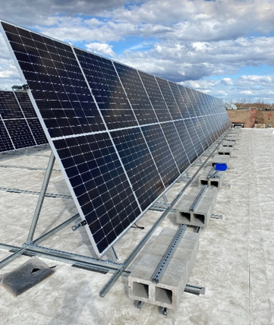
NETWORK INFRASTRUCTURE UPGRADES

Slide 10
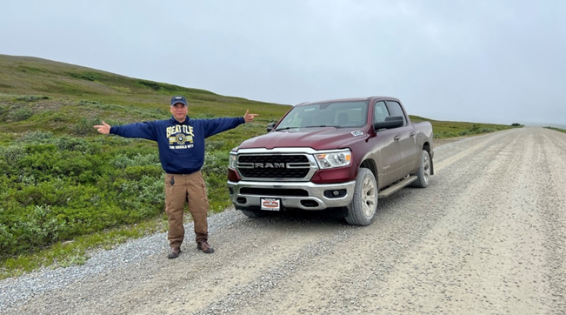
NETWORK INFRASTRUCTURE UPGRADES

Slide 11
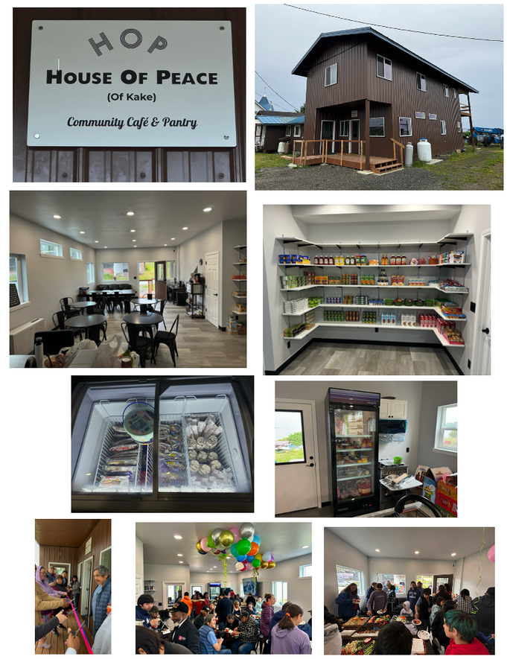
NETWORK INFRASTRUCTURE UPGRADES

Slide 12
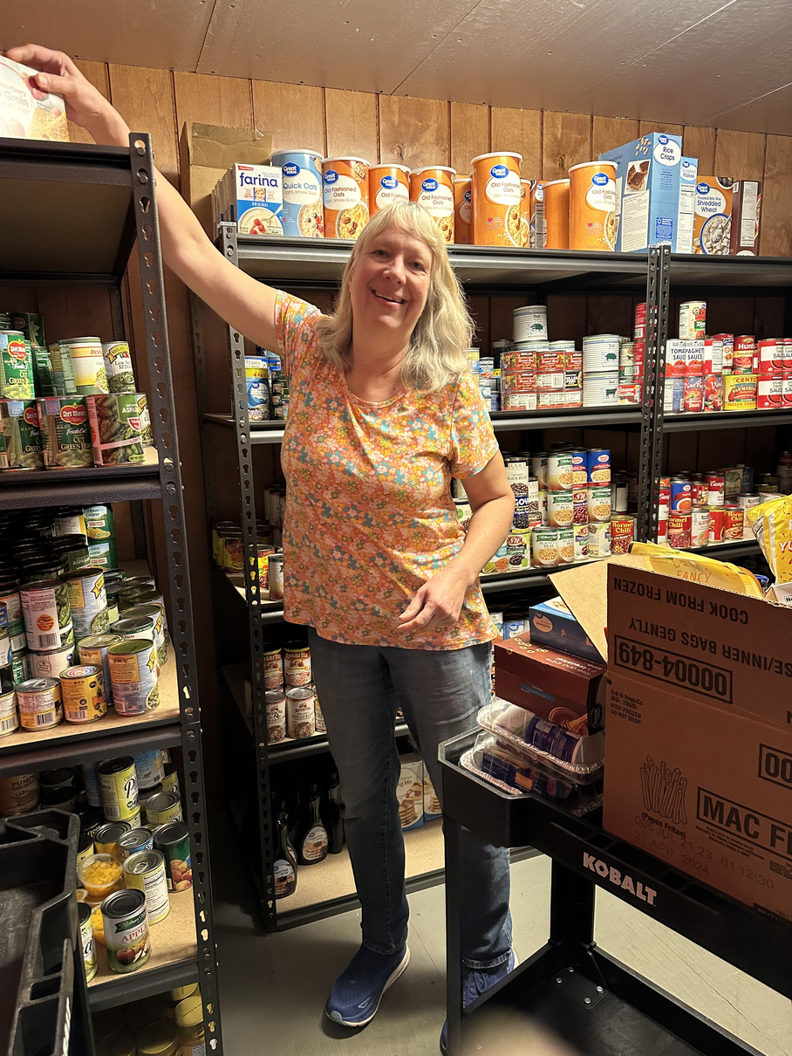
NETWORK INFRASTRUCTURE UPGRADES
and more!

Slide 13
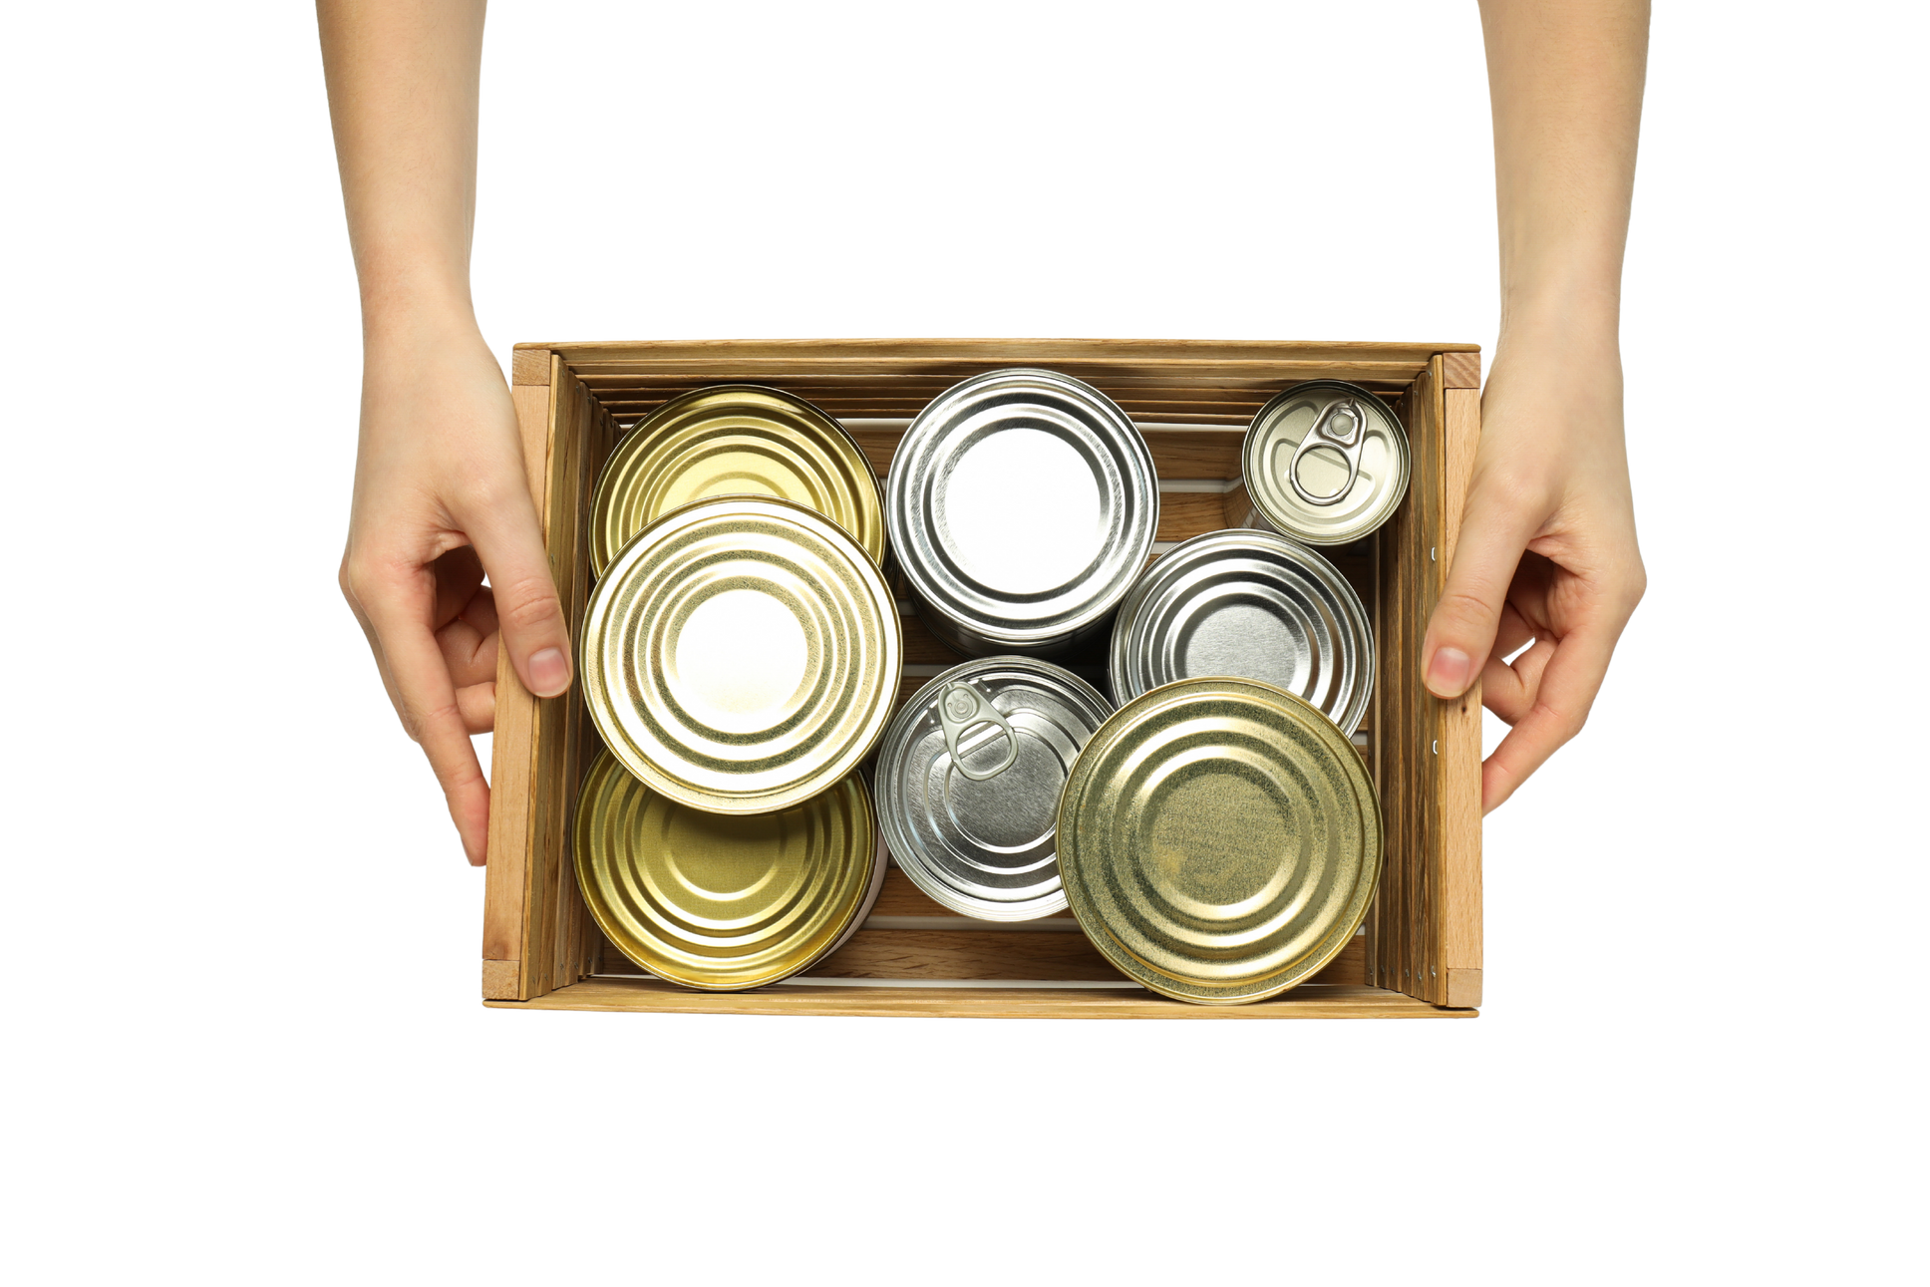

FOOD PANTRY RELIEF FUND

Slide 14
FOOD PANTRY RELIEF FUND
1 MILLION POUNDS!

Slide 15

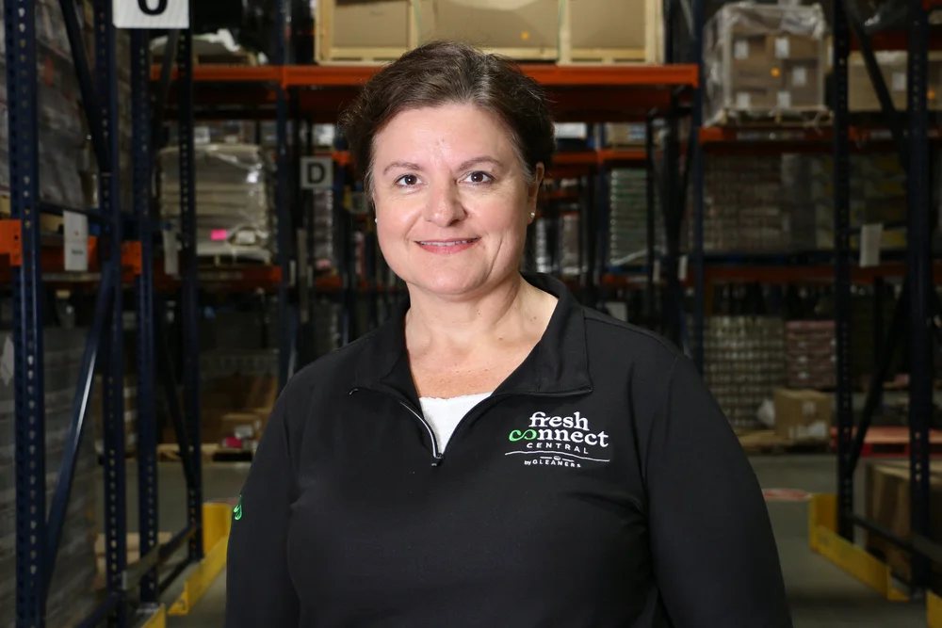
Sam Schwoeppe
DIRECTOR OF BUSINESS PARTNERSHIPS
FRESH CONNECT CENTRAL

Slide 16
Fresh Connect Central Indianapolis, Indidana

Slide 17
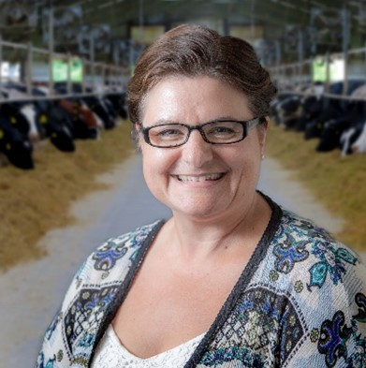
Sam Schwoeppe
Director, Business Partnerships
Fresh Connect Central by
Gleaners Food Bank
Food Bank of Alaska Conference, September 17, 2025

Slide 18
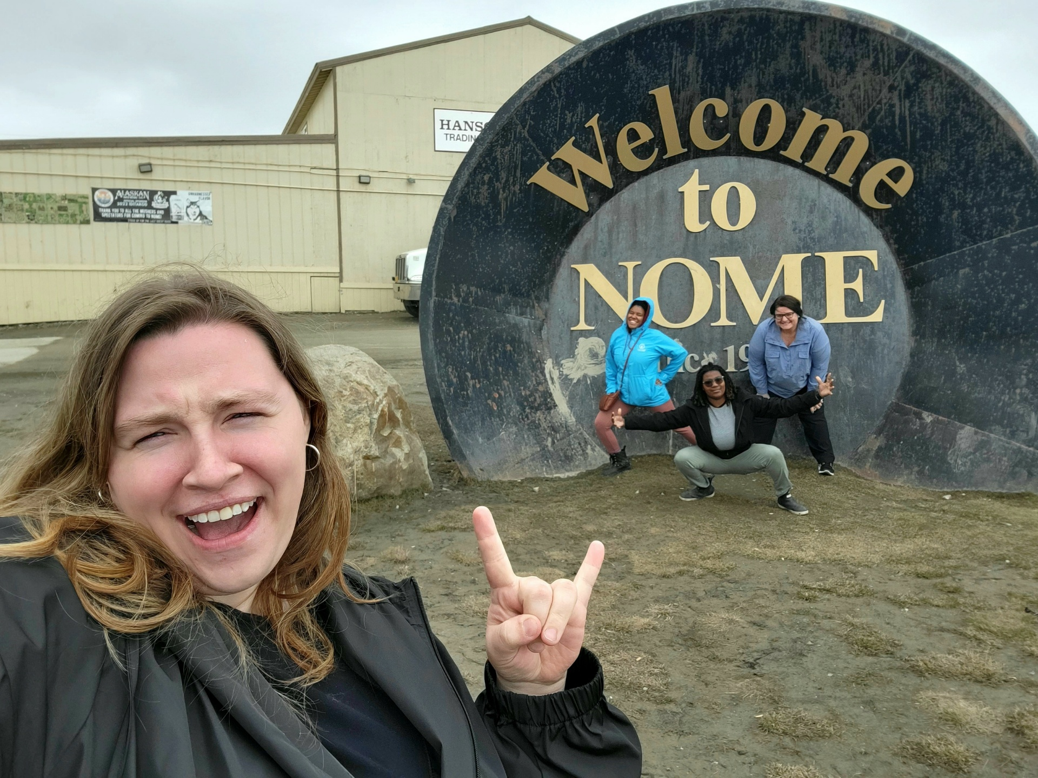

Slide 19
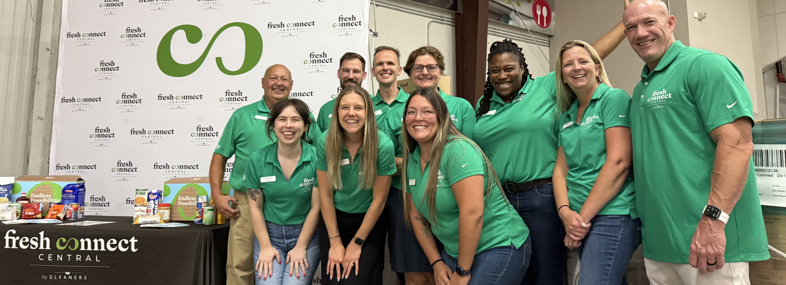
Our Team

Slide 20
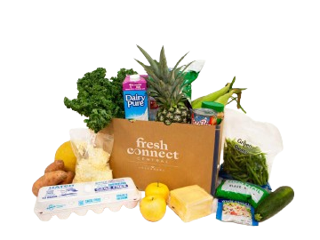
What is Fresh Connect Central and what do we do?
A social enterprise of Gleaners Food Bank of IN
Wholesale food distribution business primarily serving non-profits
Acquire fresh produce, protein, dairy, and dry goods and offer 100% customizable orders
All products are purchased and have costs associated with them
Assemble custom made-to-order food boxes on site
Work directly growers, manufacturers, brokers, vendors, etc.

Slide 21
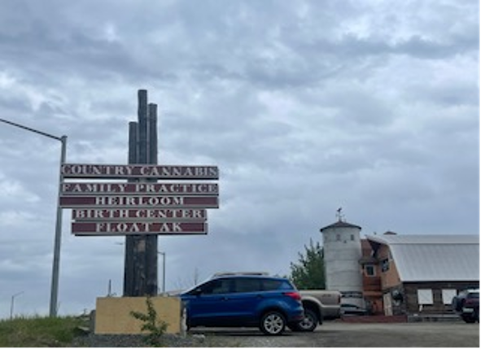


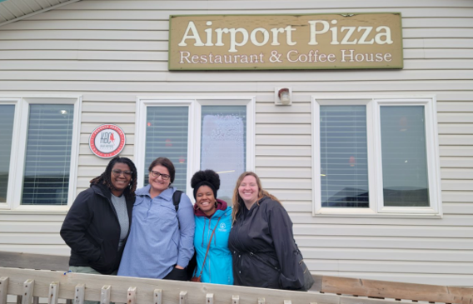



STRENGTH IN THIS ROOM
Creativity
Collaboration
Commitment
Resilience

Slide 22
Endless Possibilities
You Ask — We Deliver

