Slide 1



WELCOME

Slide 2

Commodity Supplemental Food Program
(CSFP)
Annual Training & Review

Slide 3
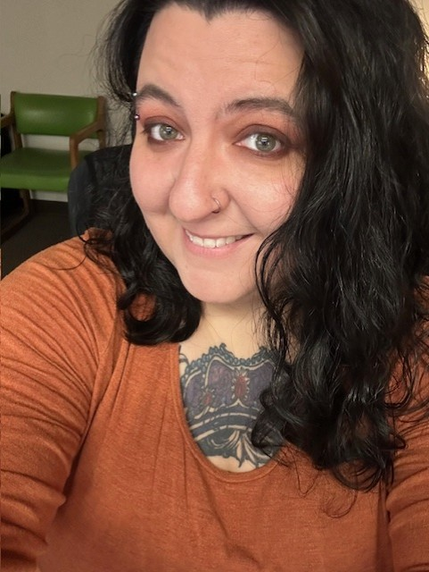
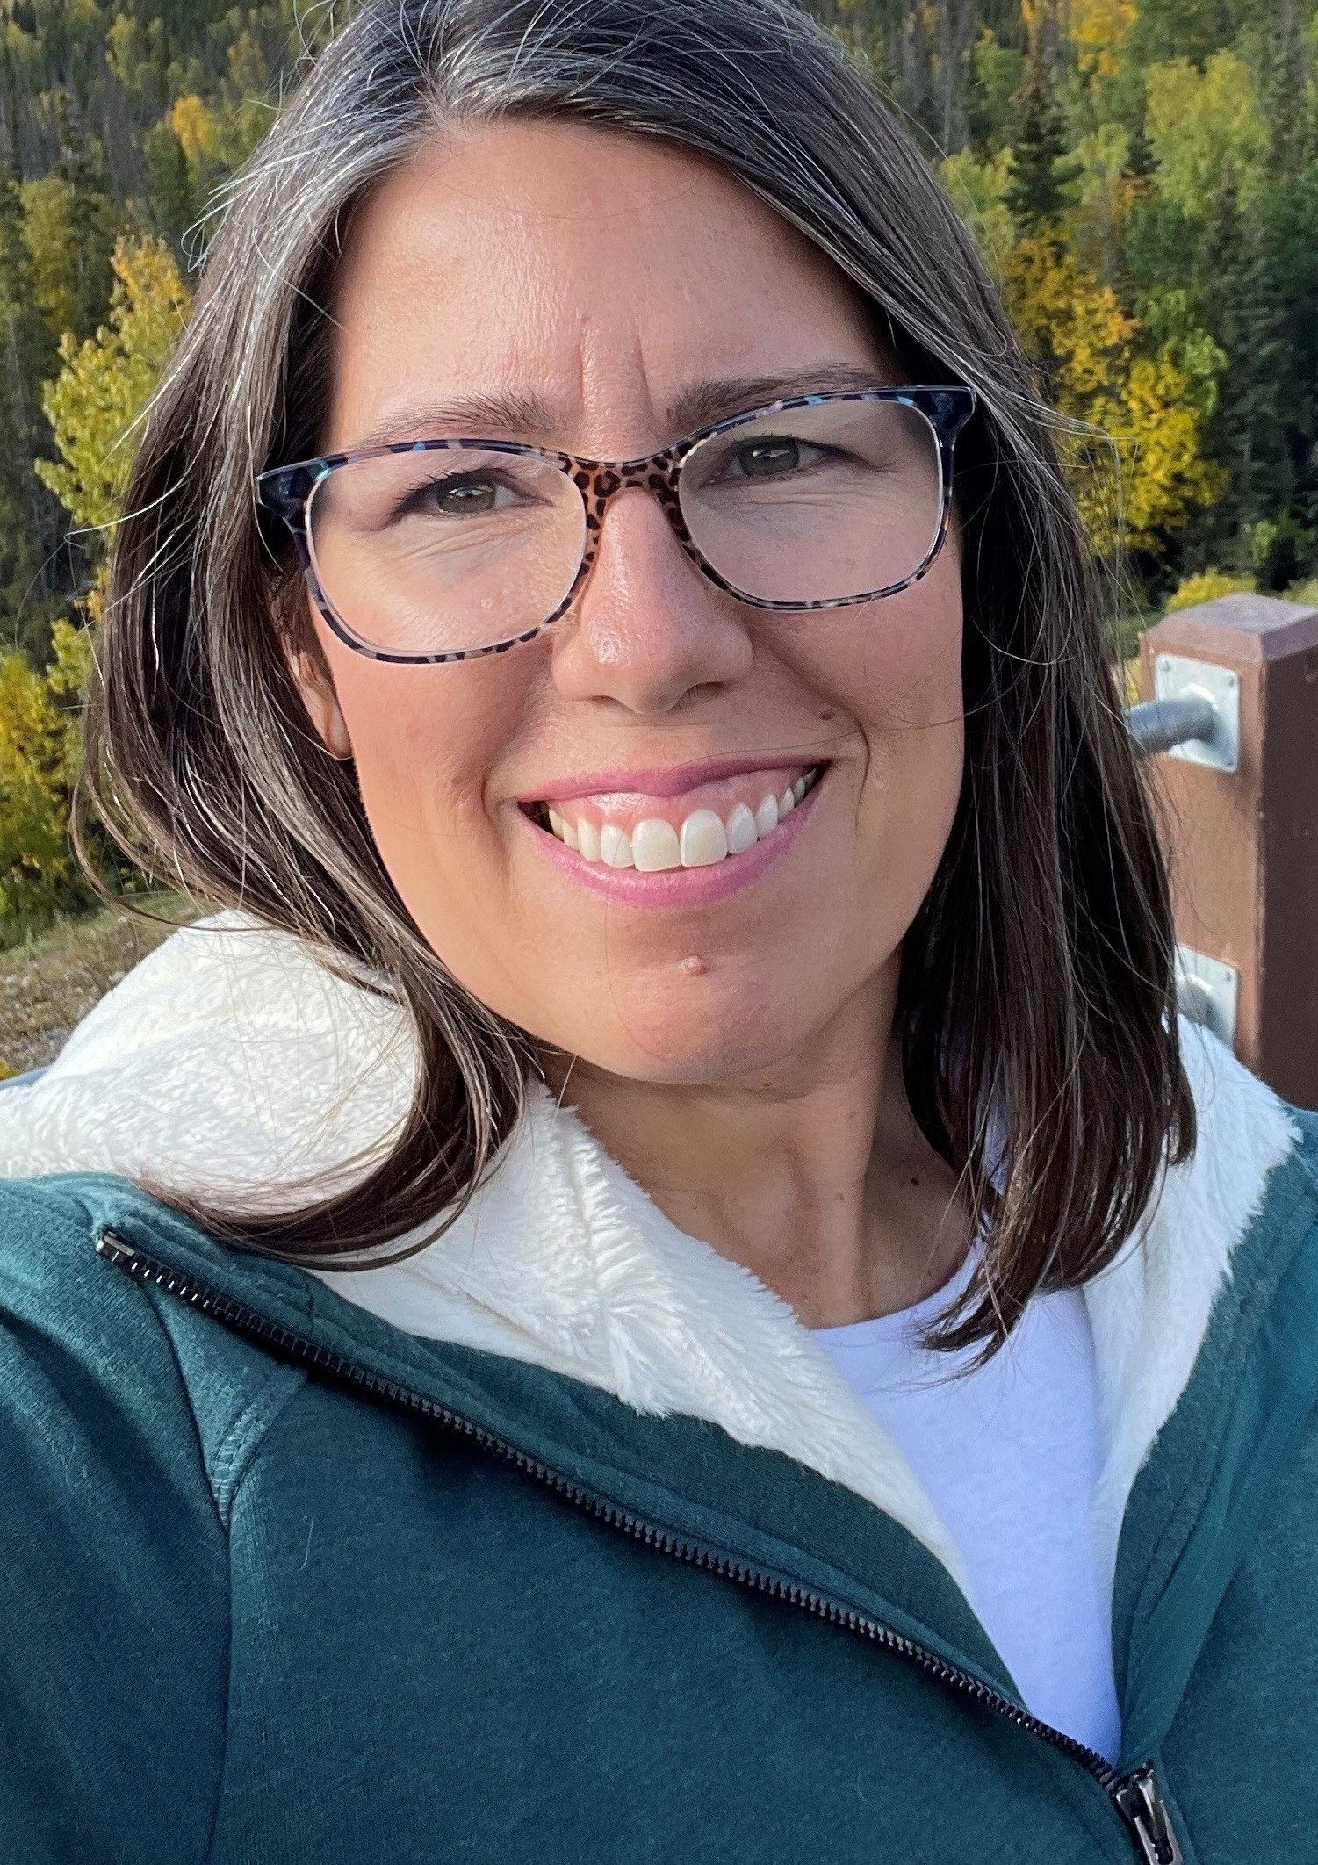

Welcome!
Chelsea Donohue
Food Bank of Alaska,
Manager of Senior Programs
907.222.3125
cdonohue@foodbankofalaska.org
Krista Jordan
State of Alaska,
CSFP Manager
krista.jordan@alaska.gov
Notes:
Welcome to our Annual CSFP Training! I am Chelsea, I’m your main contact for CSFP here at the Food Bank of Alaska. Unfortunately, Krista could not join us this year, but any questions you have that I can’t answer, I will forward along to her.

Slide 4
Today’s training
CSFP Updates and Review
Recertification Process and Dates
CSFP Application & Eligibility
Monthly Reports
Other Forms and Policy Requirements

Slide 5



USDA provides the commodities that are used for CSFP
CSFP commodity
orders are placed monthly through USDA by FBA
Orders take about 4-6 weeks to arrive at FBA warehouse
Every week, CSFP agency orders are placed to ship CSFP boxes throughout the state of Alaska.
Most of the boxes go to Anchorage, the Matsu Valley and Kenai Peninsula, but we also have distribution sites in St. Paul and Wrangell.
Once CSFP commodities arrive at FBA warehouse, monthly box builds are done to create CSFP boxes for distribution.
Notes:
CSFP is a federal program that works to improve the health of low-income seniors by supplementing their diets with nutritious USDA foods.
Food boxes are not intended to provide a complete diet but are sources of nutrients often lacking in the diets of our clients.
-contain food items like rice/pasta, cereal, canned fruits and vegetables, meat, plant-based protein, milk, and cheese.
FBA is one of two CSFP grantees in the state.
Currently, we build about 2500 boxes per month.

Slide 6
FBA’s Responsibilities
Agency’s responsibilities
Order CSFP commodities from the USDA.
Design and build the monthly boxes.
Coordinate delivery of boxes and cheese to each agency.
Train and monitor partner agencies on all CSFP policies and regulations.
Ensure the commodities are properly handled, stored, and distributed by our partner agencies.
Collect and maintain records on all CSFP clients and CSFP partner agencies.
Audit and consolidate monthly agency reports and report to the State of Alaska.
Include Nutrition Education/appropriate resources
Assist applicants with necessary paperwork.
Maintain client records and all program paperwork.
Properly count, record, and store CSFP commodities upon receipt.
Distribute CSFP boxes and cheeses to eligible clients according to program policies.
Ensure all staff/volunteers are trained in CSFP policies, Food Safety, and Civil Rights.
Post the “And Justice for All” poster.
Submit monthly reports and other necessary documents to FBA in a timely manner
Notes:
FY26 Agreements will be available soon and will outline these responsibilities.

Slide 7


CSFP Recertification
We have moved to a rolling recertification meaning every month you might receive recertification forms for clients that are due.
There may be some months you do not receive any forms.
Notes:
Previously, recertification was done for every client annually in October and November. Now, recertification can take place every month depending on when clients initially applied for the program. There may be months you do not receive recertification forms for your clients.

Slide 8
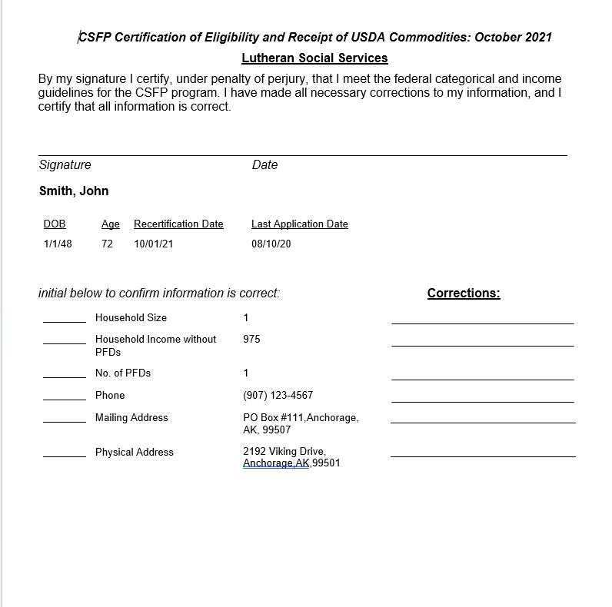
CSFP Recertification
Must be filled out completely.
Please also make sure they are legible
Recertification forms look the same as the prior process.
If information listed is correct, initial and have client sign the top.
If information is incorrect, use correction lines to update information, and have client sign the top.
Notes:
Federal, state, and program policy require that applications must be sent to FBA, processed, and clients notified of their eligibility within 10 days. Seniors who do not recertify will be removed from the program. We ask that recertifications or applications be submitted to FBA within 2 days of receipt. An eligibility notification must be completed in writing.

Slide 9
Questions on recertification?
Notes:
Next, we’ll cover the CSFP Application and Eligibility process.

Slide 10

Updates on Applications and forms
Written Notice of Beneficiary Rights
Notice of Action Letter (formerly Eligibility Determination letter)
Reminder for Race and Ethnicity data collection
Notes:
The Written Notice of Beneficiary Rights notifies clients they are not required to participate in religious content to access benefits.
The Notice of Action letter notifies clients of their participation status (eligible, ineligible, waitlist, or termination).

Slide 11
CSFP Eligibility
AGE
Income
  60 years of age or older
Household income at or below 150% of the Federal Poverty Income Guideline.
Income Guidelines are updated each spring and adjusted each fall with the AK PFD amount. Please make sure you have the most current Guidelines available.
Notes:
CSFP eligibility is based on age and income.
Income is based on the whole household. The household is considered a group of related or unrelated individuals who are living as one economic unit (sharing income and sharing expenses).
You do not need to see any proof of income from seniors.
Updated Income Guidelines will be sent out by FBA whenever they change.

Slide 12
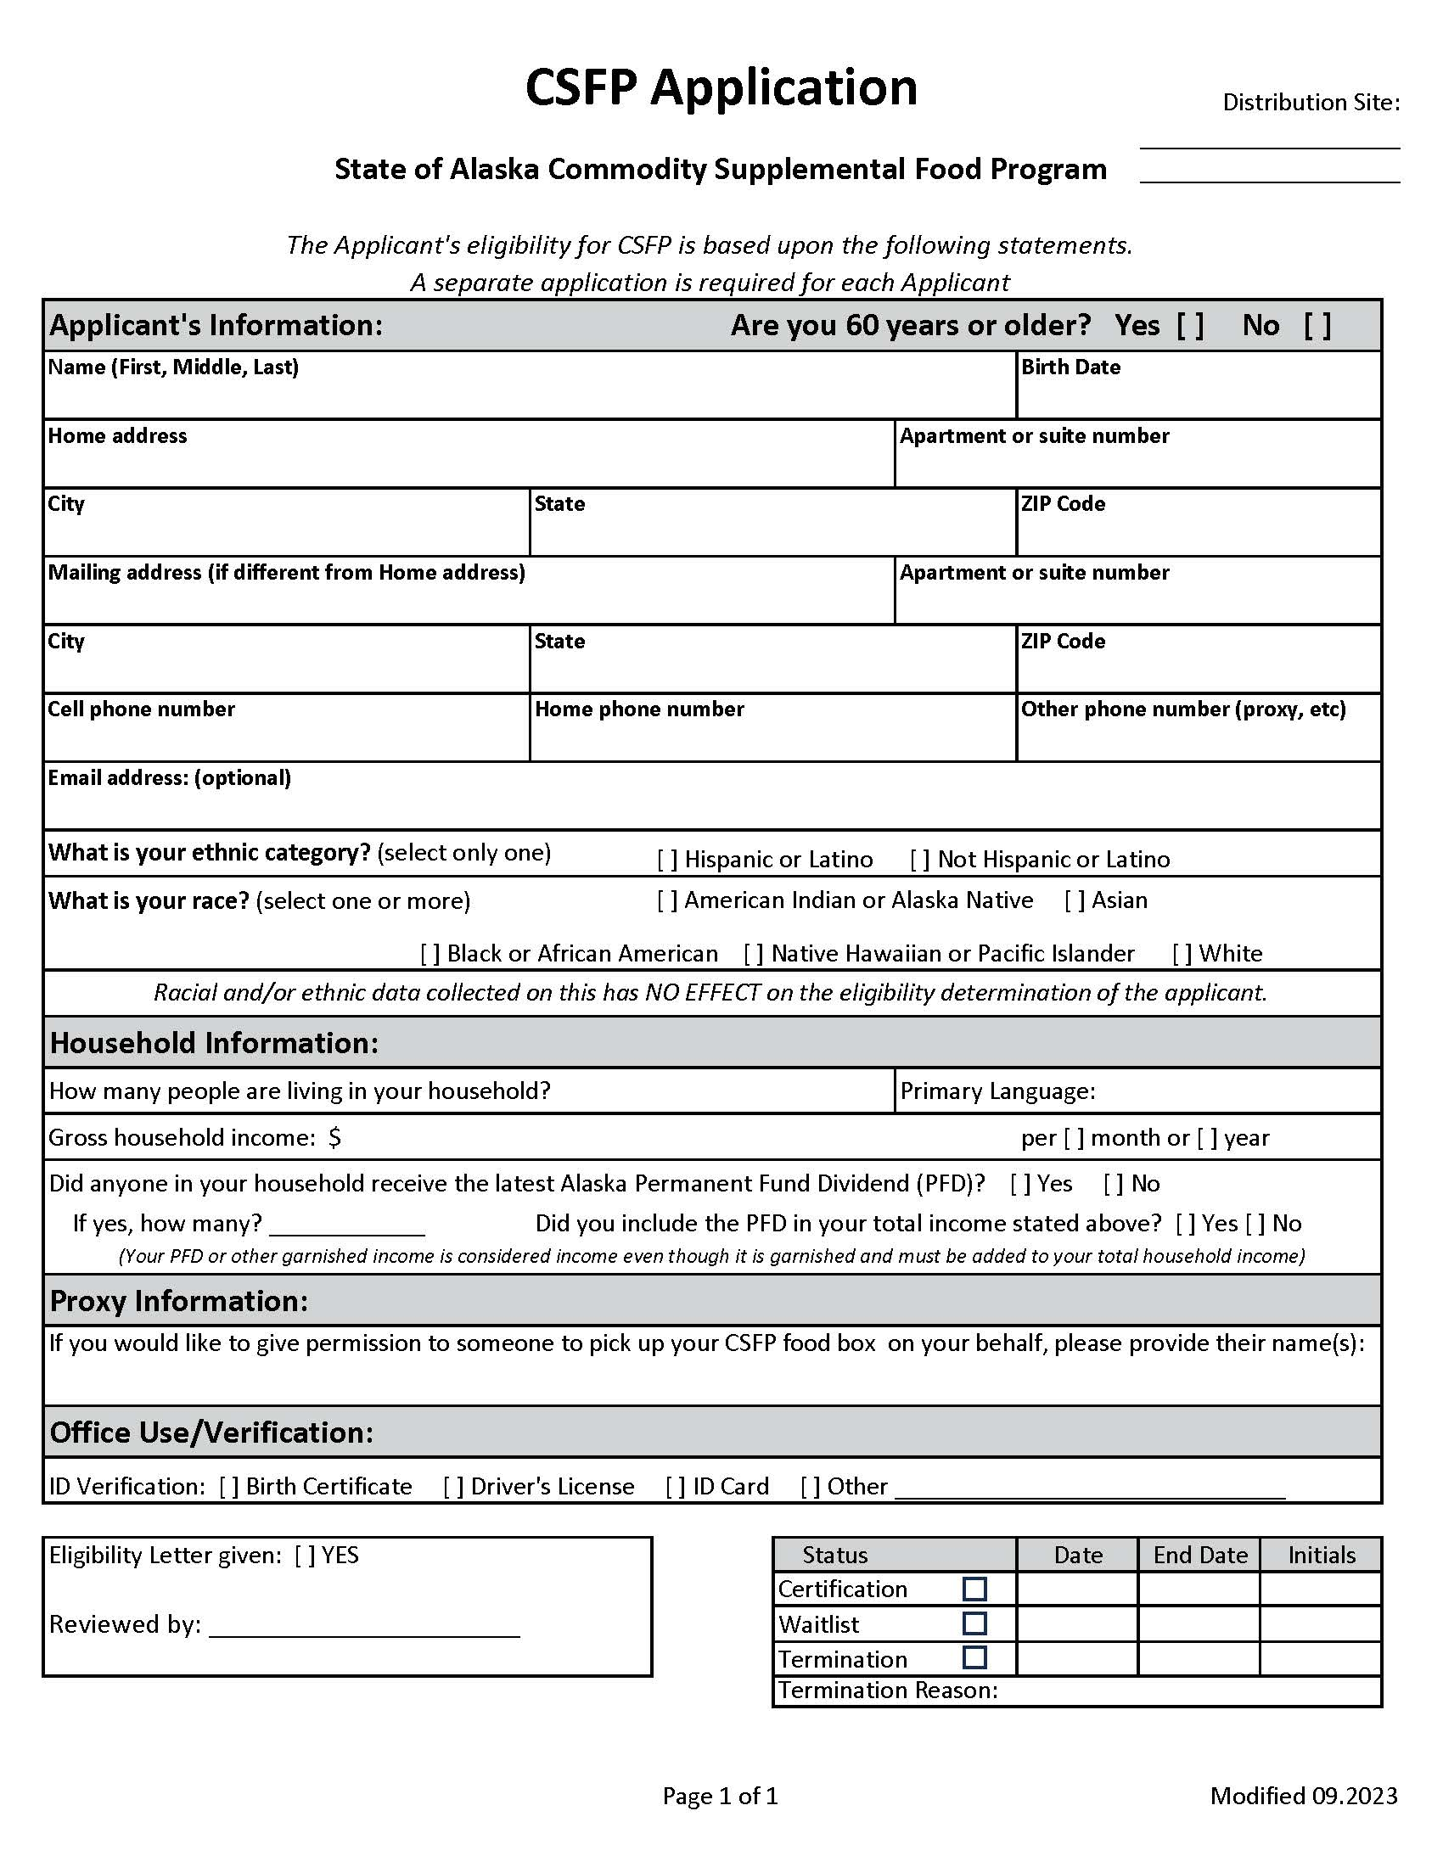
New CSFP Application
This application MUST be the one used for CSFP clients
Email will be sent with several FY26 documents
Notes:
USDA requires the Racial and Ethnic data to be completed on every application; completing this section does NOT affect eligibility determination. This data is ONLY for USDA collection and has no other effect on other programs or eligibility.
If the client does not complete these sections, we are required to complete them based on a visual determination.

Slide 13
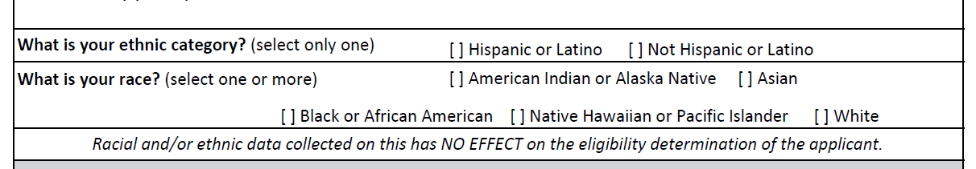



Race and ethnicity
The Racial and Ethnic section of the application MUST be filled out on every application.
If the client does not fill out of this section, a best guess MUST be made by the intake person, based on a visual determination.
Race and/or Ethnic Data has no effect on the eligibility determination or on other programs.
Notes:
We report this annually to USDA and our total numbers must match participation.
I cannot process applications in my database without this data collection on every application.

Slide 14
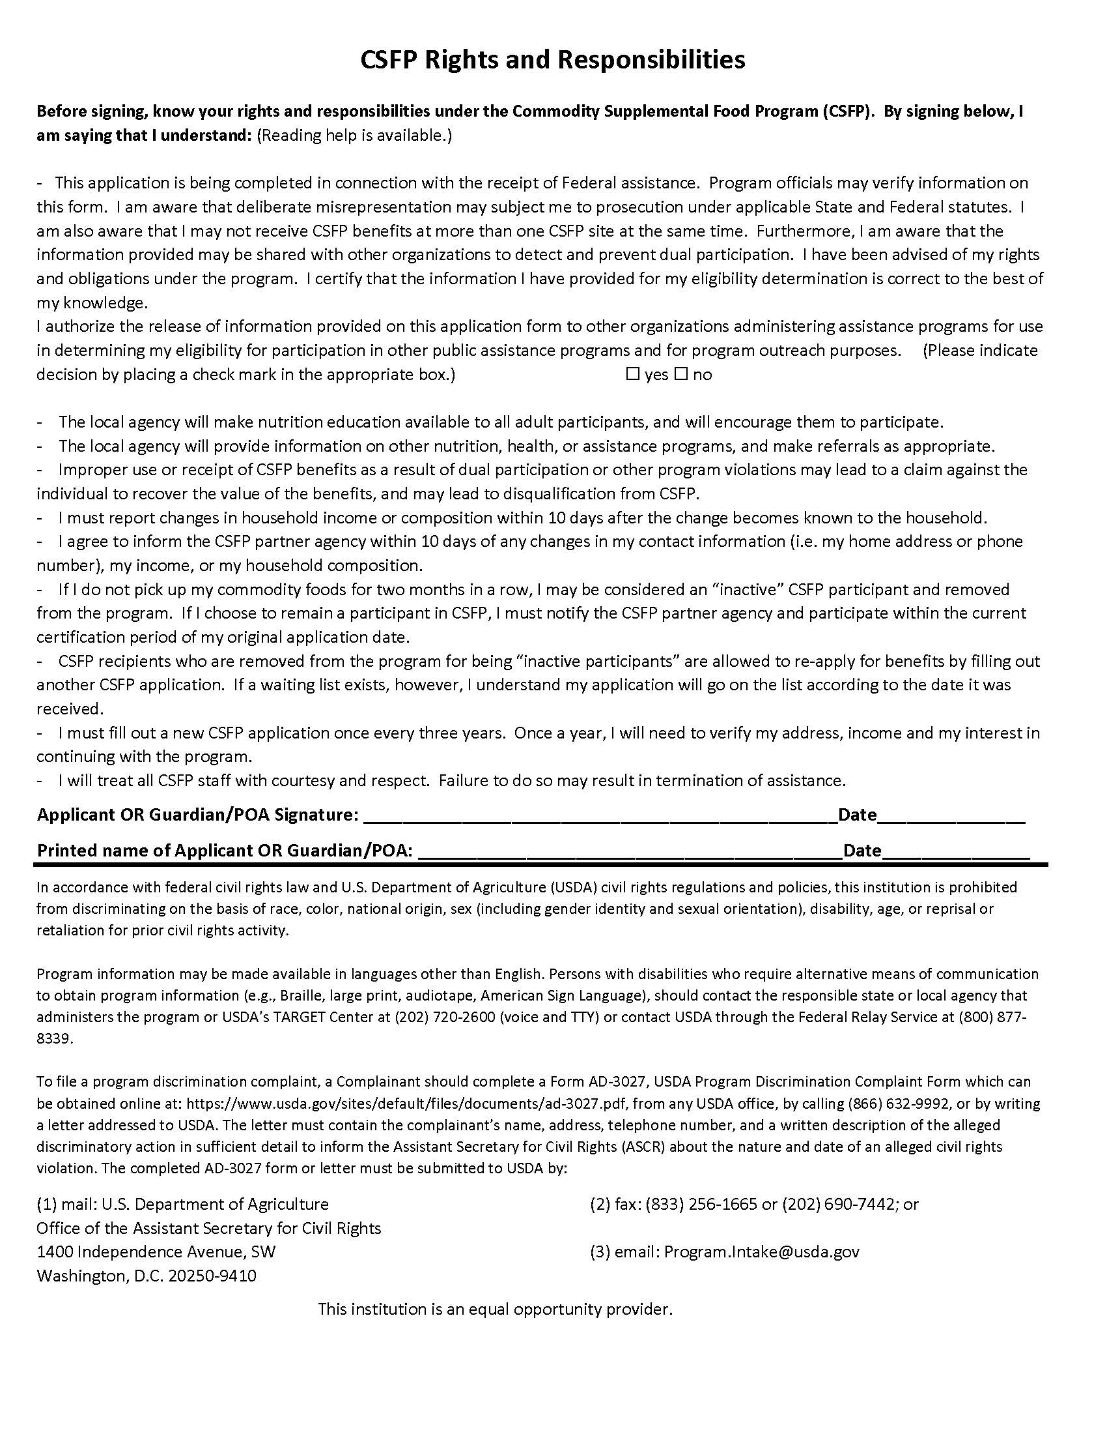
CSFP New Application (back page)
Notes:
Back page contains the nondiscrimination statement and the CSFP Rights and Responsibilities and contains the ‘yes or no’ Release of Information check boxes, which are required by USDA.

Slide 15
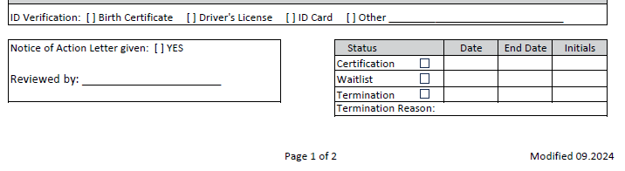
Certification Determination
EVERY client that applies needs to be given a Notice of Action letter. Check the ‘Yes’ box. Reviewed by should be the staff or volunteer that accepted the application.
If client is ineligible, a copy of the letter must be made (one copy goes to the client, agency keeps one copy with application).
Date of certification is the first of the month following application submission (i.e., a client applied in September, their application becomes active October 1st)
Certification end date is the last day of the month BEFORE application start date, plus 3 years (i.e., a client becomes active October 1st, 2025, their application will end on September 30th, 2028)
If a client is determined ineligible, the termination box needs to checked, and the termination reason (over-income or under-age) needs to be filled in.
Notes:
This section of the application should be filled out by the staff or volunteer processing the application and should be able to determine eligibility on-site based off client age and income. If you need the most recent income guidelines, let me know.
If you need a document outlining Certification start and end dates, let me know.

Slide 16
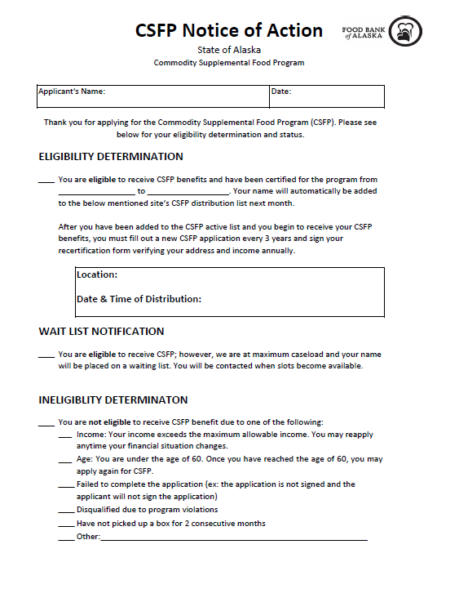
Notice of action letter
USDA regulations state that the client must be notified of their eligibility within 10 days of signing and dating their application.
The CSFP Notice of Action letter is approved by the State of Alaska and USDA. Only the agency information and distribution day and time can be altered on this form.
It is 2 pages (or double-sided) and contains specific wording regarding civil rights that MUST be included.
Fill in the client’s name, the date, and their eligibility status. You can give it directly to the client or mail it.
This form is also used to notify clients who become ineligible during recertification.
Notes:
This form must be given to a client upon eligibility determination, or within 10 days of determination.
Best practice is to give to client when they initially apply for the program.
If a client is determined ineligible, a copy of the Notice of Action MUST be made; one copy is given to the client, the other copy remains with the initial application at the site. You do not need to send a copy to me with the application.

Slide 17
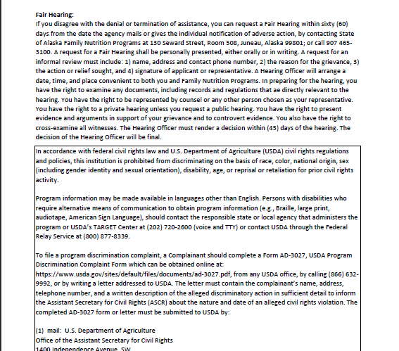
Notice of Action Letter
(Back Page)
Notes:
The back page contains the nondiscrimination statement and language on the right to a fair hearing.

Slide 18
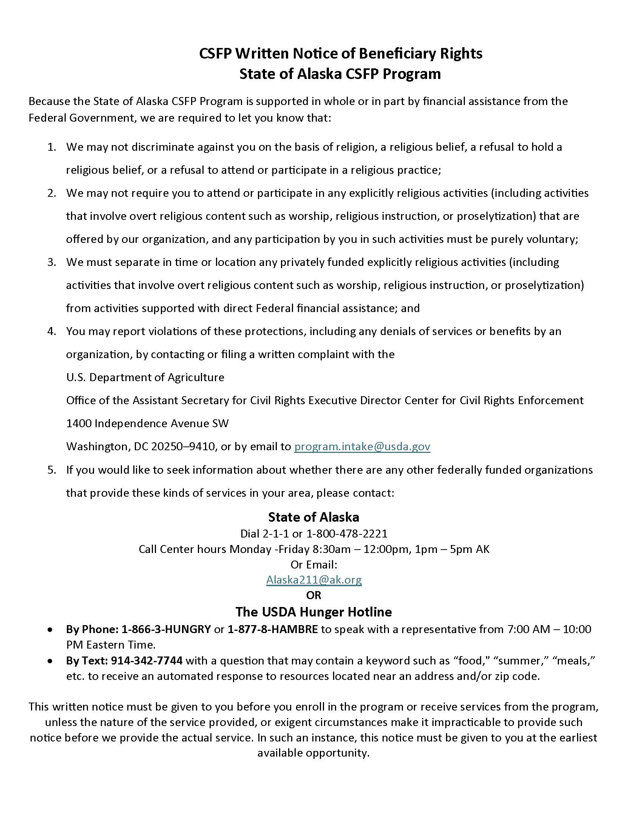
Written notice of beneficiary rights
This notice is required to be given to clients at the time of application. It contains language regarding the client’s right to choose their distribution site, as well as their right to not be discriminated against based on religion, religious belief, a refusal to hold religious belief or refusal to attend or participate in religious practice.
Clients MUST NOT be required to attend or participate in any religious activities to receive benefits.
Notes:
Application, Notice of Action, and Beneficiary Rights should be kept together as an application packet.

Slide 19
Questions on Application process?
Notes:
Next, we will be covering monthly reports.

Slide 20
End of month reports
The reports below are due to FBA as soon as possible after your distribution and no later than the 5th of the month following your distribution:
Completed Distribution List with signatures
Completed Monthly Inventory Report (MIR)
Copies of any AORs (invoices) for CSFP product received that month
We cannot send your new distribution list until we have received and processed the previous month’s reports.
Once these are received, FBA will send out your new month’s Distribution List within 2 business days (but no earlier than the first business day of the month).
Notes:
We cannot send out your new distribution list until we have received the previous month’s reports.
It’s important to turn in your reports on time – for the State of Alaska’s grant requirements, for our monthly reporting to the State, and to get your next month’s distribution list on time.

Slide 21
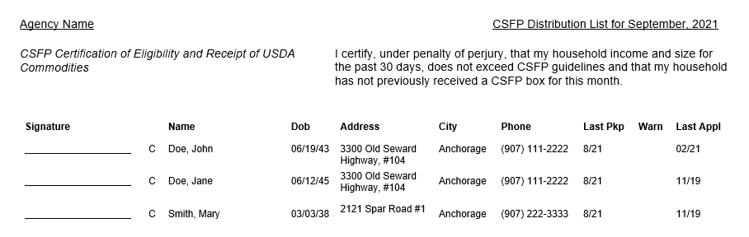
Distribution List
(example)
Due to FBA by the 5th of each month. Lists which clients receive CSFP boxes and cheese.
Notes:
This is an example of a (very short) Distribution List.
If client’s update you on address or phone number changes, or we’ve spelled something wrong, please write in the correction next to their info on the signature list or send the correction over to us in an email.
Clients who miss 2 months in a row will receive a Notice of Action letter from us stating why they were removed from the program. *extenuating circumstances exist and will be considered on a case-by-case basis*

Slide 22
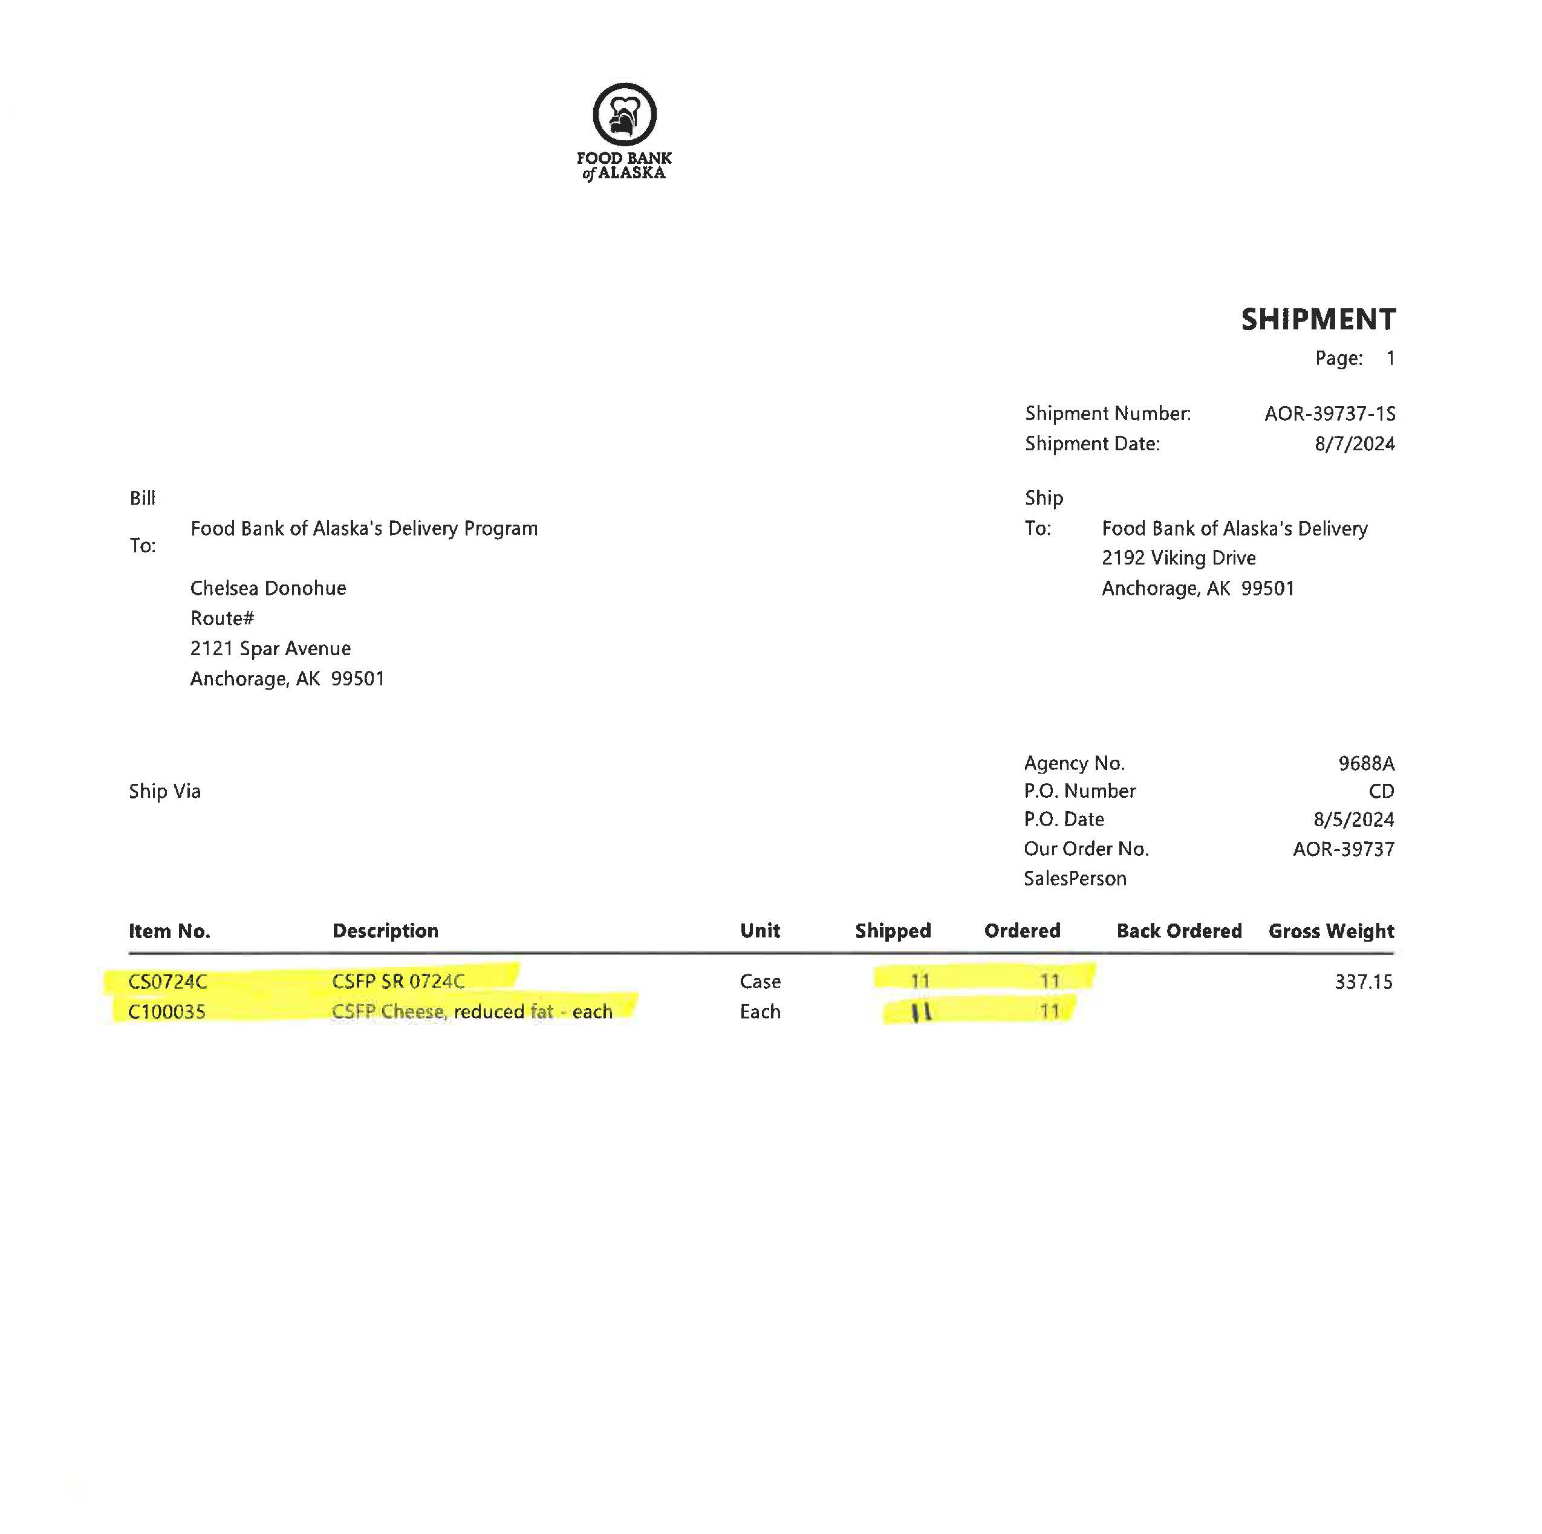
Invoice
(“AOR”)
With each order you will receive and sign off on an AOR (Agency Order Receipt) or invoice.
Please verify that the information on the AOR matches what you receive:
  Box Codes
  Number of boxes and cheeses
If there are any discrepancies, inform your delivery driver and let us know as soon as possible.
With your end of the month reports, please include a copy of any AOR(s) for CSFP product received that month.
Notes:
If you don’t receive the amounts or box codes listed on the AOR, inform the delivery driver before signing the AOR and then notify us as soon as possible. If we need to send another order out to make up for what’s missing, we need as much notice as possible. If you do not receive an AOR with your order, notify us immediately.
Please make sure you are rotating or FIFO-ing your inventory. If you have boxes or cheese left over from a previous month, be sure those are distributed FIRST, before any newly received boxes or cheese.

Slide 23
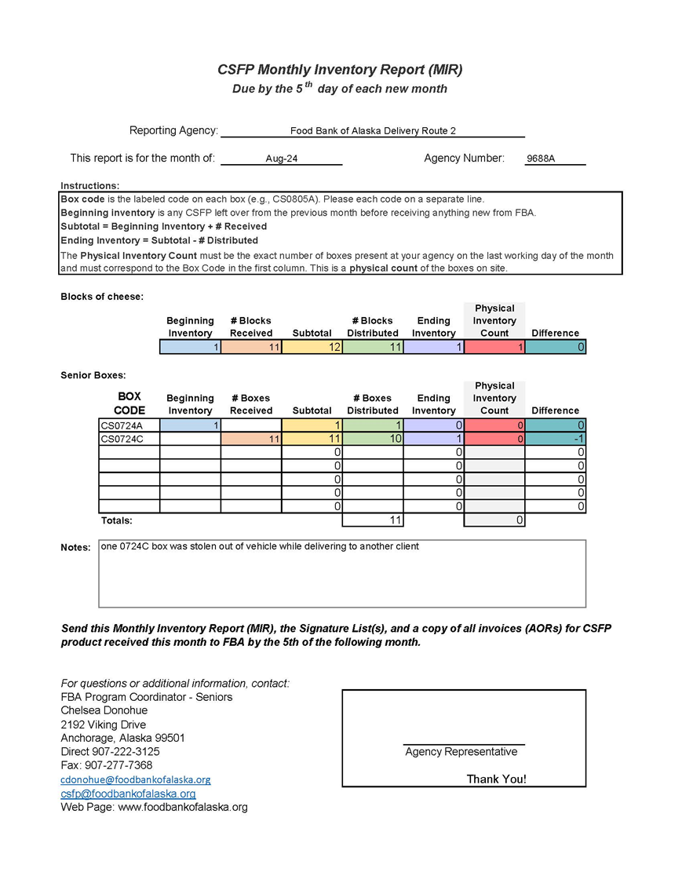
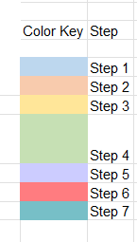
Monthly inventory report (MIR)
Step 1: Beginning Inventory – the amount of inventory you had left over from the previous month.
Step 2: Number Received – the amount of inventory you received over the month
Step 3: Subtotal – the Beginning Inventory plus the Number Received
Step 4: Number Distributed – the amount of inventory distributed to clients over the duration of the month
Step 5: Ending Inventory – the Subtotal inventory minus the Number Distributed; the cheese and boxes distributed should match
Step 6: Physical Inventory – the amount of inventory physically counted at the end of the month
Step 7: Difference – Physical Inventory minus Ending Inventory

Slide 24
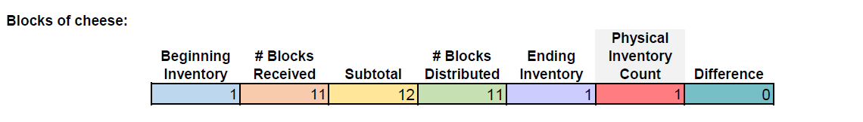

MIR
(Continued)
Filling out the MIR – Cheese
The cheese is done the same way as the boxes.
Any discrepancies between the ending inventory and physical inventory will show in the difference.
Any losses of product need to be documented in the Notes section of the MIR.
Example AOR (invoice)
Notes:
For the cheese section – this is done the same as the boxes on the previous slide.
If a senior decides they do not want their cheese, DO NOT place it back into your CSFP inventory. The unwanted cheese may be placed on a share table for other clients or can be placed into your donated inventory.
*Boxes and cheese distributed should match on your MIR*

Slide 25
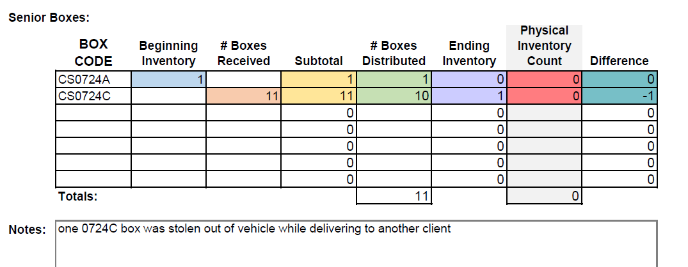
MIR
(Continued)
Filling out the MIR - Boxes
All CSFP boxes have a Box Code. Be sure to list all Box Codes on a separate line and count them separately.
Follow the same steps as with the cheese.
Beginning Inventory should match the previous month’s Physical Inventory Count.
Subtotal = Beginning Inventory + # Received
Ending Inventory = Subtotal - # Distributed
Physical Inventory Count is the actual number of boxes counted on site after distribution. It may not be the same as your Ending Inventory.
Difference = Physical Inventory – Ending Inventory
  Lost or damaged product will show up here.
Example AOR (invoice)
Notes:
FOR THE BOXES --
Please enter box codes (the little sticker on the outside of the box) in the first column. Each box code gets a separate line. Sometimes you’ll only have 1 code, sometimes you might have several.
The box codes allow us to track exactly what is in each box. When the combination of items changes, so does the code. It’s important for our inventory tracking, our reporting to the state, and for any potential product recalls.
IN THE EXAMPLE…
It is very important that you do a physical count each month! If you don’t and are reporting more boxes/cheese on site than you have, you could be held financially responsible for the commodities that are over-reported.
Also please note here that this agency is distributing their oldest boxes first – following the First In First Out inventory policy.

Slide 26
Other Potential Forms
Proxy Form –
If a senior wants to assign a friend/relative to pick up their box for them, they can fill out a Proxy Form.
Commodity Loss Report –
Any loss of CSFP commodities greater than the amounts below must be reported to FBA immediately and a Commodity Loss Report filled out and submitted as soon as possible.
1 case or more of cheese (12 blocks or more)
6 CSFP boxes or more
CSFP Incident Report –
Please fill out and submit an Incident Report to FBA, whenever there is an issue with a client.
Notes:
You should have copies of these, but if you need them, let me know.

Slide 27
Questions on Reports or forms?

Slide 28

Food Safety
Food Safety Training & Certification
FBA requires that all partner agencies participate in food safety training.
FBA provides a food safety course and test for your convenience.
  Available for free online – visit our website for more information under the agency portal or we can send the link on request.
Always be sure to check the requirements in your municipality or jurisdiction as other certifications may also be required.
Food Storage & Handling
Please refer to your CSFP Policy and Procedure Manual or Food Safety Training for proper storage and handling of CSFP boxes and cheese.
Notes:
All commodities must be stored securely. All loss of product (due to theft, damage, fire, flood, etc.) must be immediately reported to FBA verbally and a Commodities Loss Report submitted as soon as possible.
Food storage areas must be protected from the elements, fire, pests, theft, etc. They must be clean and dry, and all food must be stored at least 6 inches away from the floor and walls. Thermometers must be kept in both refrigerated and dry storage areas. Cold storage should be between 32- and 40-degrees Fahrenheit. Dry storage should be between 50- and 70-degrees Fahrenheit.

Slide 29
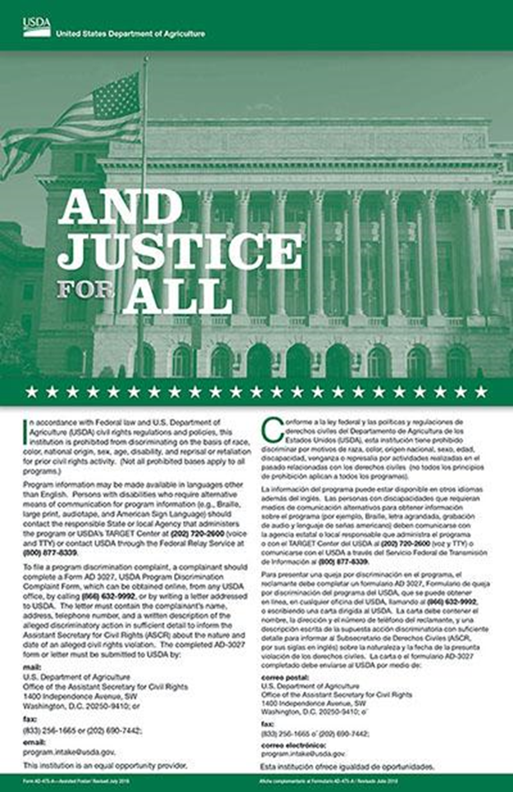
Civil rights
All staff and volunteers must have Civil Rights training.
Review the PowerPoint and sign the completion form.
Display the “And Justice for All” poster.
Any flyers or informational posters or handouts must include the Nondiscrimination Statement (NDS).
Notes:
New poster will be available soon, FBA will mail once they arrive.
The Nondiscrimination Statement (NDS) is included on the current application form and will be included in your P&P Manual. The NDS also includes details on the process for clients wishing to file a civil rights complaint.

Slide 30
Client Complaints
Commodity Complaints
  A client or agency may contact the CSFP Program Coordinator or the Director of Programs at FBA.
Civil Rights Complaints
  If a senior would like to file a complaint of discrimination, they can complete the USDA Program Discrimination Complaint Form. Details can be found on the CSFP Application, Notice of Action letter, and in the P&P Manual.
Denial or Termination of Assistance Complaints
  If a senior disagrees with the denial or termination of assistance, they can request a Fair Hearing within 60 days. That process is described on the CSFP Application, the Notice of Action and in the P&P Manual.
Notes:
All complaints can be sent directly to FBA and we can forward to our State of Alaska contacts as needed. If the agency or client is not comfortable with that, they may direct their complaints or concerns to the State of Alaska or USDA, as described on the Application, the Notice of Action, or in the Policy and Procedure Manual.
If a client wants to file a complaint against an actual agency or organization, the agency cannot take that complaint and the client should contact FBA directly. If the complaint is against an individual at the agency, then the agency may take the complaint. However, the client is always welcome to contact FBA directly.

Slide 31
Questions?
Please contact us any time with questions or concerns:
  Chelsea Donohue
  Manager of Senior Programs
  907.222.3125
  cdonohue@foodbankofalaska.org
  CSFP email: csfp@foodbankofalaska.org
  Rebecca Guyer
  Director of Programs
  907.222.3100
  rguyer@foodbankofalaska.org
  Anthony Reinert
  Chief Programs Officer
  907.222.3104
  areinert@foodbankofalaska.org
  FBA Fax: 907-277-7368 or 1-888-797-0095
Notes:
Any additional questions?
And just a reminder to sign and return the MOA and the Civil Rights training forms by the end of the month.
THANK YOU!

