Slide 1

Artificial Intelligence
An Introduction

Slide 2
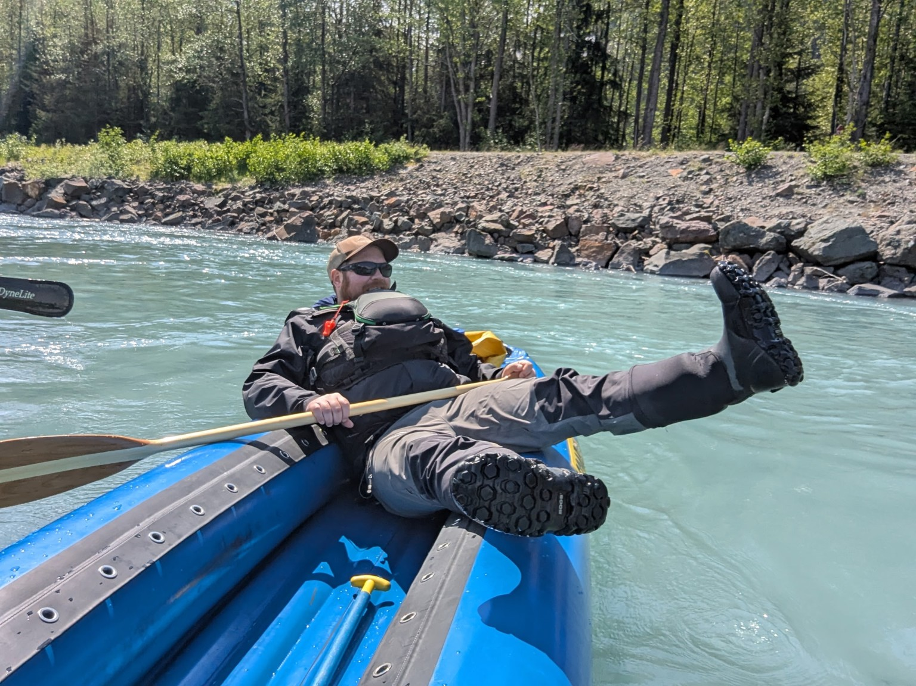
Introductions
Anthony Reinert
Food Bank of Alaska- 5 years
  Chief Program Officer
  Director of Programs
  SNAP Outreach Manager

Slide 3
Presentation Goals
AI Context
Use-Case Demonstration
Collaborative Exploration

Slide 4
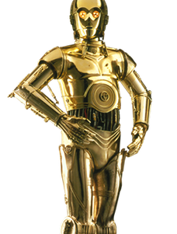

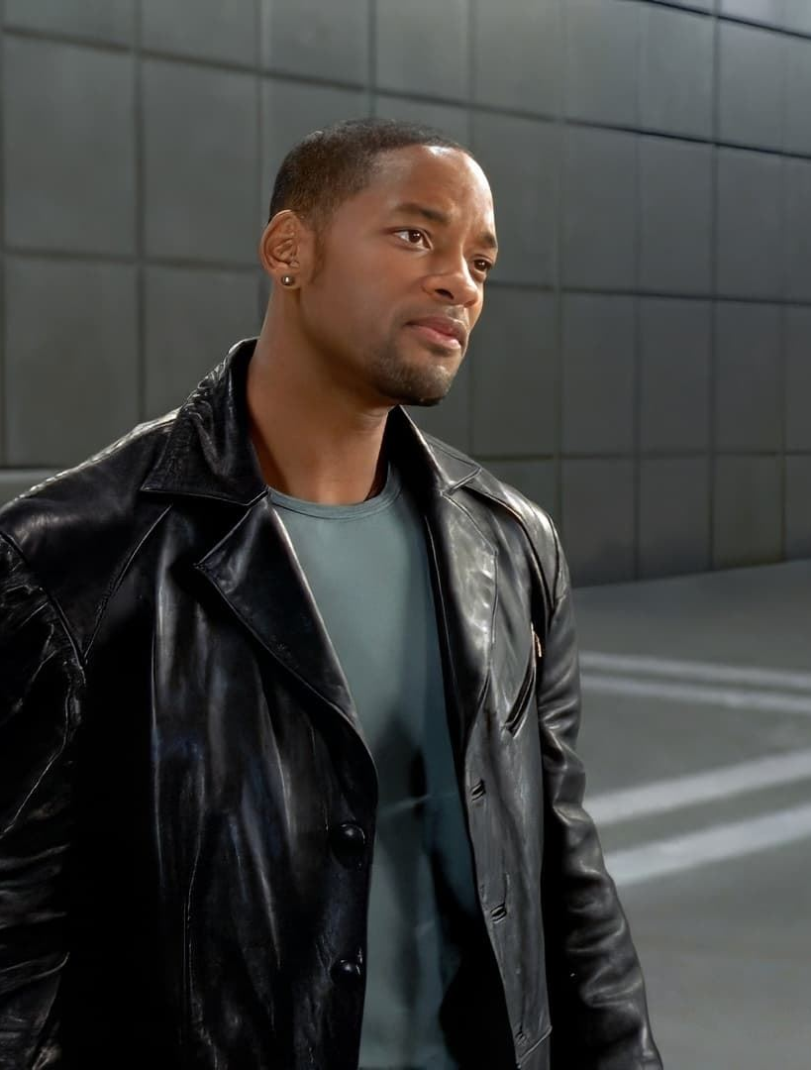
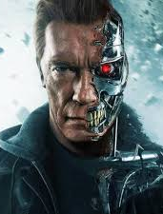
Favorite AI

Slide 5
How AI Works?
Large Language Models LLM
Generative Pre-Trained Transformer
Stable Diffusion

Slide 6
Chat GPT Use-Case
Planning
Communicating
Fundraising
Organizing
Learning
Creative

