Slide 1



PLENARY & CLOSING

Slide 2

strategic
GOAL 1:
Assess and Address Gaps and
Needs Across Alaska

Slide 3
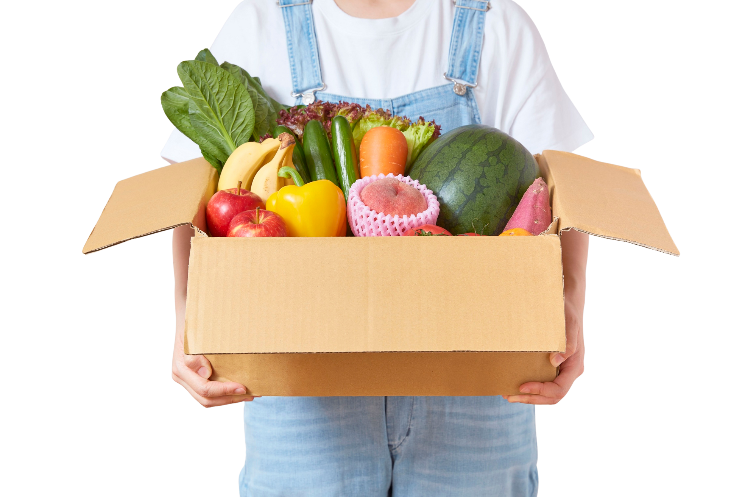
strategic
GOAL 2:
Develop a Strategic Food Sourcing Plan that Identifies Gaps and Sourcing Opportunities

Slide 4

strategic
GOAL 3:
Strengthen Agency Partner Capacity

Slide 5
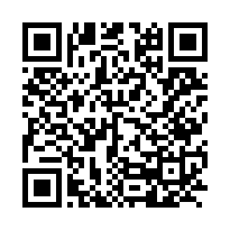

survey
TIME!
Scan the QR Code

Slide 6
SEE YOU TOMORROW!

